Slide 1
Boosting uniformity in quasirandom groups: fast and simple
October 2024
Emanuele Viola
NEU
Joint work with Harm Derksen and Chin Ho Lee

Slide 2

Book ad Mathematics of the impossible Draft on my homepage

Slide 3
Now the talk

Slide 4
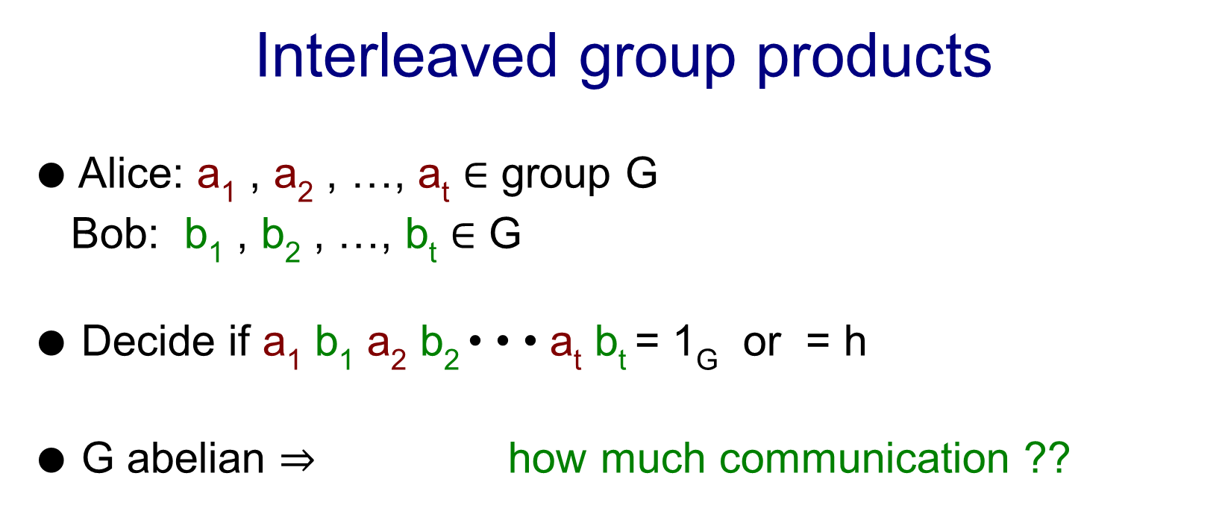
Interleaved group products
● Alice: a₁ , a₂ , …, a_{t} ∈ group G
Bob: b₁ , b₂ , …, b_{t} ∈ G
● Decide if a₁ b₁ a₂ b₂ • • • a_{t} b_{t} = 1_{G} or = h
● G abelian $⇒$how much communication ??
a
b

Slide 5
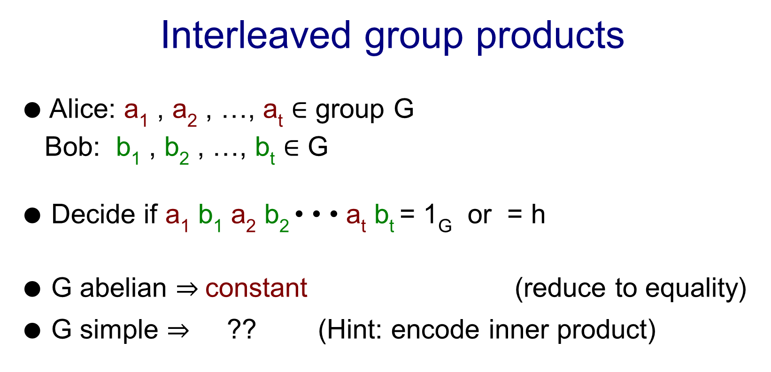
Interleaved group products
● Alice: a₁ , a₂ , …, a_{t} ∈ group G
Bob: b₁ , b₂ , …, b_{t} ∈ G
● Decide if a₁ b₁ a₂ b₂ • • • a_{t} b_{t} = 1_{G} or = h
● G abelian $⇒$constant (reduce to equality)
● G simple $⇒$?? (Hint: encode inner product)
a
b

Slide 6

Interleaved group products
● Alice: a₁ , a₂ , …, a_{t} ∈ group G
Bob: b₁ , b₂ , …, b_{t} ∈ G
● Decide if a₁ b₁ a₂ b₂ • • • a_{t} b_{t} = 1_{G} or = h
● G abelian $⇒$constant (reduce to equality)
● G simple $⇒$ct (encode inner product)
● Question [Miles V]: c t log |G| for some G? (crypto app.)
a
b

Slide 7
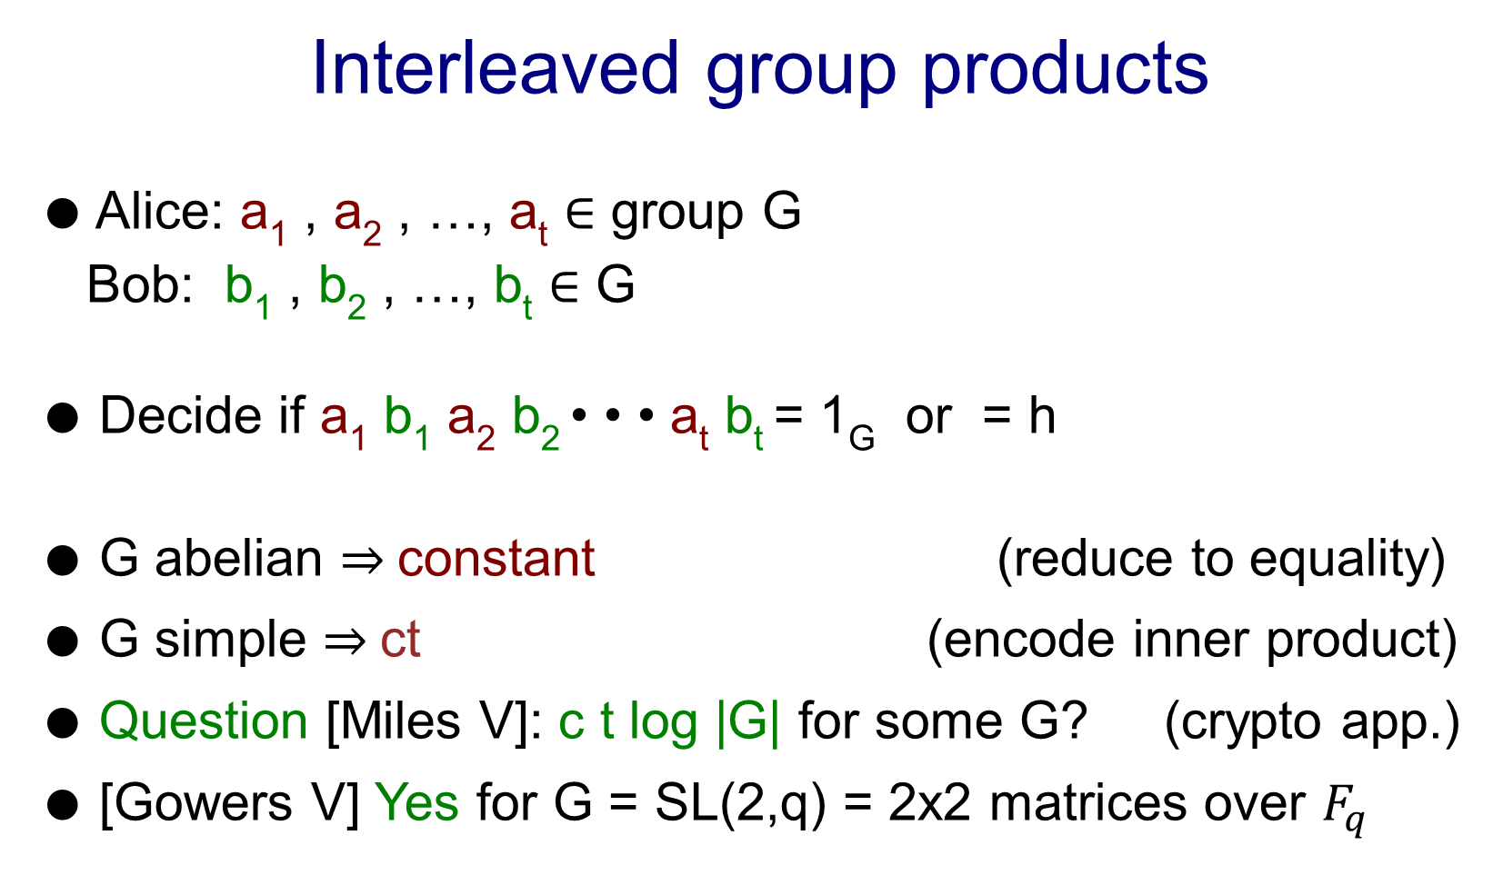
Interleaved group products
● Alice: a₁ , a₂ , …, a_{t} ∈ group G
Bob: b₁ , b₂ , …, b_{t} ∈ G
● Decide if a₁ b₁ a₂ b₂ • • • a_{t} b_{t} = 1_{G} or = h
● G abelian $⇒$constant (reduce to equality)
● G simple $⇒$ct (encode inner product)
● Question [Miles V]: c t log |G| for some G? (crypto app.)
● [Gowers V] Yes for G = SL(2,q) = 2x2 matrices over $F_{q}$
a
b

Slide 8

Interleaved group products
● Alice: a₁ , a₂ , …, a_{t} ∈ group G
Bob: b₁ , b₂ , …, b_{t} ∈ G
● Decide if a₁ b₁ a₂ b₂ • • • a_{t} b_{t} = 1_{G} or = h
● G abelian $⇒$constant (reduce to equality)
● G simple $⇒$ct (encode inner product)
● Question [Miles V]: c t log |G| for some G? (crypto app.)
● [Gowers V] Yes for G = SL(2,q) = 2x2 matrices over $F_{q}$
● [Shalev] refines bounds for other groups
a
b

Slide 9

Interleaved group products
● Alice: a₁ , a₂ , …, a_{t} ∈ group G
Bob: b₁ , b₂ , …, b_{t} ∈ G
● Decide if a₁ b₁ a₂ b₂ • • • a_{t} b_{t} = 1_{G} or = h
● G abelian $⇒$constant (reduce to equality)
● G simple $⇒$ct (encode inner product)
● Question [Miles V]: c t log |G| for some G? (crypto app.)
● [Gowers V] Yes for G = SL(2,q) = 2x2 matrices over $F_{q}$
● [Shalev] refines bounds for other groups
● [Derksen V] Quasirandom G, 3-line “book proof”
Generalizes, simplifies, improves all above
a
b

Slide 10
k-party number-on-forehead
● Alice: a₁ , a₂ , …, a_{t} ∈ G
Bob: b₁ , b₂ , …, b_{t} ∈ G
Clio: c₁ , c₂ , …, c_{t} ∈ G
● Decide if a₁ b₁ c₁ a₂ b₂ c₂ • • • a_{t} b_{t} c_{t} = 1_{G} or = h
● Note: Candidate or solving major open questions:
● Separating deterministic, randomized communication
Simplify/improve [Kelley Lovett Meka ’23] ?
● Hard even for k >> log n parties ?
a
b
c

Slide 11
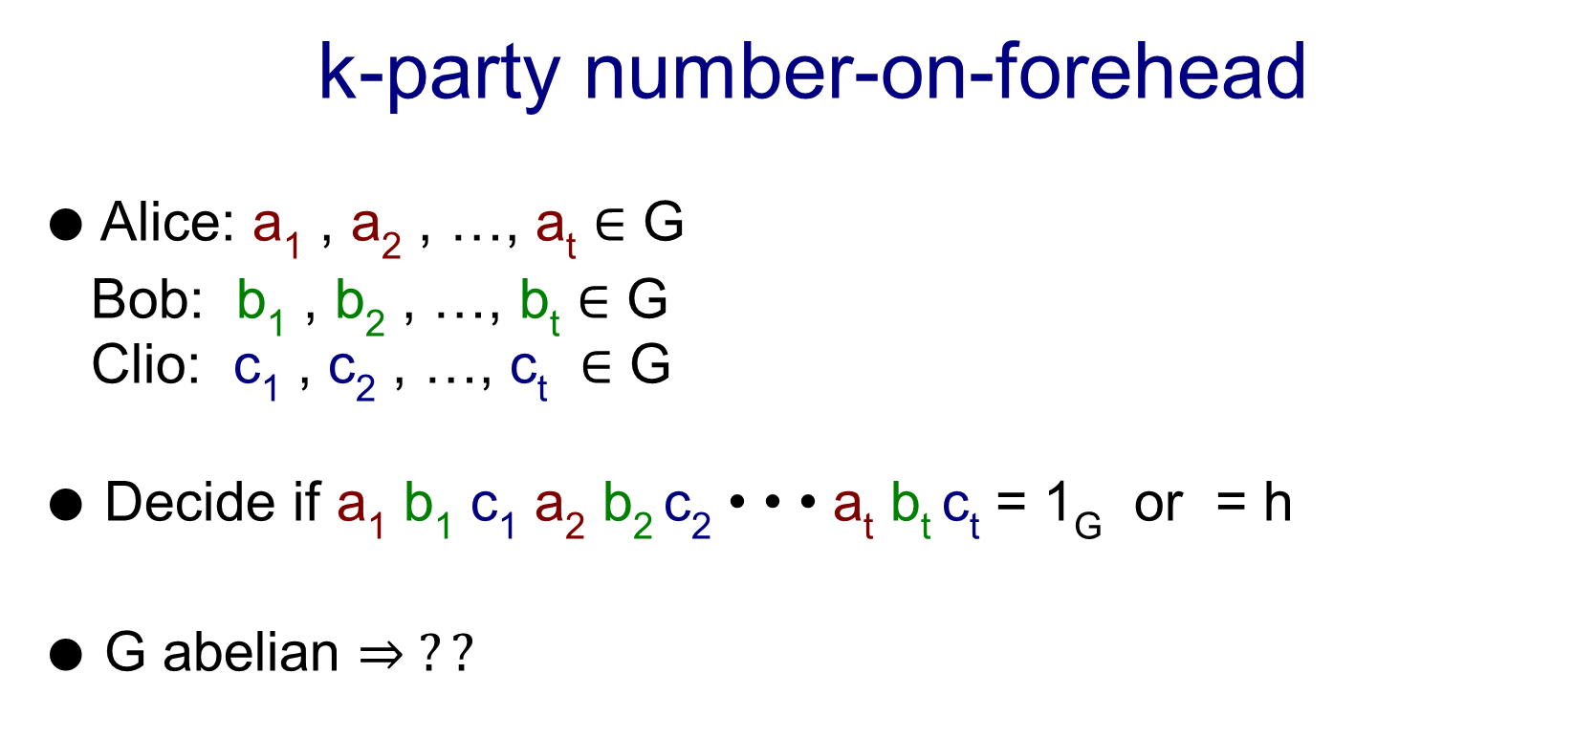
k-party number-on-forehead
● Alice: a₁ , a₂ , …, a_{t} ∈ G
Bob: b₁ , b₂ , …, b_{t} ∈ G
Clio: c₁ , c₂ , …, c_{t} ∈ G
● Decide if a₁ b₁ c₁ a₂ b₂ c₂ • • • a_{t} b_{t} c_{t} = 1_{G} or = h
● G abelian $⇒ ??$
a
b
c

Slide 12
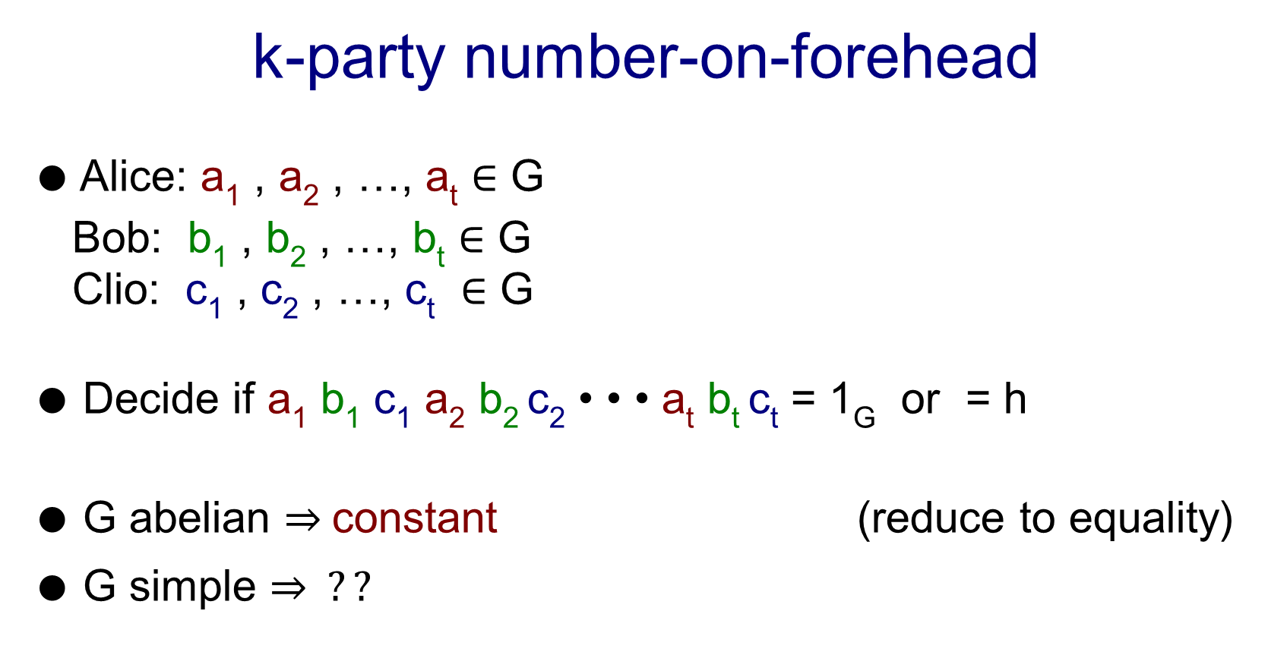
k-party number-on-forehead
● Alice: a₁ , a₂ , …, a_{t} ∈ G
Bob: b₁ , b₂ , …, b_{t} ∈ G
Clio: c₁ , c₂ , …, c_{t} ∈ G
● Decide if a₁ b₁ c₁ a₂ b₂ c₂ • • • a_{t} b_{t} c_{t} = 1_{G} or = h
● G abelian $⇒$constant (reduce to equality)
● G simple $⇒ ??$
a
b
c

Slide 13

k-party number-on-forehead
● Alice: a₁ , a₂ , …, a_{t} ∈ G
Bob: b₁ , b₂ , …, b_{t} ∈ G
Clio: c₁ , c₂ , …, c_{t} ∈ G
● Decide if a₁ b₁ c₁ a₂ b₂ c₂ • • • a_{t} b_{t} c_{t} = 1_{G} or = h
● G abelian $⇒$constant (reduce to equality)
● G simple $⇒$t $c^{−k}$ (encode generalized inner product)
● Question [Miles V]: t $c^{−k}$ log |G| for some G? (crypto app.)
a
b
c

Slide 14

k-party number-on-forehead
● Alice: a₁ , a₂ , …, a_{t} ∈ G
Bob: b₁ , b₂ , …, b_{t} ∈ G
Clio: c₁ , c₂ , …, c_{t} ∈ G
● Decide if a₁ b₁ c₁ a₂ b₂ c₂ • • • a_{t} b_{t} c_{t} = 1_{G} or = h
● G abelian $⇒$constant (reduce to equality)
● G simple $⇒$t $c^{−k}$ (encode generalized inner product)
● Question [Miles V]: t $c^{−k}$ log |G| for some G? (crypto app.)
● [Gowers V] t 2^{-ck} log |G|, G = SL(2,q)
a
b
c

Slide 15

k-party number-on-forehead
● Alice: a₁ , a₂ , …, a_{t} ∈ G
Bob: b₁ , b₂ , …, b_{t} ∈ G
Clio: c₁ , c₂ , …, c_{t} ∈ G
● Decide if a₁ b₁ c₁ a₂ b₂ c₂ • • • a_{t} b_{t} c_{t} = 1_{G} or = h
● G abelian $⇒$constant (reduce to equality)
● G simple $⇒$t $c^{−k}$ (encode generalized inner product)
● Question [Miles V]: t $c^{−k}$ log |G| for some G? (crypto app.)
● [Gowers V] t 2^{-ck} log |G|, G = SL(2,q)
● [this work] t$c^{−k}$ log |G|, quasirandom G
Generalizes, simplifies*, improves all above
a
b
c

Slide 16
k-party number-on-forehead
● Alice: a₁ , a₂ , …, a_{t} ∈ G
Bob: b₁ , b₂ , …, b_{t} ∈ G
Clio: c₁ , c₂ , …, c_{t} ∈ G
● Decide if a₁ b₁ c₁ a₂ b₂ c₂ • • • a_{t} b_{t} c_{t} = 1_{G} or = h
● G abelian $⇒$constant (reduce to equality)
● G simple $⇒$t $c^{−k}$ (encode generalized inner product)
● Question [Miles V]: t $c^{−k}$ log |G| for some G? (crypto app.)
● [Gowers V] t 2^{-ck} log |G|, G = SL(2,q)
● [this work] t$c^{−k}$ log |G|, quasirandom G
Generalizes, simplifies*, improves all above
a
b
c
Simpler for groups like SL(2,q), others need [Gowers V] as first step

Slide 17

Proof technique: Boosting independence
● G = SL(2,q). D distribution on G^{m}
● Lemma [Gowers V]:
D h-uniform $⇒$ D₁ • D₂ • • • D₁₀₀ close to (h+1)-uniform
● Proof: Technical reduction to 2-party case
● Lemma [this work]:
D h-uniform $⇒$ D₁ • D₂ • • • D₁₀₀ close to (2h)-uniform
● Proof: Representation analysis

Slide 18

● Lemma [this work]: D distribution on G^{m}
D h-uniform $⇒$ D₁ • D₂ • • • D₁₀₀ close to (2h)-uniform
● High-level proof steps:
Write distributions in representation basis
Representation dimensions
G abelian ⬄ dimensions = 1
G quasirandom ⬄ dimensions are large (${\left|G\right|}^{c}$for SL(2,q))
(1) D h-uniform $⇒$degree-h representations vanish
(2) Representation dimensions multiply with degree
$\left(1\right)+(2)⇒\text{D}\text{ • }\text{D}$ “mixes” or “flattens” at rate about
${\text{ (}\text{representation} \text{dimension} \text{of} \text{G}\text{)}}^{h}$QED

Slide 19
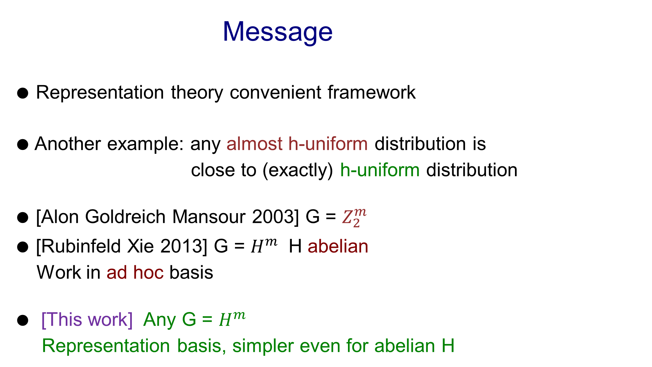
Message
● Representation theory convenient framework
● Another example: any almost h-uniform distribution is
close to (exactly) h-uniform distribution
● [Alon Goldreich Mansour 2003] G = $Z_{2}^{m}$
● [Rubinfeld Xie 2013] G = $H^{m}$ H abelian
Work in ad hoc basis
● [This work] Any G = $H^{m}$
Representation basis, simpler even for abelian H

Slide 20
The end

