Slide 1
Homomorphic Signatures
Daniel Wichs
Northeastern University
based on work with: Sergey Gorbunov and Vinod Vaikuntanathan

Slide 2








Fully Homomorphic Encryption (FHE) [Rivest-Adleman-Dertouzos ’78, Gentry ’09,…]
$$pk, sk$$
$$c= Enc_{pk}(x)$$
$$c^{∗}=Eval(f,c)$$
Alice
$$Dec_{sk}\left(c^{∗} \right)= f(x)$$

Slide 3









Fully Homomorphic Signatures
Median Household Size?
large dataset
Alice
Bob
$$x$$
$$y=f(x)$$
$$y$$
Authenticity: how do we know $y$ is correct?

Slide 4
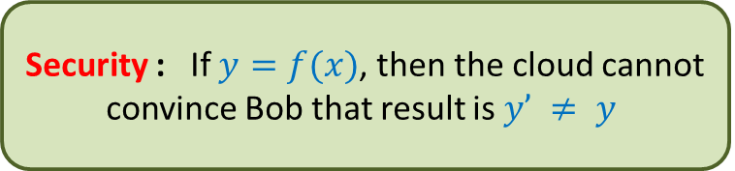







Fully Homomorphic Signatures
$$pk, sk$$
short
$$pk$$
Alice
Bob
$$x$$
$$y$$
, $σ^{∗}$
$$, σ$$
$$y=f(x)$$
$σ^{∗}=$Eval($f,σ$)
σ = Sign$sk$($x$)
Verify$pk$($f, y, σ^{∗}$)
Security : If $y=f(x)$, then the cloud cannot convince Bob that result is $y’ ≠ y$

Slide 5
Theorem [Gorbunov, Vaikuntanathan, Wichs’15]:
A leveled fully homomorphic signature (HS) scheme for all circuits of some a-priori bounded depth d.
Shortness: Size of certificate σ_{f,y} is poly(λ, d) where λ is the security parameter and d is the circuit depth for f.
Security: assuming hardness of LWE/SIS.
Caveat: Need large public random string (public params)
or random oracle model.
Notes:
Other results in verifiable computation and other results in signatures?

Slide 6
Unified Construction: Connects FHE and FHS
Fully
Homomorphic
Encryption
Fully
Homomorphic
Commitments
Fully
Homomorphic
Signatures
Notes:
Show how to construct FHS, but we actually do something better: show a unified construction of both FHE and FHS. This was surprising to me, because these are seemingly very different primitives. I don’t know of any direct connection. Nevertheless, we were able to show that there is some “common ancestor” that connects them and lets you get both (two stones in one shot).

Slide 7





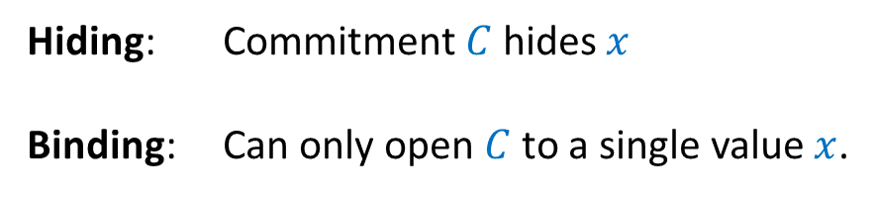

Commitments
$pk$ : public commitment key
$sk$ : trapdoor
Alice
$C$ = commit$pk$($x, R$)
Bob
bit: $x$ , opening: $R$
$$x$$
$$∈\{0,1\}$$
Hiding: Commitment $C$ hides $x$
Binding: Can only open $C$ to a single value $x$.

Slide 8
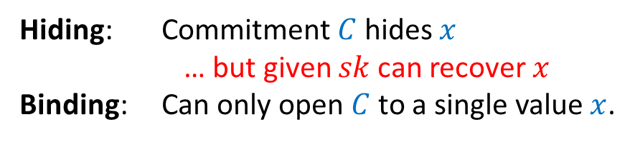
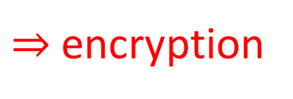
Extractable Commitments
$⇒$ encryption
$pk$ : public commitment key
$sk$ : trapdoor
Alice
$C$ = commit$pk$($x, R$)
Bob
bit: $x$ , opening: $R$
$$x$$
$$∈\{0,1\}$$
Hiding: Commitment $C$ hides $x$
… but given $sk$can recover $x$
Binding: Can only open $C$ to a single value $x$.

Slide 9
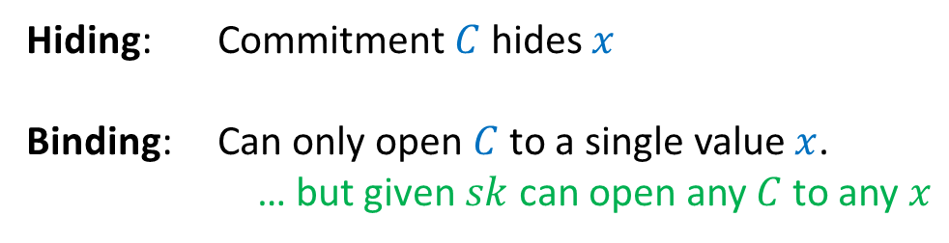
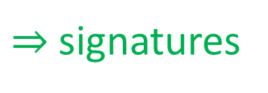
Equivocal Commitments
$⇒$ signatures
$pk$ : public commitment key
$sk$ : trapdoor
Alice
$C$ = commit$pk$($x, R$)
Bob
bit: $x$ , opening: $R$
$$x$$
$$∈\{0,1\}$$
Hiding: Commitment $C$ hides $x$
Binding: Can only open $C$ to a single value $x$.
… but given $sk$ can open any $C$ to any $x$

Slide 10
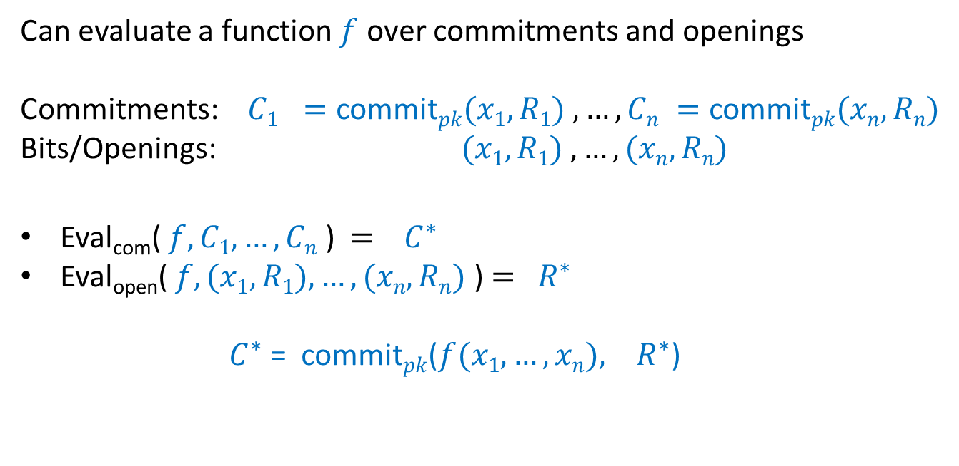
Fully Homomorphic Commitments
Can evaluate a function $f$ over commitments and openings
Commitments: $C1 =\text{commit}pk(x1, R1) ,…, Cn =\text{commit}pk(xn, Rn)$
Bits/Openings: $(x1, R1) ,…, (xn, Rn)$
Eval_{com}( $f, C1,…,Cn$ ) $=$ $C^{∗}$
Eval_{open}( $f, (x1, R1),…,(xn, Rn)$ ) $=$ $R^{∗}$
$C^{∗}$= commit$pk$($f(x1,…,xn), R^{∗}$)

Slide 11
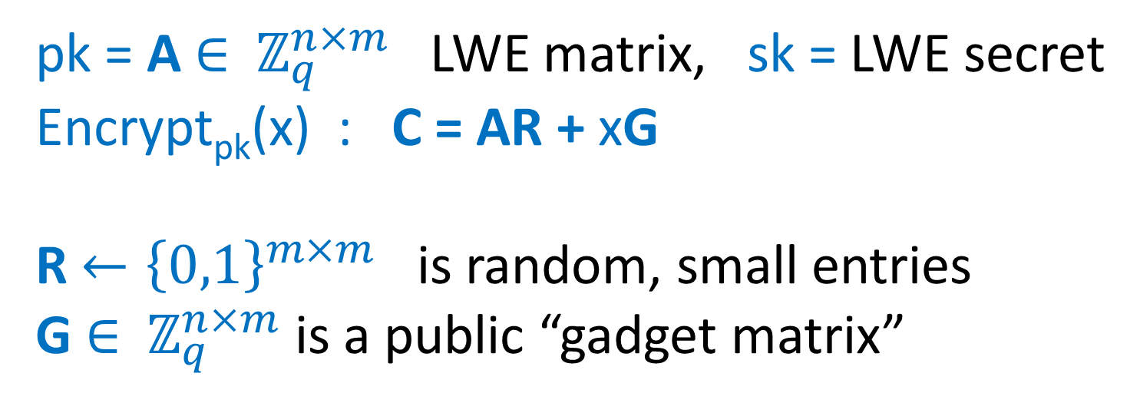
Recall the GSW FHE
pk = A $∈$ $ℤ_{q}^{n×m}$ LWE matrix, sk = LWE secret
Encrypt_{pk}(x) : C = AR + xG
R $←{\left\{0,1\right\}}^{m×m}$ is random, small entries
G $∈$ $ℤ_{q}^{n×m}$ is a public “gadget matrix”

Slide 12
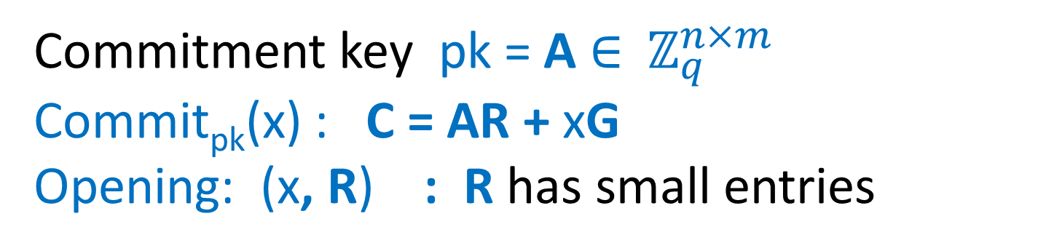
GSW as a Commitment
Commitment key pk = A $∈$ $ℤ_{q}^{n×m}$
Commit_{pk}(x) : C = AR + xG
Opening: (x, R) : R has small entries

Slide 13
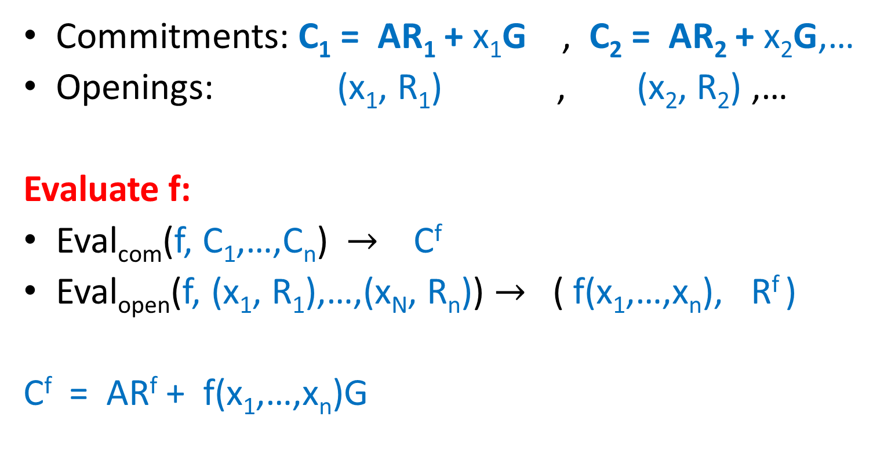
Homomorphic Computation on Commitments and Openings
Commitments: C₁ = AR₁ + x₁G , C₂ = AR₂ + x₂G,…
Openings: (x₁, R₁) , (x₂, R₂) ,…
Evaluate f:
Eval_{com}(f, C₁,…,C_{n}) $→$ C^{f}
Eval_{open}(f, (x₁, R₁),…,(x_{N}, R_{n})) $→$ ( f(x₁,…,x_{n}), R^{f} )
C^{f} = AR^{f} + f(x₁,…,x_{n})G
Might reveal extra info about x₁,…,x_{n}.
(can remove this)

Slide 14
Homomorphic Computation on Commitments and Openings
Commitments: C₁ = AR₁ + x₁G , C₂ = AR₂ + x₂G
Openings: (x₁, R₁) (x₂, R₂)
Addition:
Eval_{com} C⁺ = C₁ + C₂
Eval_{open} ( x₁ + x₂, R₁ + R₂)
C⁺ = ( AR₁ + x₁G ) + ( AR₂ + x₂G ) = A(R₁+R₂) + (x₁+x₂)G

Slide 15
Homomorphic Computation on Commitments and Openings
Commitments: C₁ = AR₁ + x₁G , C₂ = AR₂ + x₂G
Openings: (x₁, R₁) (x₂, R₂)
Multiplication:
Eval_{com} C^{x} = C₁ G⁻¹(C₂)
Eval_{open} (x₁x₂, R₁ G⁻¹(C₂) + x₁R₂)
C^{x} = (AR₁ + x₁G) G⁻¹(C₂) = (AR₁ G⁻¹(C₂) + x₁(AR₂ + x₂G)
= A(R₁ G⁻¹(C₂) + x₁R₂) + x₁x₂G

Slide 16
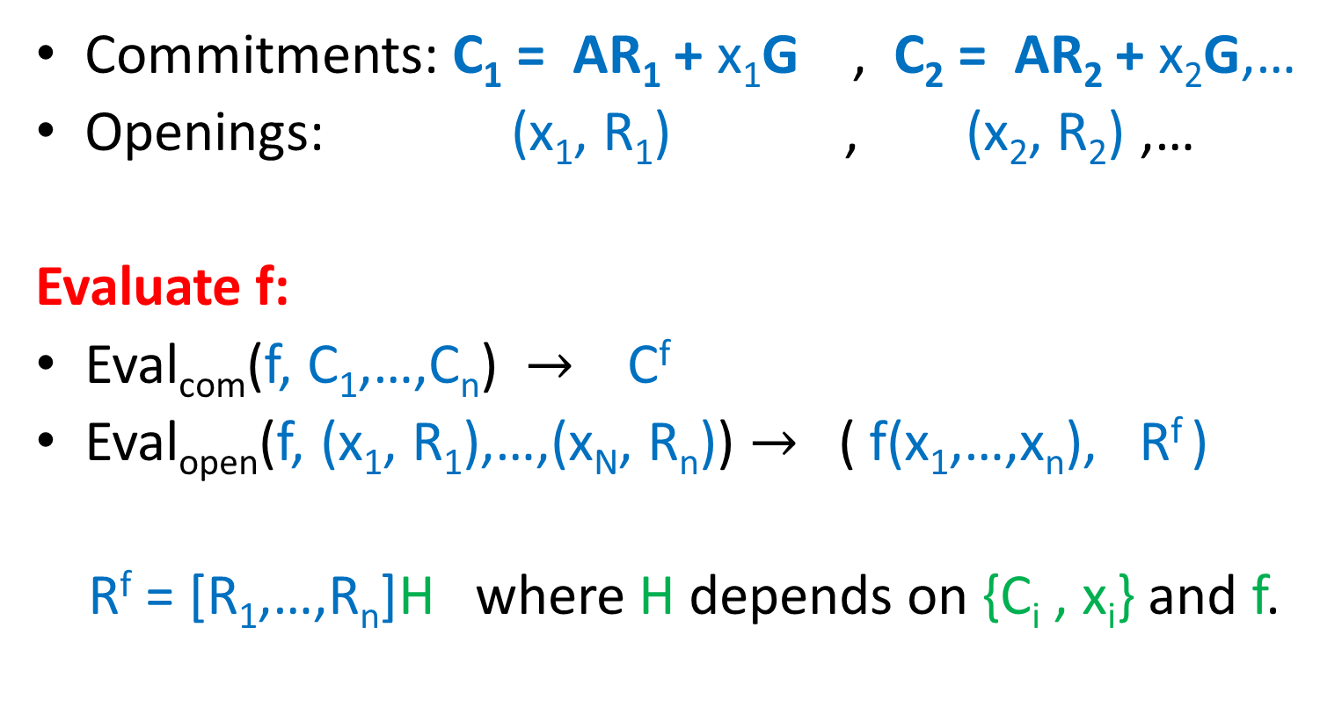
Homomorphic Computation on Commitments and Openings
Commitments: C₁ = AR₁ + x₁G , C₂ = AR₂ + x₂G,…
Openings: (x₁, R₁) , (x₂, R₂) ,…
Evaluate f:
Eval_{com}(f, C₁,…,C_{n}) $→$ C^{f}
Eval_{open}(f, (x₁, R₁),…,(x_{N}, R_{n})) $→$ ( f(x₁,…,x_{n}), R^{f} )
R^{f} = [R₁,…,R_{n}]H where H depends on {C_{i} , x_{i}} and f.

Slide 17
Two Flavors of Commitments
Commit_{pk}(x) : C = AR + xG
A is chosen as in GSW:
computationally hiding (LWE).
statistically binding.
extractable using trapdoor.
A is chosen uniformly random:
scheme is statistically hiding, commitments are uniformly random.
computationally binding (LWE or SIS)
equivocal using a trapdoor (next)
B
A =
b = sB+e
A =

Slide 18
SIS Trapdoor [Ajtai99,…,MP12]
Goal: choose a random A with a trapdoor such that for any V can find short R : AR = V.
R = TG⁻¹(V)
To open commitment C to a bit x, set V = C – xG.
m/2
m/2
Trapdoor:
T =
-R*
A =
B
BR* + G
n
I
AT = G

Slide 19
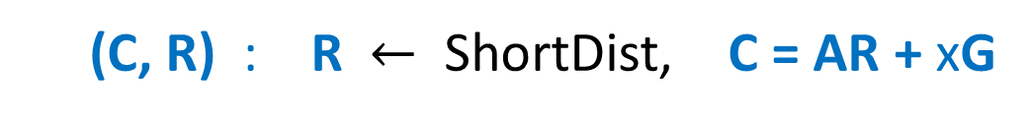
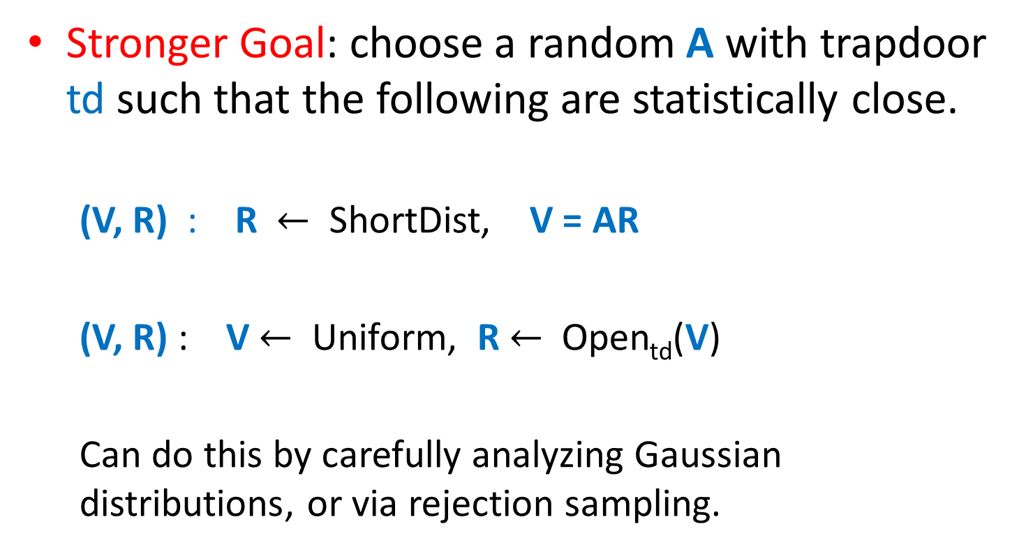
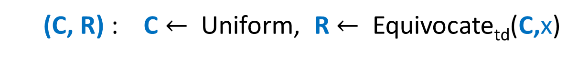
SIS Trapdoor with Correct Distribution [GPV08, MP12, LW15]
Stronger Goal: choose a random A with trapdoor td such that the following are statistically close.
(V, R) : R $←$ ShortDist, V = AR
(V, R) : V $←$ Uniform, R $←$ Open_{td}(V)
Can do this by carefully analyzing Gaussian distributions, or via rejection sampling.
(C, R) : R $←$ ShortDist, C = AR + xG
(C, R) : C $←$ Uniform, R $←$ Equivocate_{td}(C,x)

Slide 20
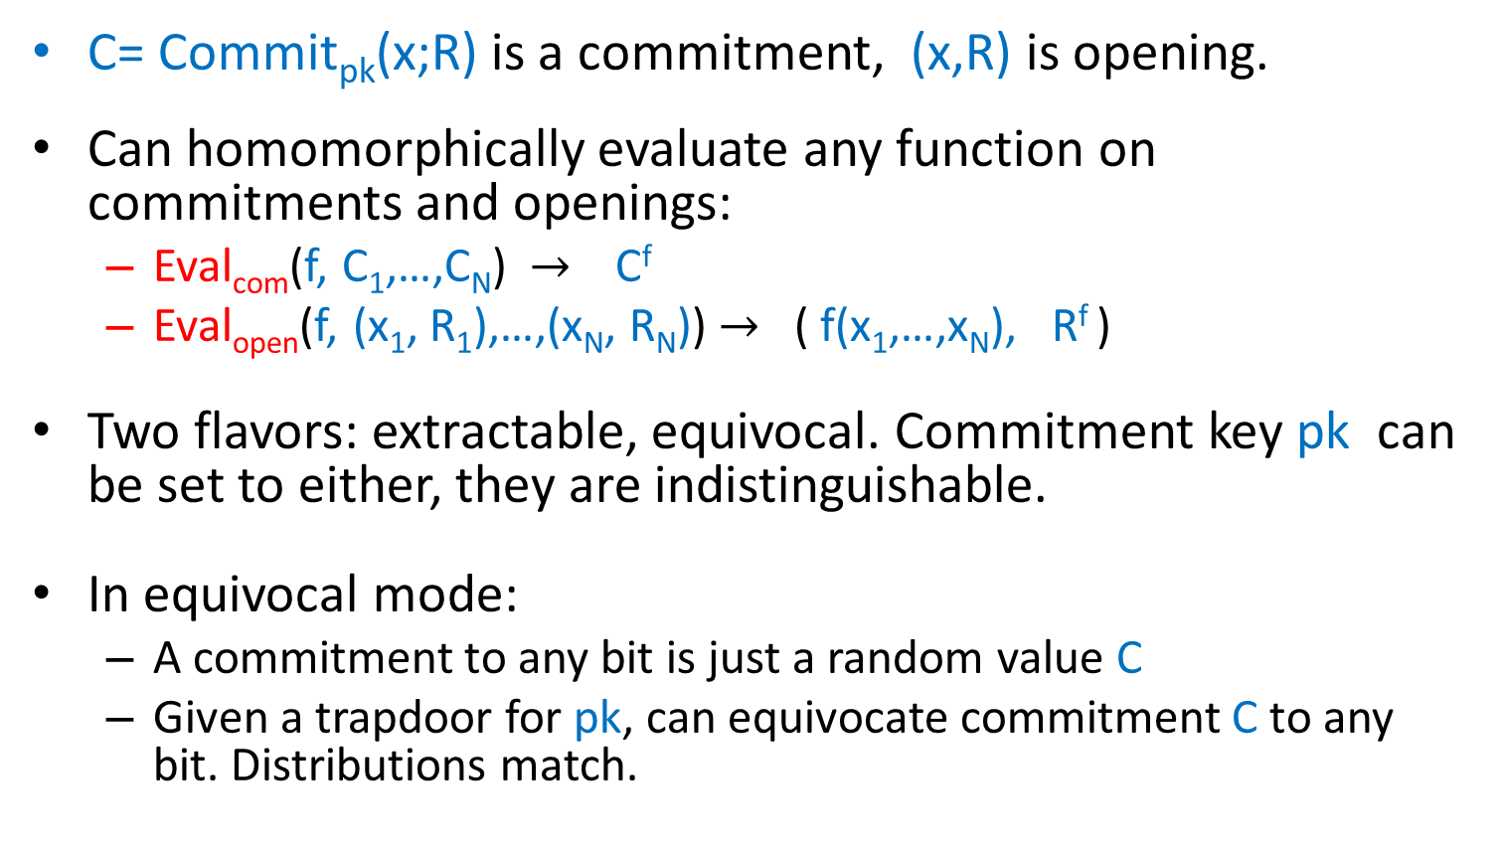
Summary: Homomorphic Commitments
C= Commit_{pk}(x;R) is a commitment, (x,R) is opening.
Can homomorphically evaluate any function on commitments and openings:
Eval_{com}(f, C₁,…,C_{N}) $→$ C^{f}
Eval_{open}(f, (x₁, R₁),…,(x_{N}, R_{N})) $→$ ( f(x₁,…,x_{N}), R^{f} )
Two flavors: extractable, equivocal. Commitment key pk can be set to either, they are indistinguishable.
In equivocal mode:
A commitment to any bit is just a random value C
Given a trapdoor for pk, can equivocate commitment C to any bit. Distributions match.

Slide 21
Recall: Fully Homomorphic Signatures
$$pk, sk$$
short
$$pk$$
Alice
Bob
$$x$$
$$y$$
, $σ^{∗}$
$$, σ$$
$$y=f(x)$$
$σ^{∗}=$Eval($f,σ$)
σ = Sign$sk$($x$)
Verify$pk$($f, y, σ^{∗}$)
Security : If $y=f(x)$, then the cloud cannot convince Bob that result is $y’ ≠ y$

Slide 22

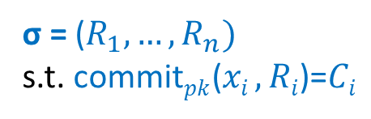


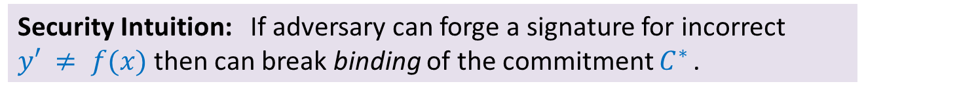






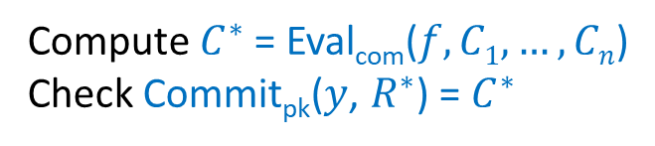


Constructing Fully Homomorphic Signatures
Security Intuition: If adversary can forge a signature for incorrect $y′ ≠ f(x)$then can break binding of the commitment $C^{∗}$.
Public randomness:
$$C1 … Cn$$
random commitments
$$$$$$$$$$$$$$$$$$$$$$$$$$$$$$$$$$$$$$$$$
Public key: $pk$
Secret key: $sk$ (equivocation)
$$, σ$$
$$x$$
$$y=f(x)$$
$$y$$
$$, r^{∗ }$$
σ = Sign_{sk}($x=(x_{1},…x_{n})$)
Verify_{pk}($f, y, R^{∗}$)=1
$R^{∗}$:= Eval_{open}($f, (x1, R1), …, (xn, Rn)$)
σ = ($R_{1},…,R_{n})$
s.t. commit$pk$($xi ,Ri$)=$Ci$
Compute $C^{∗}$= Eval_{com}($f, C1, …, Cn$)
Check Commit_{pk}($y$, $R^{∗}$) = $C^{∗}$

Slide 23
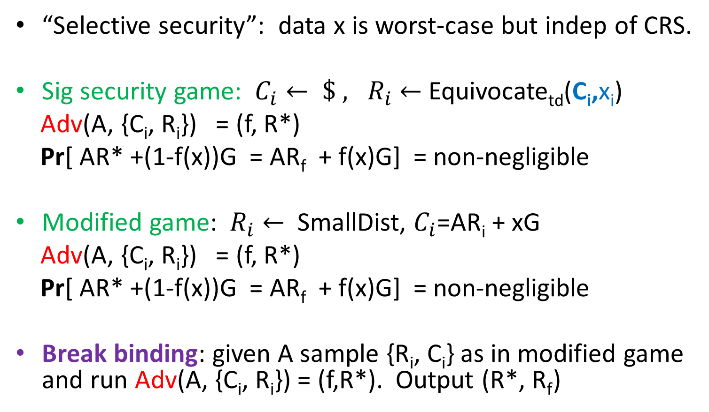
Security Proof
“Selective security”: data x is worst-case but indep of CRS.
Sig security game: $C_{i}← \$ , R_{i}$ $←$Equivocate_{td}(C_{i},x_{i})
Adv(A, {C_{i}, R_{i}}) = (f, R*)
Pr[ AR* +(1-f(x))G = AR_{f} + f(x)G] = non-negligible
Modified game: $R_{i}$ $←$ SmallDist, $C_{i}$=AR_{i} + xG
Adv(A, {C_{i}, R_{i}}) = (f, R*)
Pr[ AR* +(1-f(x))G = AR_{f} + f(x)G] = non-negligible
Break binding: given A sample {R_{i}, C_{i}} as in modified game and run Adv(A, {C_{i}, R_{i}}) = (f,R*). Output (R*, R_{f})

Slide 24
Extensions
Full security (beyond selective):
Homomorphic chameleon hash [KR00]
= Homomorphic equivocal commitments.
Multiple data sets:
Use standard signature to sign a fresh verification key of homomorphic signature scheme for each data set.
Context Hiding (certificate only reveals output of comp.)
Can be done generically with NIZKs.
Nice way to do this for our scheme using equivocation trapdoors.

Slide 25
Open Problems
Remove large public parameters?
Remove dependence on depth. Bootstrapping?

Slide 26

Notes:
Comments: add short vector for SIS solution (u-u’)r.
Say that SIS is believed to be hard to certain lattice problems.

