Slide 1
Reduction-Resilient Cryptography: Primitives that Resist Reductions from All Standard Assumptions
Daniel Wichs (Charles River Crypto Day ‘12)

Slide 2
Overview
Negative results for several natural primitives : cannot prove security via ‘black box reduction’.
Leakage-resilience with unique keys.
Pseudo-entropy generators.
Deterministic encryption.
Fiat-Shamir for “3-round proofs”.
Succinct non-interactive arguments (SNARGs).
No black-box reduction from any ‘standard’ assumption.
W ‘13
Bitansky-Garg-W ‘13
Gentry-W ‘11
‘weird’ definitions

Slide 3

Standard vs. Weird
Efficient challenger
=
Falsifiable Definition
Standard Security Definition: Interactive game between a challenger and an adversary. Challenger decides if adversary wins.
For PPT Adversary, Pr[Adversary wins] = negligible
Decisional: ½ $±$ negligible
WIN?
e.g. Discrete Log
(g, g^{x} )
Adversary
Challenger
x
Notes:
Syntactic property
May be able to have two ways of writing the same definitions that are semantically equivalent, but one is standard and one is weird.

Slide 4
Standard vs. Weird
Standard Security Definition: Interactive game between a challenger and an adversary. Challenger decides if adversary wins.
For PPT Adversary, Pr[Adversary wins] = negligible
Weird = non-standard

Slide 5
Standard vs. Weird
Standard Definitions: Discrete Log, DDH, RSA, LWE, QR, “One-More DL”, Signature Schemes, CCA Encryption,…
Weird Definitions:
‘Zero-Knowledge’ security.
‘Knowledge of Exponent’ problem [Dam91, HT98].
Extractable hash functions. [BCCT11].
Leakage-resilience, adversarial randomness distributions.
Exponential hardness

Slide 6
Message of This Talk
For some primitives with a weird definition, we cannot prove security under any standard assumption via a reduction that treats the attacker as a black box.

Slide 7
Outline
Leakage-Resilience
Develop a framework for proving impossibility.
Pseudo-entropy
Correlated-inputs and deterministic encryption
Fiat-Shamir
Succinct Non-Interactive Arguments (SNARGs)

Slide 8

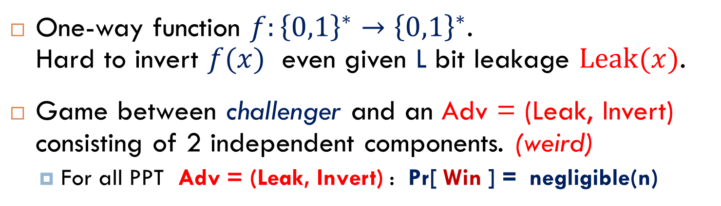

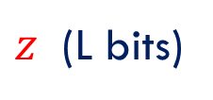


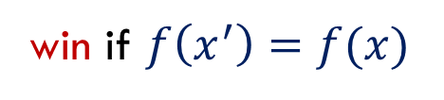
Leakage-Resilience
One-way function $f:{\left\{0,1\right\}}^{∗}→{\left\{0,1\right\}}^{∗}$. Hard to invert $f(x)$ even given L bit leakage $Leak(x)$.
Game between challenger and an Adv = (Leak, Invert) consisting of 2 independent components. (weird)
For all PPT Adv = (Leak, Invert) : Pr[ Win ] = negligible(n)
Leak
$$x$$
$z$ (L bits)
$$x←_{\$}{\left\{0,1\right\}}^{n}$$
Challenger
$$z, f(x)$$
Invert
$$x′$$
win if $f\left(x^{′}\right)=f(x)$

Slide 9
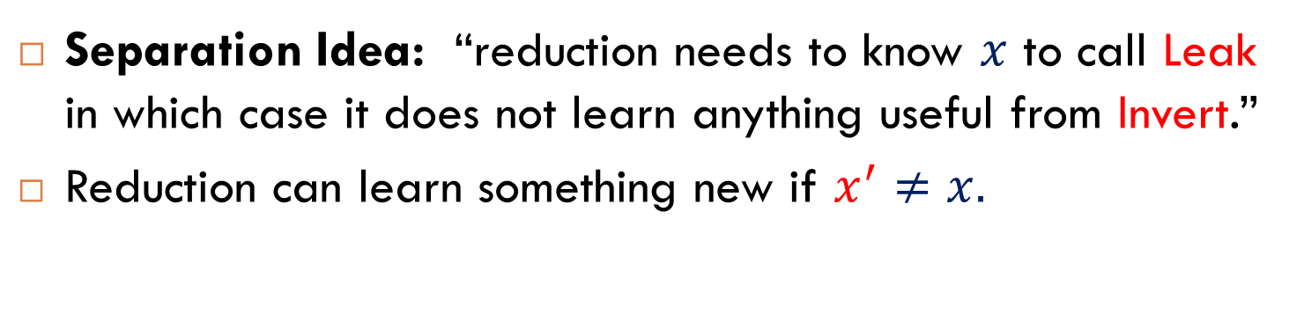
Leakage-Resilience
Separation Idea: “reduction needs to know $x$ to call Leak in which case it does not learn anything useful from Invert.”
Reduction can learn something new if $x^{′}≠x.$
Leak
$$x$$
$z$ (L bits)
$$x←_{\$}{\left\{0,1\right\}}^{n}$$
Challenger
$$z, f(x)$$
Invert
$$x′$$
win if $f\left(x^{′}\right)=f(x)$

Slide 10
Leakage Resilient
Many positive results for leakage-resilient primitives from standard assumptions. [AGV09, NS09, ADW09, KV09, …, HLWW12]
Leakage-resilient OWF from any OWF. [ADW09,KV09]
Arbitrarily large (polynomial) amount of leakage L.
Add requirement: leakage-resilient injective OWF.
Cannot have black-box reduction from any standard assumption.

Slide 11
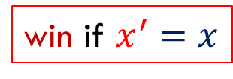

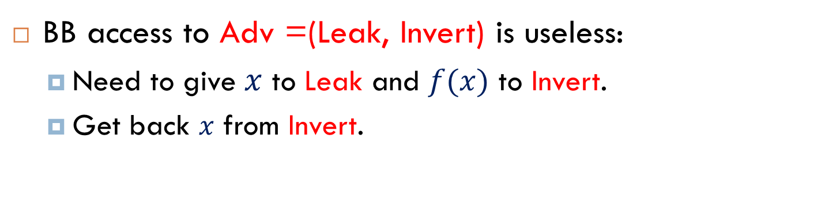


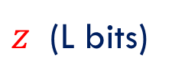
Leakage-Resilient Injective OWF
BB access to Adv =(Leak, Invert) is useless:
Need to give $x$ to Leak and $f(x)$ to Invert.
Get back $x$ from Invert.
Leak
$$x$$
$z$ (L bits)
$$x←_{\$}{\left\{0,1\right\}}^{n}$$
Challenger
$$z, f(x)$$
Invert
$x$’
win if $x^{′}=x$

Slide 12
Framework: Simulatable Adversary
Adversary*
Simulator
≈
Leak*
Invert*
Stat, Comp
Special inefficient adversary breaks security of primitive.
Two independent functions (Leak, Invert).
Efficient simulator that is indistinguishable.
Can be stateful and coordinated.

Slide 13
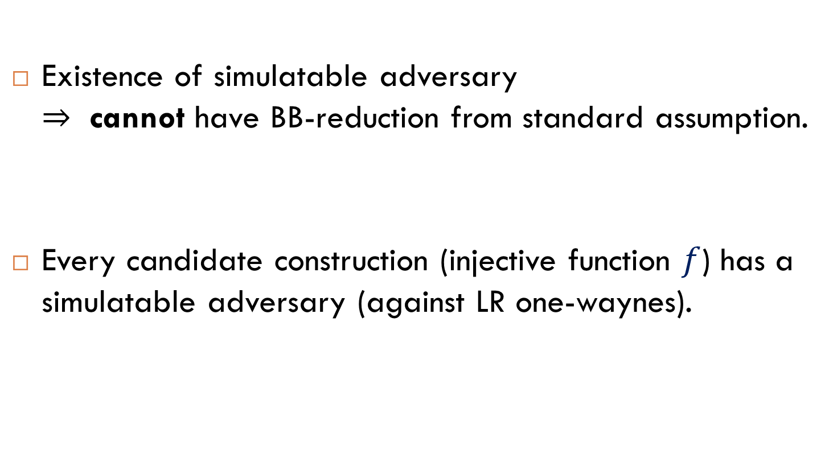
Framework: Simulatable Adversary
Existence of simulatable adversary $⇒$ cannot have BB-reduction from standard assumption.
Every candidate construction (injective function $f$) has a simulatable adversary (against LR one-waynes).

Slide 14

Simulatable Adversary $⇒$ Separation
Adversary
Leak
Invert
WIN
Assumption Challenger
Reduction
Reduction: uses any (even inefficient) adversary that breaks LR one-way security to break assumption.

Slide 15
Simulatable Adversary $⇒$ Separation
Adversary*
WIN
Assumption Challenger
Reduction
Reduction uses “simulatable adv” to break assumption.

Slide 16
Simulatable Adversary $⇒$ Separation
Adversary*
WIN
Distinguisher
Assumption Challenger
Reduction
Reduction uses “simulatable adv” to break assumption.

Slide 17
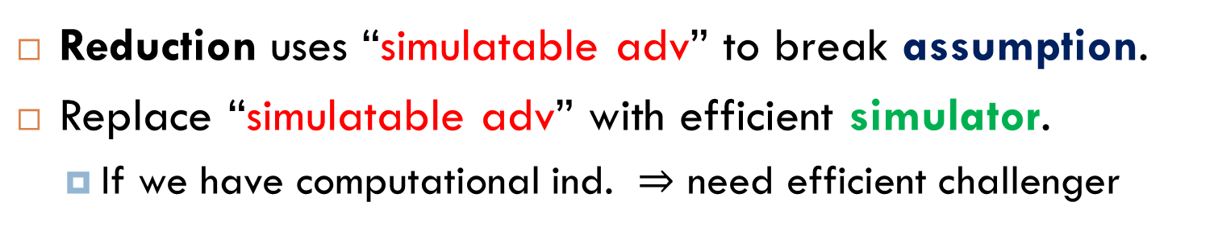
Simulatable Adversary $⇒$ Separation
Simulator
WIN
Distinguisher
Assumption Challenger
Reduction
Reduction uses “simulatable adv” to break assumption.
Replace “simulatable adv” with efficient simulator.
If we have computational ind. $⇒$ need efficient challenger

Slide 18
Simulatable Adversary $⇒$ Separation
Simulator
WIN
Assumption Challenger
Reduction
There is an efficient attack on the assumption.

Slide 19
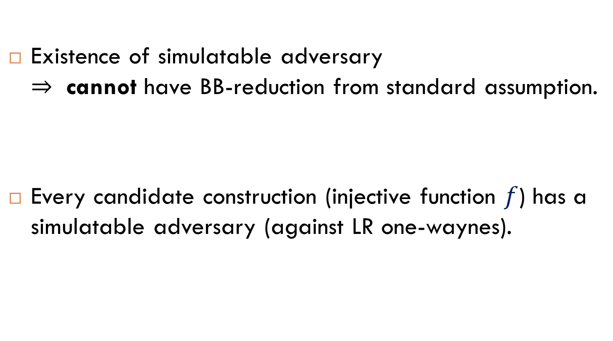
Framework: Simulatable Adversary
Existence of simulatable adversary $⇒$ cannot have BB-reduction from standard assumption.
Every candidate construction (injective function $f$) has a simulatable adversary (against LR one-waynes).

Slide 20

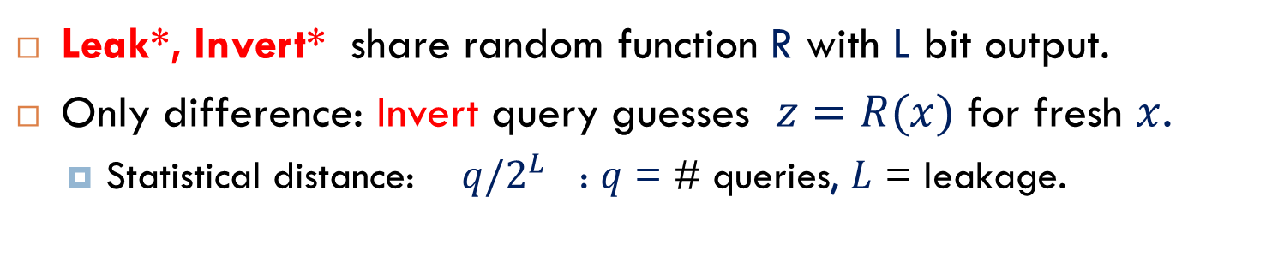


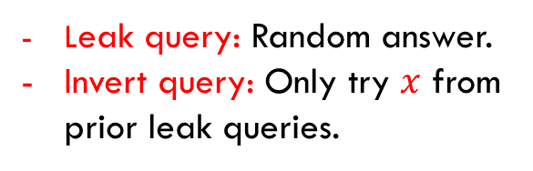




Constructing a Simulatable Adv
Leak*, Invert* share random function R with L bit output.
Only difference: Invert query guesses $z=R(x)$ for fresh $x$.
Statistical distance: $q/2^{L}$ : $q$ = # queries, $L$ = leakage.
Find $x=f^{−1}\left(y\right)$
Check $R(x)=z$
≈
$$R$$
$$R$$
Simulator
Leak*
Invert*
Leak query: Random answer.
Invert query: Only try $x$ from prior leak queries.
$$x$$
$$z=R(x)$$
$$y,z$$
$$x$$

Slide 21
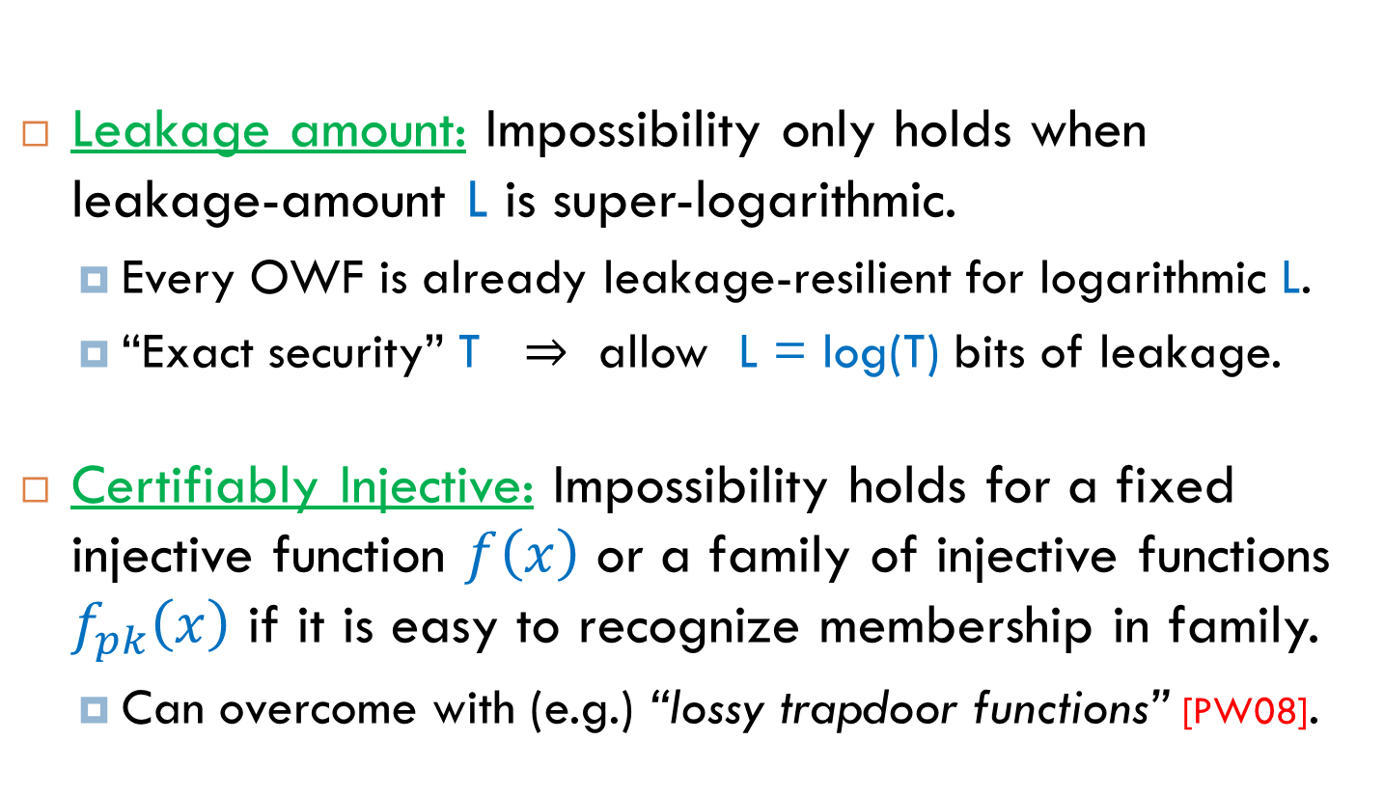
Caveats
Leakage amount: Impossibility only holds when leakage-amount L is super-logarithmic.
Every OWF is already leakage-resilient for logarithmic L.
“Exact security” T $⇒$ allow L = log(T) bits of leakage.
Certifiably Injective: Impossibility holds for a fixed injective function $f\left(x\right)$ or a family of injective functions $f_{pk}\left(x\right)$ if it is easy to recognize membership in family.
Can overcome with (e.g.) “lossy trapdoor functions” [PW08].

Slide 22
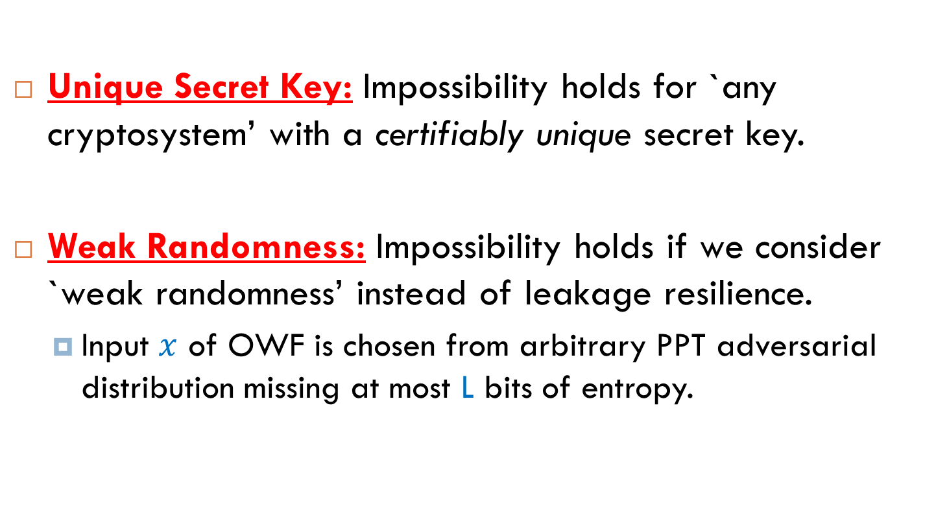
Generalizations
Unique Secret Key: Impossibility holds for `any cryptosystem’ with a certifiably unique secret key.
Weak Randomness: Impossibility holds if we consider `weak randomness’ instead of leakage resilience.
Input $x$ of OWF is chosen from arbitrary PPT adversarial distribution missing at most L bits of entropy.

Slide 23
Outline
Leakage-Resilience
Develop a framework for proving separations.
Pseudo-entropy
Correlation and Deterministic Encryption
Fiat-Shamir
Succinct Non-Interactive Arguments

Slide 24
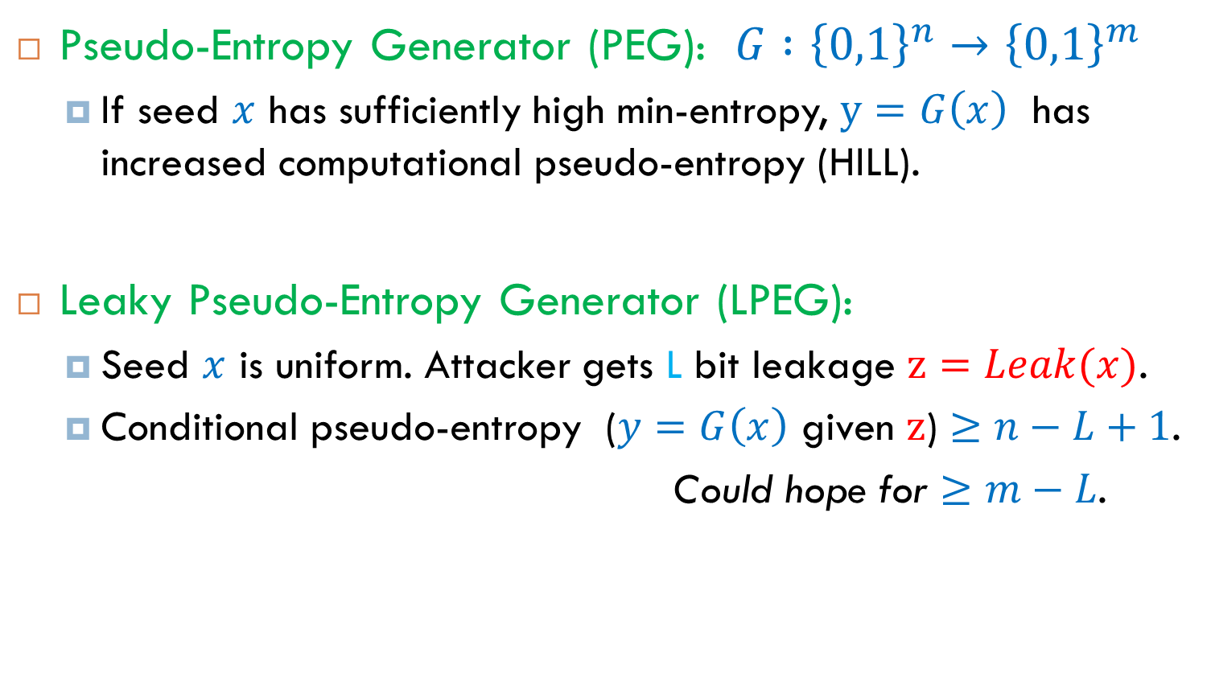
Pseudo-Entropy Generator
Pseudo-Entropy Generator (PEG): $G :{\left\{0,1\right\}}^{n}→{\left\{0,1\right\}}^{m}$
If seed $x$ has sufficiently high min-entropy, $y=G\left(x\right)$ has increased computational pseudo-entropy (HILL).
Leaky Pseudo-Entropy Generator (LPEG):
Seed $x$ is uniform. Attacker gets L bit leakage $z=Leak(x)$.
Conditional pseudo-entropy ($y=G\left(x\right)$ given $z$) $≥n−L+1$.
Could hope for $≥m−L$.
$\left(y,z\right)≈_{c}(y^{′},z^{′})$ such that $H_{∞}\left(y^{′} | z^{′}\right)≥n−L+1$

Slide 25
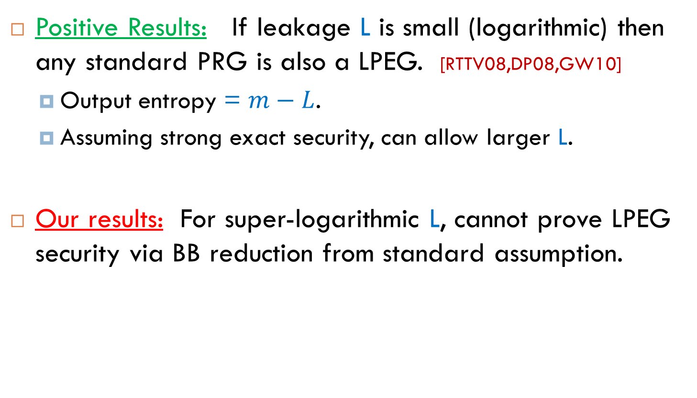
Pseudo-Entropy Generator
Positive Results: If leakage L is small (logarithmic) then any standard PRG is also a LPEG. [RTTV08,DP08,GW10]
Output entropy = $m−L$.
Assuming strong exact security, can allow larger L.
Our results: For super-logarithmic L, cannot prove LPEG security via BB reduction from standard assumption.

Slide 26
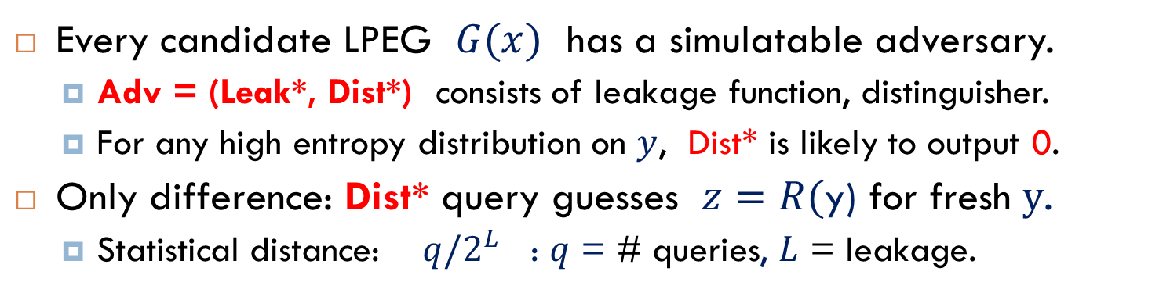
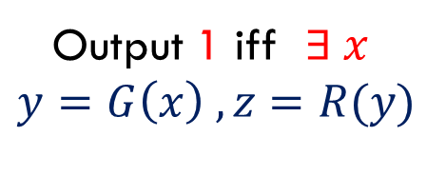
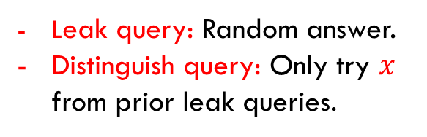


Simulatable Adv for LPEG
Every candidate LPEG $G(x)$ has a simulatable adversary.
Adv = (Leak*, Dist*) consists of leakage function, distinguisher.
For any high entropy distribution on $y$, Dist* is likely to output 0.
Only difference: Dist* query guesses $z=R($y) for fresh $y$.
Statistical distance: $q/2^{L}$ : $q$ = # queries, $L$ = leakage.
≈
Output 1 iff $∃ x$
$$y=G\left(x\right) , z=R(y)$$
$$R$$
$$R$$
Simulator
Leak*
Dist*
Leak query: Random answer.
Distinguish query: Only try $x$ from prior leak queries.
$$x$$
$$z=R(G(x))$$
$$y,z$$
$$0/1$$

Slide 27
Outline
Leakage-Resilience
Develop a framework for proving separations.
Pseudo-entropy
Correlation and Deterministic Encryption
Fiat-Shamir
Succinct Non-Interactive Arguments

Slide 28
Deterministic Public-Key Encryption
Cannot be `semantically secure’. [GM84]
Can be secure if messages have sufficient entropy. [BBO07]
Strong notion in RO model: encrypt arbitrarily many messages, can be arbitrarily correlated, each one has entropy on its own.
Standard model: each message must have fresh entropy conditioned on others. [BFOR08, BFO08, BS11]
Bounded number of arbitrarily correlated messages. [FOR12]
Our work: cannot prove ‘strong notion’ under standard assumptions via BB reductions.
Even if we only consider one-way security.
Even if we don’t require efficient decryption.

Slide 29
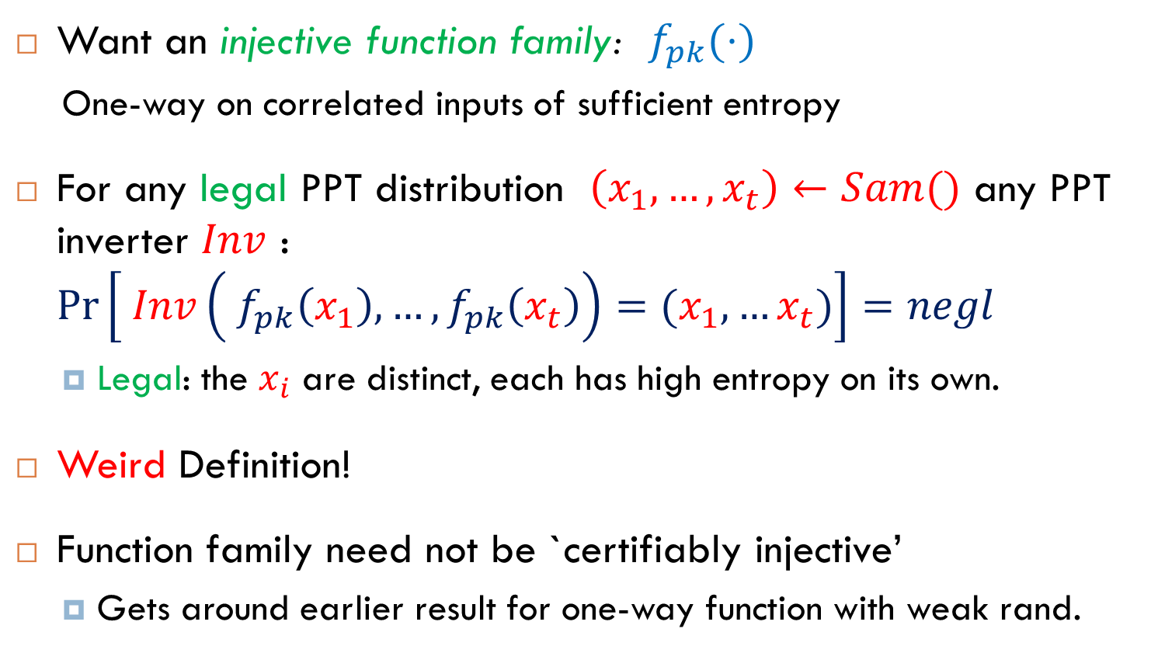
Defining Security
Want an injective function family: $f_{pk}(⋅)$
One-way on correlated inputs of sufficient entropy
For any legal PPT distribution $\left(x_{1},…, x_{t}\right)←Sam()$ any PPT inverter $Inv$ : $\operatorname{Pr}\left[ Inv\left( f_{pk}\left(x_{1}\right), …,f_{pk}\left(x_{t}\right)\right)=(x_{1},…x_{t})\right]=negl$
Legal: the $x_{i}$ are distinct, each has high entropy on its own.
Weird Definition!
Function family need not be `certifiably injective’
Gets around earlier result for one-way function with weak rand.

Slide 30



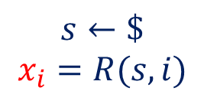

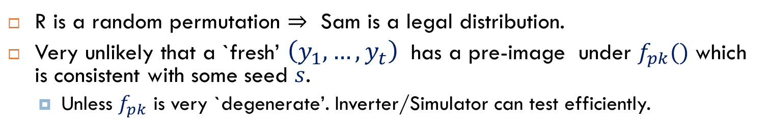

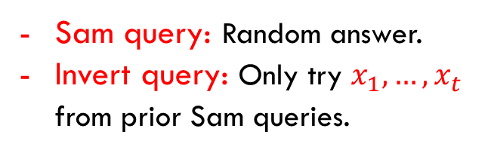

Simulatable Attacker
≈
$$s←\$$$
$$x_{i}=R(s,i)$$
Try all $s$
$$R$$
$$R$$
Sam*
Inv*
Simulator
Sam query: Random answer.
Invert query: Only try $x_{1},…,x_{t}$ from prior Sam queries.
$$\left(x_{1},…, x_{t}\right)$$
$$\left(y_{1},…, y_{t}\right), pk$$
$$\left(x_{1},…, x_{t}\right)$$
R is a random permutation $⇒$ Sam is a legal distribution.
Very unlikely that a `fresh’ $\left(y_{1},…, y_{t}\right)$ has a pre-image under $f_{pk}()$ which is consistent with some seed $s$.
Unless $f_{pk}$ is very `degenerate’. Inverter/Simulator can test efficiently.

Slide 31
Outline
Leakage-Resilience
Develop a framework for proving separations.
Pseudo-entropy
Correlation and Deterministic Encryption
Fiat-Shamir
Succinct Non-Interactive Arguments

Slide 32
The Fiat-Shamir Heuristic
Use a hash function h to collapse a 3-round public-coin (3PC) argument into a non-interactive argument.
Statement: x
Witness: w
Prover(x,w)
Verifier(x)
a
random challenge: c
z
Ver(x,a,c,z)

Slide 33
The Fiat-Shamir Heuristic
Use a hash function h to collapse a 3-round public-coin (3PC) argument into a non-interactive argument.
Statement: x
Witness: w
Prover(x,w)
Verifier(x)
a
c = h(a)
z
Ver(x,a,c,z)

Slide 34
The Fiat-Shamir Heuristic
Use a hash function h to collapse a 3-round public-coin (3PC) argument into a non-interactive argument.
Statement: x
Witness: w
Prover(x,w)
Verifier(x)
c = h(a)
a,
z
Ver(x,a,c,z)

Slide 35
The Fiat-Shamir Heuristic
Use a hash function h to collapse a 3-round public-coin (3PC) argument into a non-interactive argument.
Used for signatures, NIZKs, succinct arguments (etc.)
Is it secure? Does it preserve soundness?
Yes: if h is a Random Oracle. [BR93]
No: there is a 3PC argument on which Fiat-Shamir fails when instantiated with any real hash function h. [Bar01,GK03]
Maybe: there is a hash function h that makes Fiat-Shamir secure when applied to any 3PC proof.

Slide 36
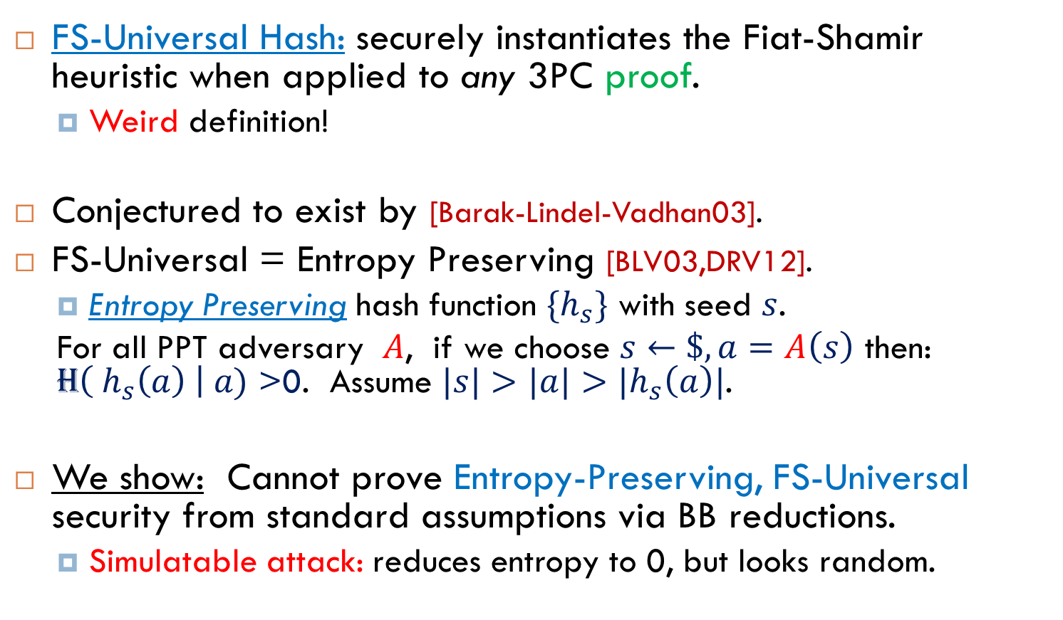
Fiat-Shamir-Universal Hash
FS-Universal Hash: securely instantiates the Fiat-Shamir heuristic when applied to any 3PC proof.
Weird definition!
Conjectured to exist by [Barak-Lindel-Vadhan03].
FS-Universal = Entropy Preserving [BLV03,DRV12].
Entropy Preserving hash function $\{h_{s}\}$ with seed $s$.
For all PPT adversary $A$, if we choose $s←\$, a=A\left(s\right)$ then: H$\left( h_{s}\left(a\right) \right| a)$ >0. Assume $|s|>|a|>|h_{s}\left(a\right)|$.
We show: Cannot prove Entropy-Preserving, FS-Universal security from standard assumptions via BB reductions.
Simulatable attack: reduces entropy to 0, but looks random.

Slide 37
Outline
Leakage-Resilience
Develop a framework for proving separations.
Pseudo-entropy
Correlation and Deterministic Encryption
Fiat-Shamir
Succinct Non-Interactive Arguments

Slide 38
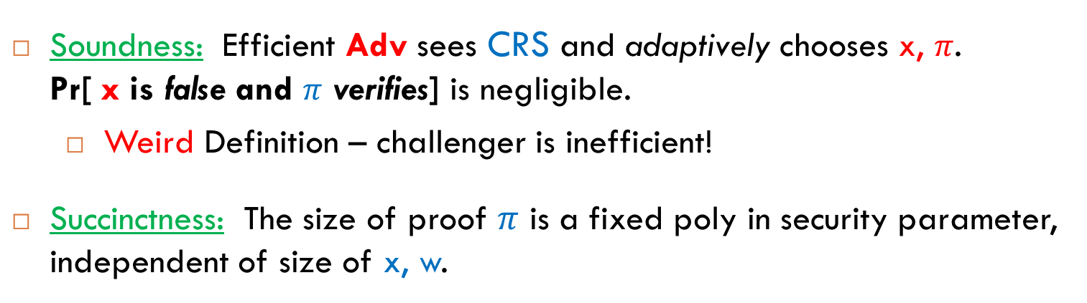
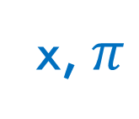
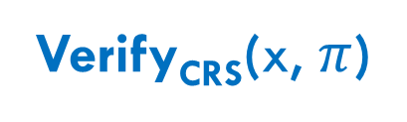
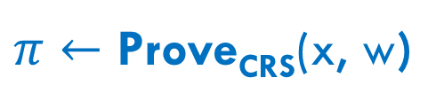

SNARGs
CRS $←$Gen()
short proof
valid/invalid
x, $π$
$π←$ Prove_{CRS}(x, w)
Verify_{CRS}(x, $π$)
witness
statement
Soundness: Efficient Adv sees CRS and adaptively chooses x, $π$. Pr[ x is false and $π$ verifies] is negligible.
Weird Definition – challenger is inefficient!
Succinctness: The size of proof $π$ is a fixed poly in security parameter, independent of size of x, w.

Slide 39
SNARGs
Positive Results:
Random Oracle Model [Micali 94]
‘Extractability/Knowledge’ Assumptions [BCCT11,GLR11,DFH11]
Our Result: Cannot prove security via BB reduction from any falsifiable assumption.
Standard assumption w/ efficient challenger.

Slide 40
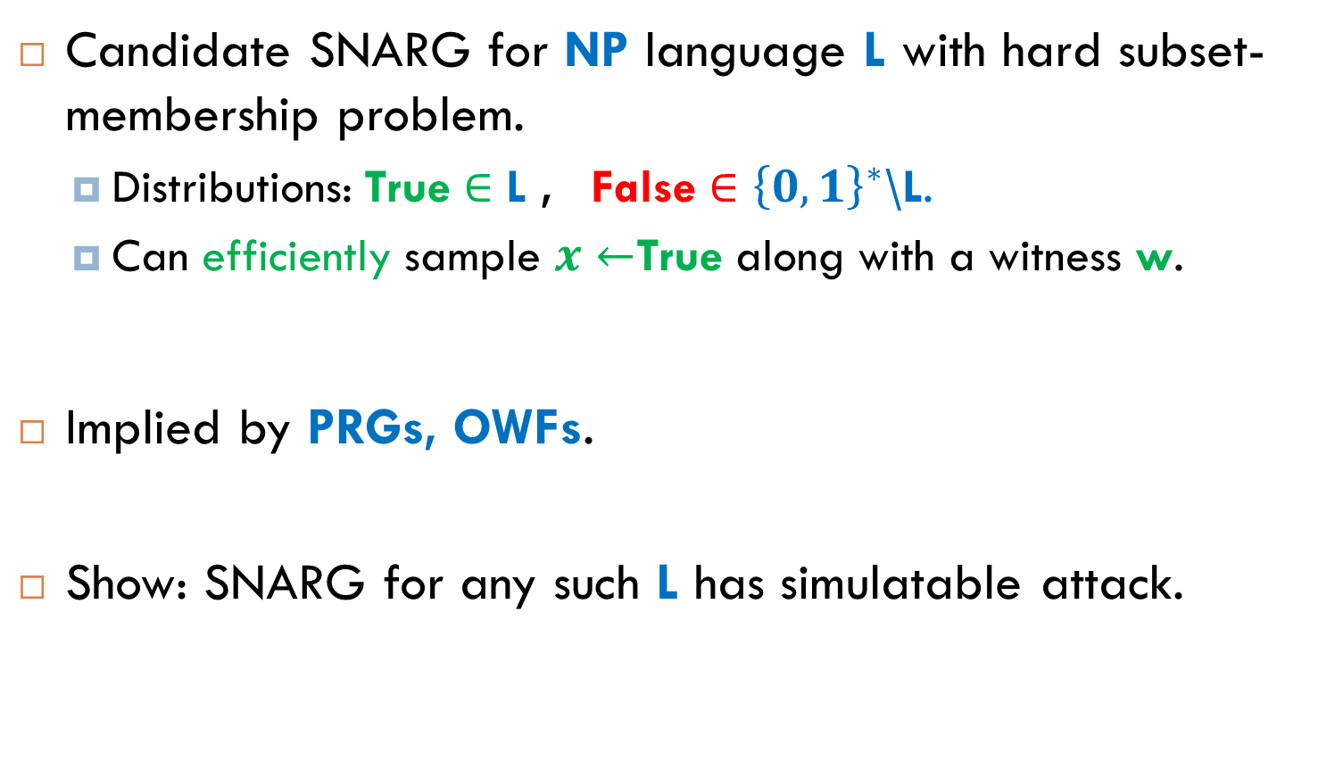
SNARGs for Hard Languages
Candidate SNARG for NP language L with hard subset-membership problem.
Distributions: True $∈$ L , False $∈{\left\{0,1\right\}}^{∗}$\L.
Can efficiently sample $x←$True along with a witness w.
Implied by PRGs, OWFs.
Show: SNARG for any such L has simulatable attack.

Slide 41

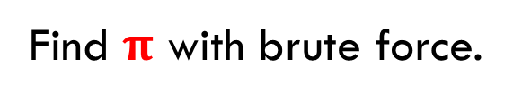
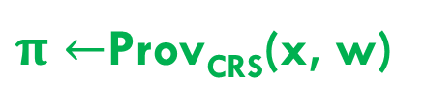
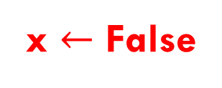
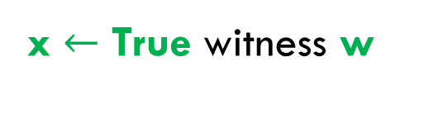
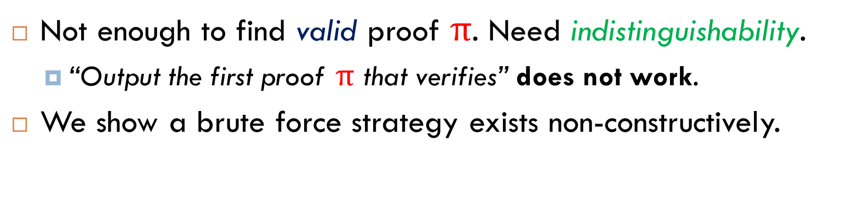
Simulatable Adversary
SNARG Adv
Simulator
≈
x $←$ False
x $←$ True witness w
Find $π$ with brute force.
$π←$Prov_{CRS}(x, w)
Not enough to find valid proof $π$. Need indistinguishability.
“Output the first proof $π$ that verifies” does not work.
We show a brute force strategy exists non-constructively.

Slide 42
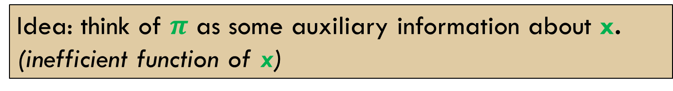
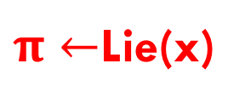

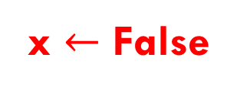
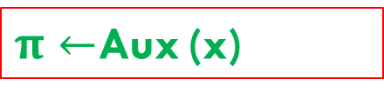
Simulatable Adversary
SNARG Adv
Simulator
≈
x $←$ False
x $←$ True witness w
$π←$Lie(x)
$π←$Prov_{CRS}(x, w)
$π←$Aux (x)
Idea: think of $π$ as some auxiliary information about x.
(inefficient function of x)

Slide 43
Indisitinguishability w/ Auxiliary Info
Theorem: Assume that: X ≈ Y
For all (even inefficient) Aux exists some Lie s.t.
( X, Aux(X) )
≈
( Y, Lie(Y) )
… but security degrades by exp(|Aux|).
Proof uses min-max theorem. Similarity to proofs
of hardcore lemma and “dense model theorems”.

Slide 44

Outline
Leakage-Resilience
Develop a framework for proving separations.
Pseudo-entropy
Correlation and Deterministic Encryption
Fiat-Shamir
Succinct Non-Interactive Arguments

Slide 45
Comparison to other BB Separations
Many “black box separation results”
[Impagliazzo Rudich 89]: Separate KA from OWP.
[Sim98]: Separate CRHFs from OWP.
[GKM+00, GKTRV00, GMR01, RTV04, BPR+08 …]
In all of the above: Cannot construct primitive A using a generic instance of primitive B as a black box.
Our result: Construction can be arbitrary. Reduction uses attacker as a black box.
Other examples: [DOP05, HH09, Pas11,DHT12]
Most relevant [HH09] for KDM security. Can be overcome with non-black-box techniques: [BHHI10]!

Slide 46
Conclusions & Open Problems
Several natural primitives with ‘weird’ definitions cannot be proven secure via a BB reduction from any standard assumption.
Can we overcome the separations with non-black-box techniques (e.g. [Barak 01, BHHI10]) ?
Security proofs under other (less) weird assumptions.

