Slide 1
Outsourcing Private RAM Computation
Daniel Wichs
Northeastern University
with: Craig Gentry, Shai Halevi, Mariana Raykova

Slide 2
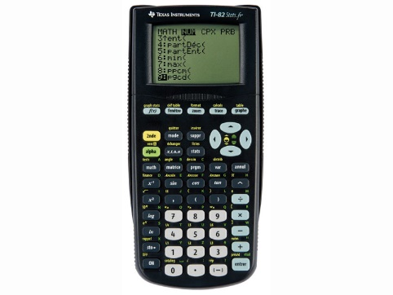
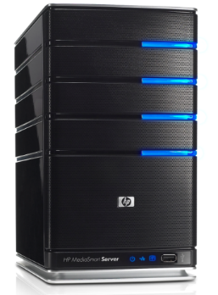
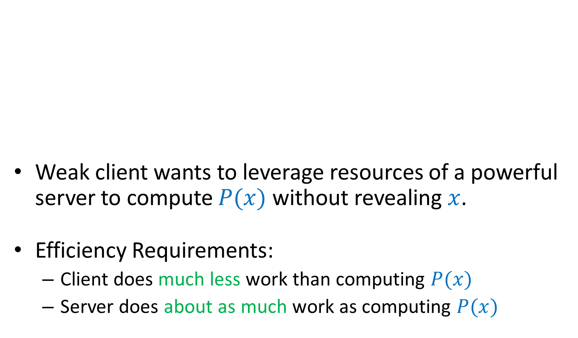


Problem Overview
$$x$$
Weak client wants to leverage resources of a powerful server to compute $P(x)$ without revealing $x$.
Efficiency Requirements:
Client does much less work than computing $P(x)$
Server does about as much work as computing $P(x)$
…
$$y=P(x)$$
Server
Client

Slide 3
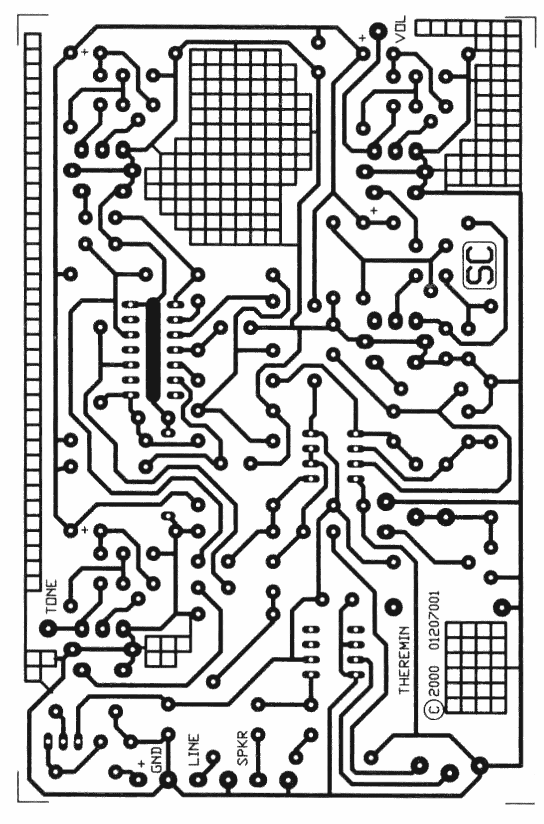
Use FHE! Done?
Private outsourcing is possible using Fully Homomorphic Encryption (FHE). [RAD78,Gen09,…]
But FHE works over circuits rather than RAM programs.
I’m very efficient!

Slide 4
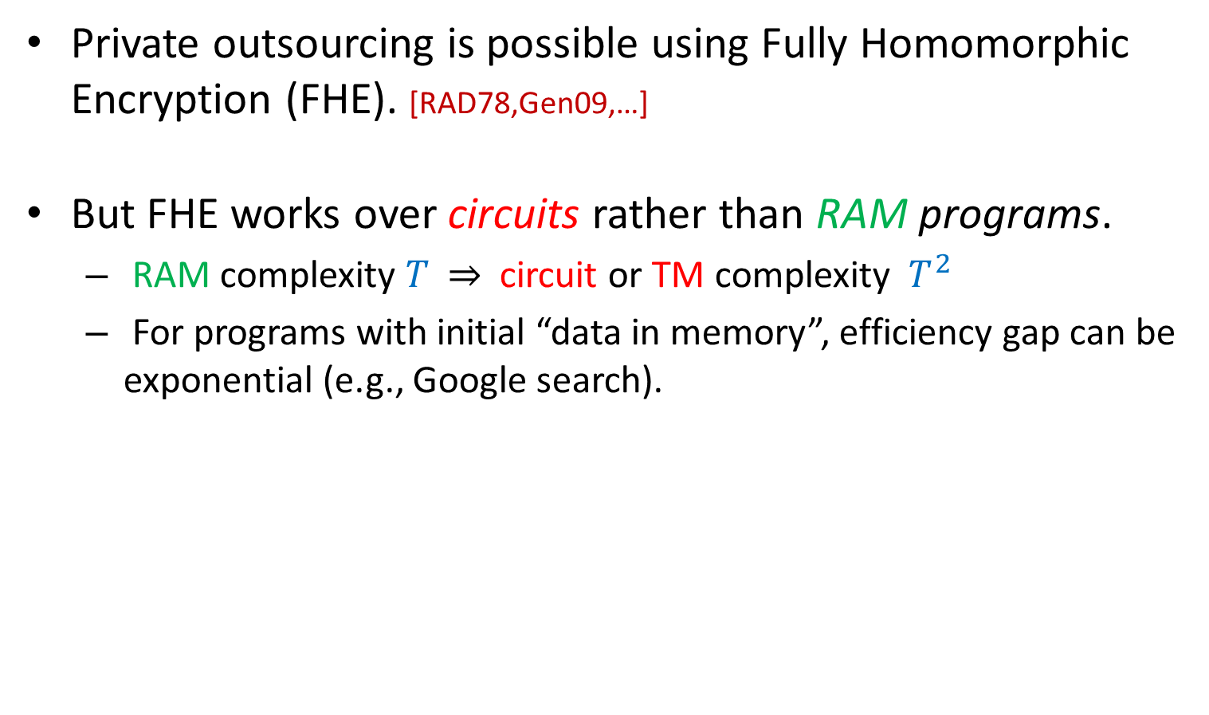
Circuits vs. RAM
Private outsourcing is possible using Fully Homomorphic Encryption (FHE). [RAD78,Gen09,…]
But FHE works over circuits rather than RAM programs.
RAM complexity $T$ $⇒$ circuit or TM complexity $T^{2}$
For programs with initial “data in memory”, efficiency gap can be exponential (e.g., Google search).

Slide 5
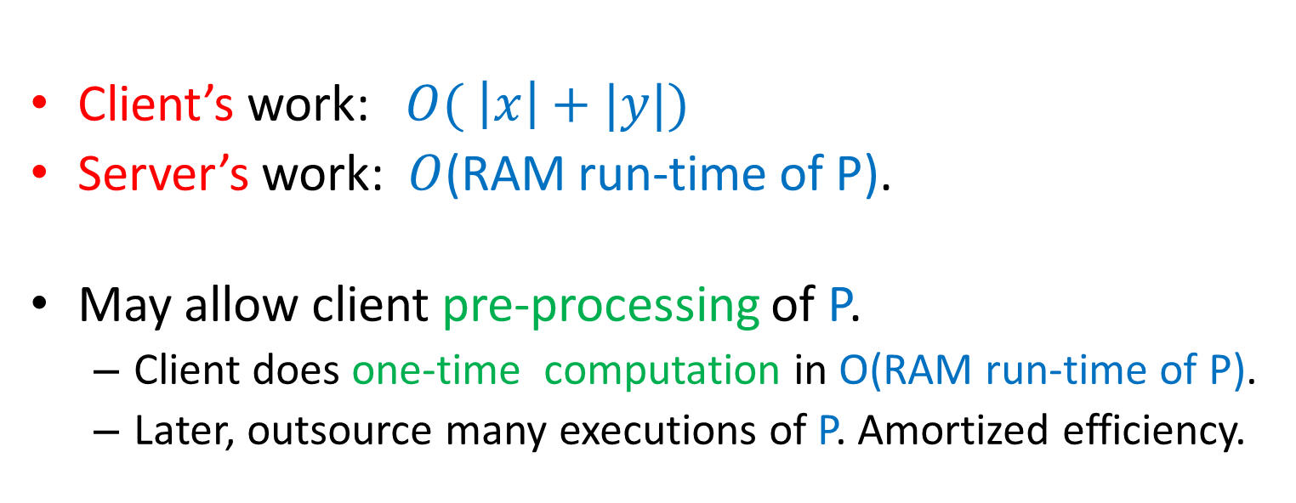

Goals
$$x$$
…
$$y=P(x)$$
Client
Server
Client’s work: $O( \left|x\right|+|y|)$
Server’s work: $O$(RAM run-time of P).
May allow client pre-processing of P.
Client does one-time computation in O(RAM run-time of P).
Later, outsource many executions of P. Amortized efficiency.

Slide 6

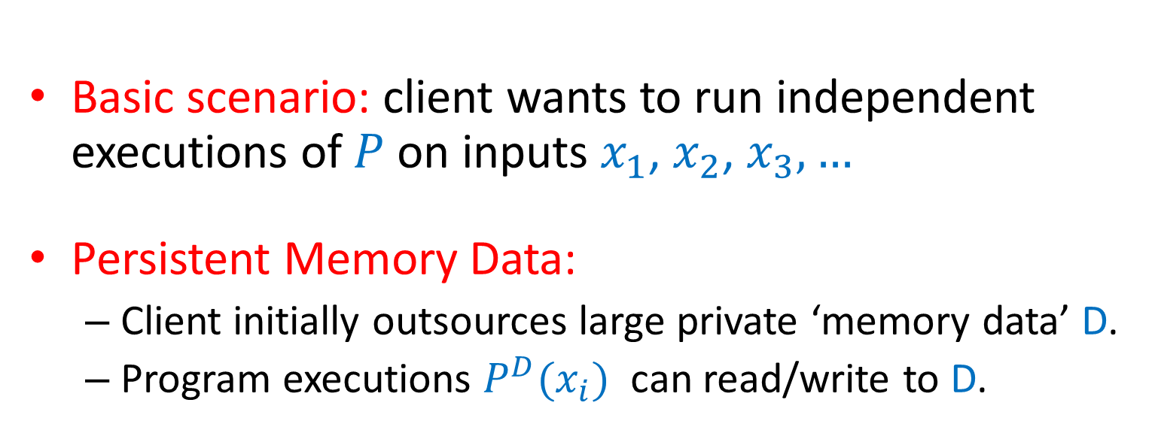
Goals
$$x$$
$$\tilde{D}$$
…
$$y=P(x)$$
Client
Server
Basic scenario: client wants to run independent executions of $P$on inputs $x_{1}$, $x_{2}$, $x_{3},…$
Persistent Memory Data:
Client initially outsources large private ‘memory data’ D.
Program executions $P^{D}(x_{i})$ can read/write to D.

Slide 7
Goals
Client
Server
Non-interactive solution: “reusable garbled RAM”.

Slide 8


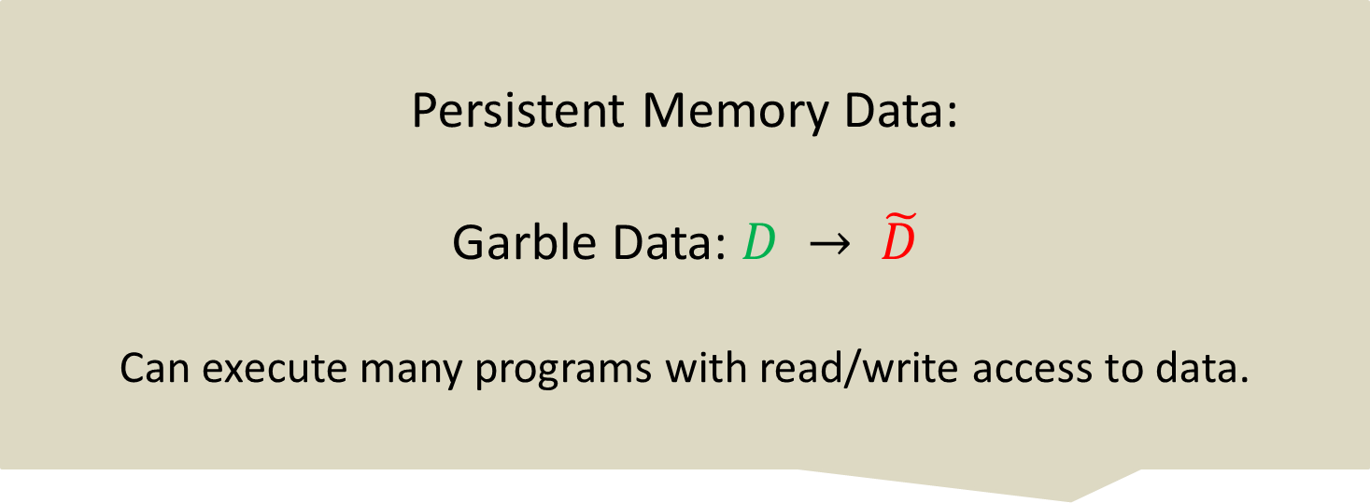
Garbled Computation
Persistent Memory Data:
Garble Data: $D → \tilde{D}$
Can execute many programs with read/write access to data.
Garbled Circuits
[Yao82]
Reusable Garbled Circuits
[GKPVZ 13a,b]
Garble circuit: $C → \tilde{C}$
Garble input: $x → \tilde{x}$
Given $\tilde{C},$ $\tilde{x}$ only reveals $C(x)$
Secure on one input $x$.
Can garble many inputs per circuit.
Efficiently outsource circuit comp.
Extension to TM.
Garbled RAM
[LO13, GHLORW14]
Reusable Garbled RAM
This Talk!
Garble RAM: $P → \tilde{P}$
Garble input: $x → \tilde{x}$
Size of $\tilde{P}$, run-time $\tilde{P}(\tilde{x})$ is O(RAM run-time $P$).
Can garble many inputs per program.
Efficiently outsource RAM comp.

Slide 9
Main Results
1-time Garbled RAM
+
Reusable Garbled RAM
Reusable Garbled Circuits
New security/efficiency requirements.
Instantiate with iO or Functional Rnc.

Slide 10
Main Result
with persistent data
1-time Garbled RAM
with persistent data
+
Reusable Garbled RAM
with persistent data
Reusable Garbled Circuits
Stronger security requirements.
Instantiate with “strong diO” (heuristic obf)

Slide 11
Without Persistent Data

Slide 12

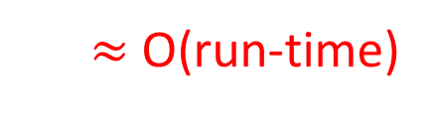
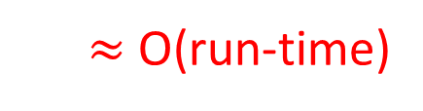
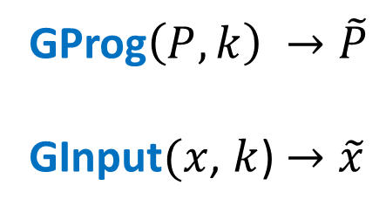
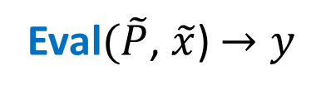
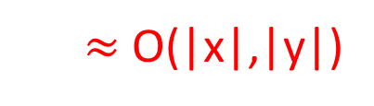
1-Time Garbled RAM Definition
without persistent data
View can be simulated given
y
GProg$\left(P,k\right) →\tilde{P}$
GInput$(x$, $k$) $→\tilde{x}$
$≈$ O(run-time)
$≈$ O(|x|,|y|)
Client
Server
secret: k
Eval$(\tilde{P}$, $\tilde{x}$) $→y$
$≈$ O(run-time)

Slide 13

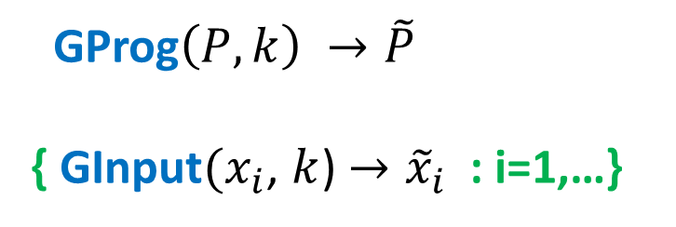
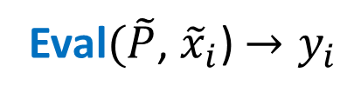
Reusable Garbled RAM Definition
without persistent data
View can be simulated given
$$y_{1},y_{2}…$$
GProg$\left(P,k\right) →\tilde{P}$
{ GInput$(x_{i}$, $k$) $→{\tilde{x}}_{i}$ : i=1,…}
Client
Server
secret: k
Eval$(\tilde{P}$, ${\tilde{x}}_{i}$) $→y_{i}$

Slide 14

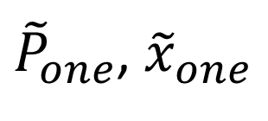
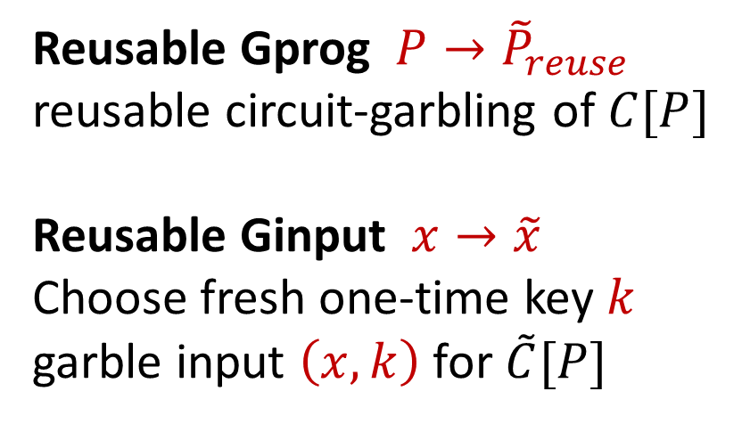

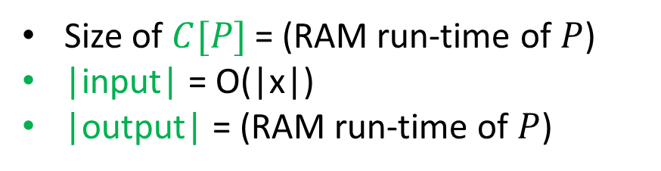
Construct reusable garbled RAM by combining:
one-time garbled RAM (GProg1, GInput1, GEval1)
reusable garbled circuits
${\tilde{P}}_{one}$, ${\tilde{x}}_{one}$
Reusable Gprog ${P→\tilde{P}}_{reuse}$
reusable circuit-garbling of $C[P]$
Reusable Ginput ${x→\tilde{x}}_{}$
Choose fresh one-time key $k$
garble input $\left(x,k\right)$ for $\tilde{C}[P]$
$C[P]${
GProg1$(P$; $k$) $→{\tilde{P}}_{one}$
GInput1$(x$, $k$) $→{\tilde{x}}_{one}$
}
Size of $C[P]$ = (RAM run-time of $P$)
|input| = O(|x|)
|output| = (RAM run-time of $P$)
$$x,k$$

Slide 15

Construct reusable garbled RAM by combining:
one-time garbled RAM (GProg1, GInput1, GEval1)
reusable garbled circuits
${\tilde{P}}_{one}$, ${\tilde{x}}_{one}$
Problem: In reusable garbled circuits of
[GKPVZ13], size of garbled input always exceeds size of circuit output.
Unfortunately: This is inherent. Cannot do better if want simulation security.
$C[P]${
GProg1$(P$; $k$) $→{\tilde{P}}_{one}$
GInput1$(x$, $k$) $→{\tilde{x}}_{one}$
}
Size of $C[P]$ = (RAM run-time of $P$)
|input| = O(|x|)
|output| = (RAM run-time of $P$)
$$x,k$$

Slide 16
Construct reusable garbled RAM by combining:
one-time garbled RAM (GProg1, GInput1, GEval1)
reusable garbled circuits
Solution:
Show that we do not need simulation-security for reusable garbled-circuits. A weaker notion suffices.
Construct reusable garbled-circuits with weaker security notion but better efficiency needed in construction.

Slide 17
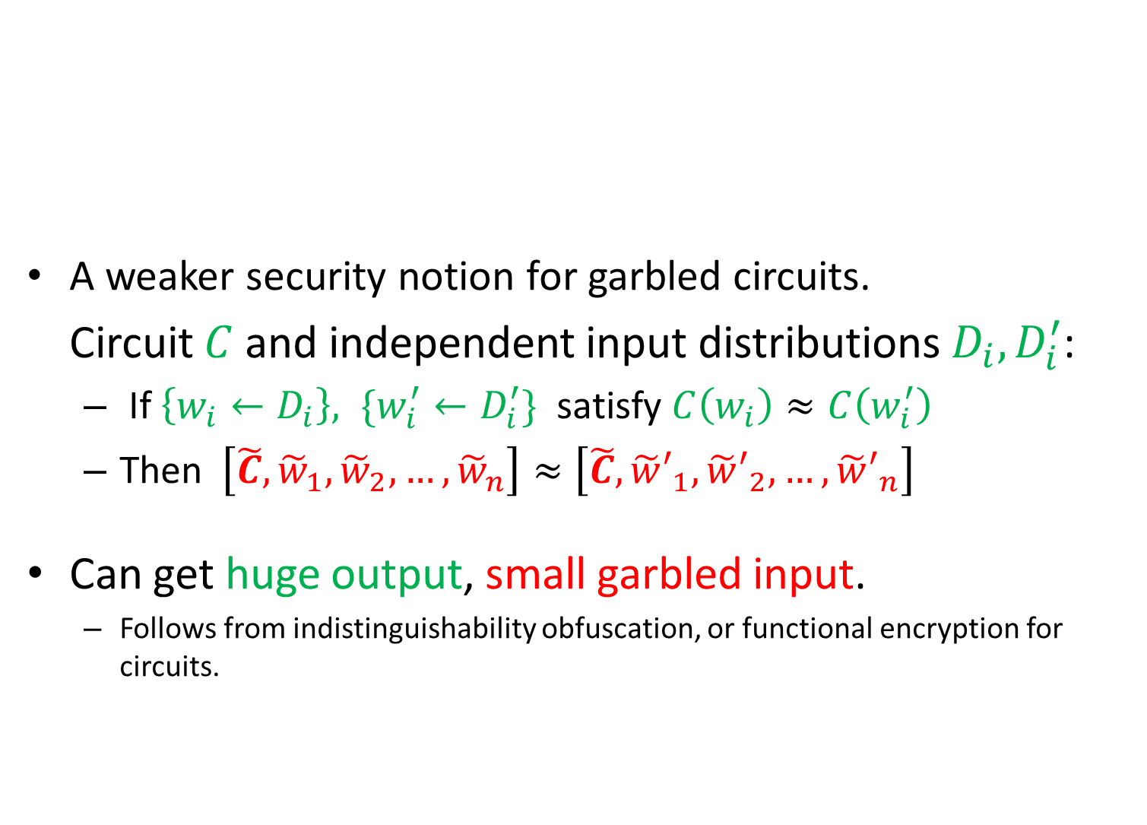
Distributional Indistinguishability
A weaker security notion for garbled circuits.
Circuit $C$ and independent input distributions $D_{i},D_{i}^{′}$:
If $\left\{w_{i}←D_{i}\right\}, \{w_{i}^{′}←D_{i}^{′}\}$ satisfy $C\left(w_{i}\right)≈C\left(w_{i}^{′}\right)$
Then $\left[\tilde{C}, {\tilde{w}}_{1},{\tilde{w}}_{2},…,{\tilde{w}}_{n}\right]≈\left[\tilde{C}, {\tilde{w}′}_{1},{\tilde{w}′}_{2},…,{\tilde{w}′}_{n}\right]$
Can get huge output, small garbled input.
Follows from indistinguishability obfuscation, or functional encryption for circuits.

Slide 18
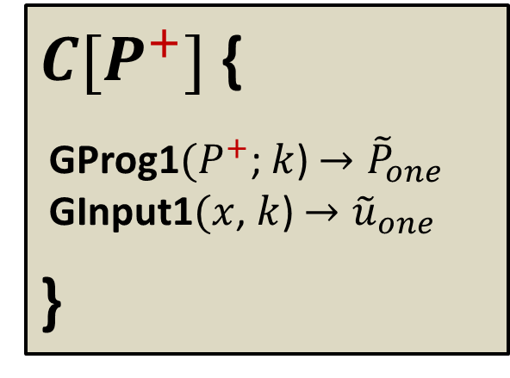
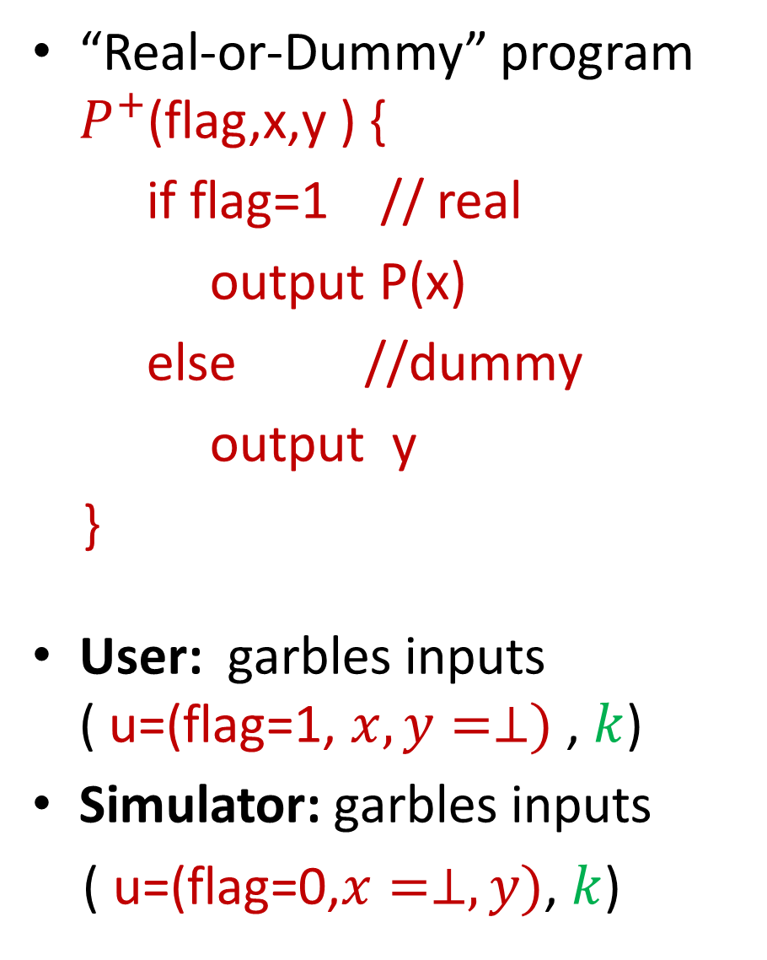
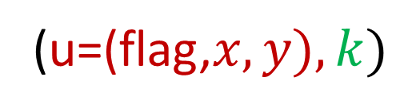


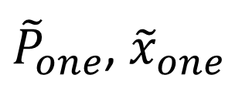

“Real-or-Dummy” program $P^{+}$(flag,x,y ) {
if flag=1 // real
output P(x)
else //dummy
output y
}
User: garbles inputs ( u=(flag=1, $x,y=⊥)$ , $k$)
Simulator: garbles inputs
( u=(flag=0,$x=⊥, y)$, $k$)
${\tilde{P}}_{one}$, ${\tilde{x}}_{one}$
${\tilde{P}}_{one}$, ${\tilde{u}}_{one}$
$C[P^{+}]${
GProg1$(P^{+}$; $k$) $→{\tilde{P}}_{one}$
GInput1$(x$, $k$) $→{\tilde{u}}_{one}$
}
$$u,$$
$$x,k$$
(u=(flag,$x,y), k)$

Slide 19
With Persistent Memory

Slide 20
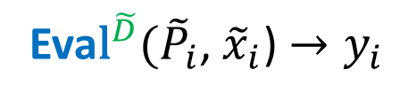
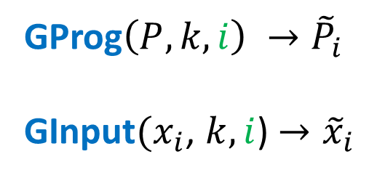

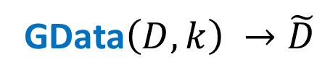
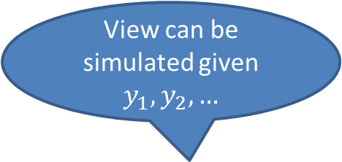
1-time Garbled RAM Definition
with persistent data
View can be simulated given $y_{1},y_{2},…$
GData$\left(D,k\right) →\tilde{D}$
$≈$ O(|D|)
GProg$\left(P,k,i\right) →{\tilde{P}}_{i}$
GInput$(x_{i}$, $k,i$) $→{\tilde{x}}_{i}$
$≈$ O(run-time)
Client
Server
secret: k
Eva${\text{l}}^{\tilde{D}}({\tilde{P}}_{i}$, ${\tilde{x}}_{i}$) $→y_{i}$
$≈$ O(run-time)

Slide 21
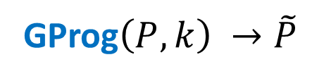

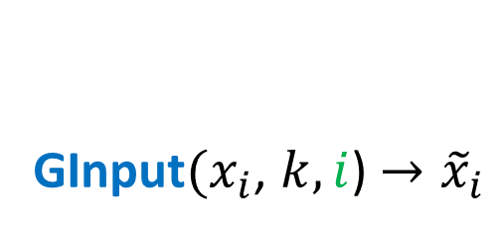
Reusable Garbled RAM Definition
with persistent data
View can be simulated given $y_{1},y_{2},…$
GData$\left(D,k\right) →\tilde{D}$
GProg$\left(P,k\right) →\tilde{P}$
GInput$(x_{i}$, $k,i$) $→{\tilde{x}}_{i}$
Client
Server
secret: k
Eva${\text{l}}^{\tilde{D}}(\tilde{P}$, ${\tilde{x}}_{i}$) $→y_{i}$

Slide 22
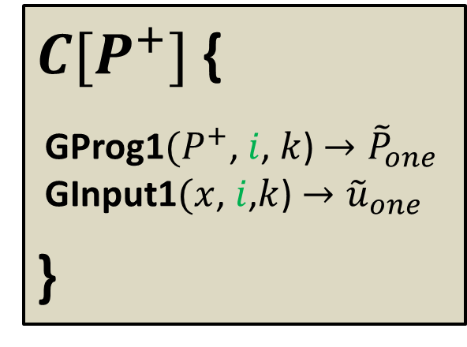
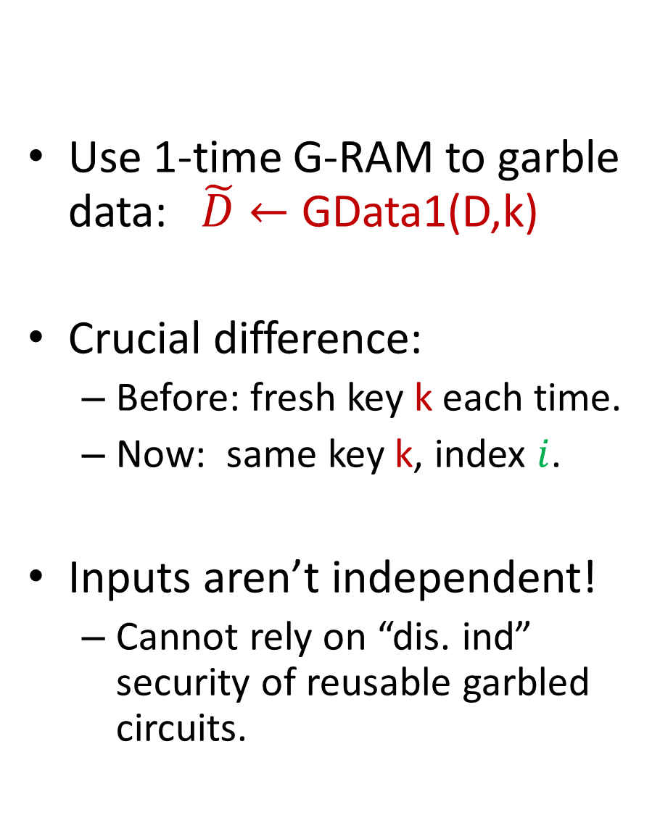
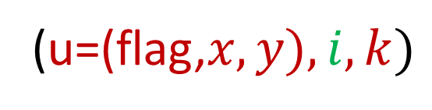



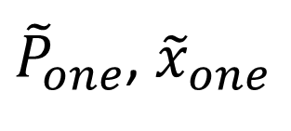

Use 1-time G-RAM to garble data: $\tilde{D}←$ GData1(D,k)
Crucial difference:
Before: fresh key k each time.
Now: same key k, index $i$.
Inputs aren’t independent!
Cannot rely on “dis. ind” security of reusable garbled circuits.
$$\tilde{D}$$
${\tilde{P}}_{one}$, ${\tilde{x}}_{one}$
${\tilde{P}}_{one}$, ${\tilde{u}}_{one}$
$C[P^{+}]${
GProg1$(P^{+}$, $i$, $k$) $→{\tilde{P}}_{one}$
GInput1$(x$, $i$,$k$) $→{\tilde{u}}_{one}$
}
$$u,$$
$$x,k$$
(u=(flag,$x,y), i,k)$

Slide 23
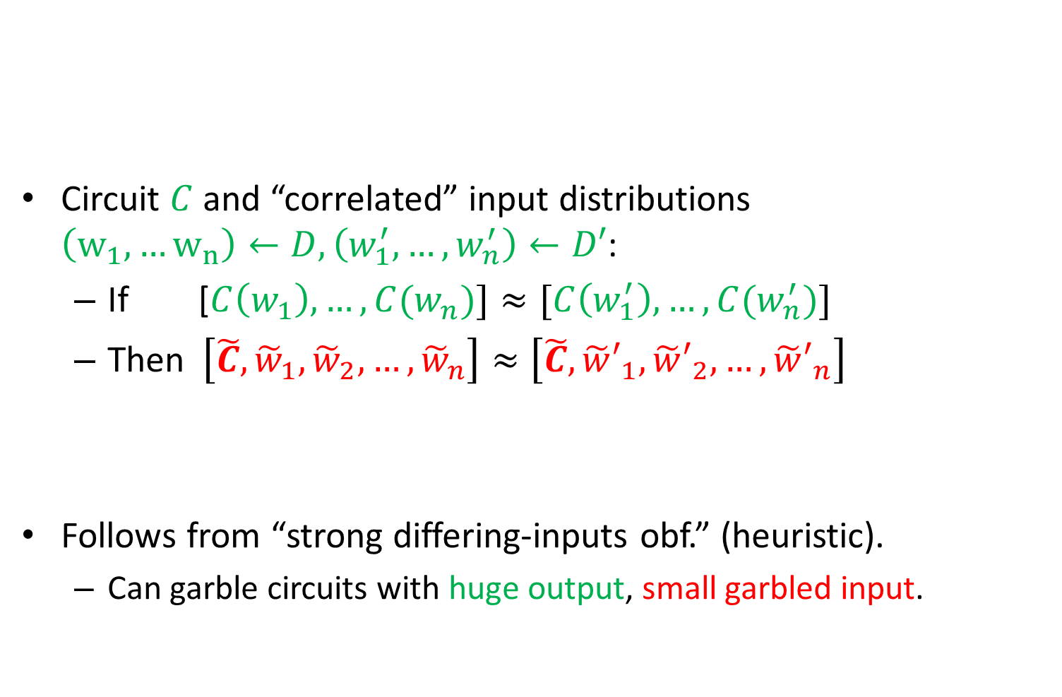
Correlated Distributional Indistinguishability
Circuit $C$ and “correlated” input distributions $\left(w_{1},…w_{n}\right)←D,\left(w_{1}^{′},…,w_{n}^{′}\right)←D′$:
If [$C\left(w_{1}\right),…,C(w_{n})]≈[C\left(w_{1}^{′}\right),…,C(w_{n}^{′})]$
Then $\left[\tilde{C}, {\tilde{w}}_{1},{\tilde{w}}_{2},…,{\tilde{w}}_{n}\right]≈\left[\tilde{C}, {\tilde{w}′}_{1},{\tilde{w}′}_{2},…,{\tilde{w}′}_{n}\right]$
Follows from “strong differing-inputs obf.” (heuristic).
Can garble circuits with huge output, small garbled input.

Slide 24
Theorem: Get reusable garbled RAM where:
Garble, evaluate program: O(RAM run-time P).
Garble input = O( input + output size).
assuming “ind. obfuscation” + stat. sound NIZK.
Theorem: Get reusable garbled RAM with persistent memory where:
garble data = O( data size)
garble program = O( description size P )
garble input = O( input + output size)
evaluate = O( RAM run-time P)
assuming “strong differing-inputs obfuscation” (heuristic).

Slide 25


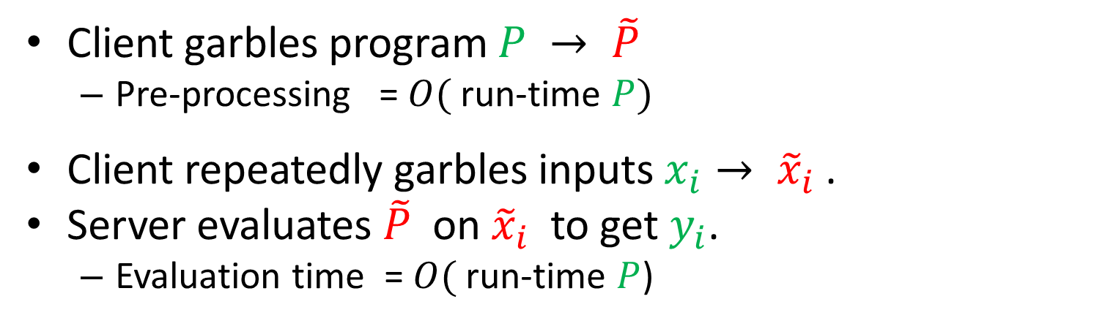

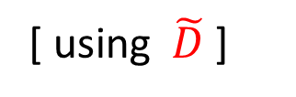
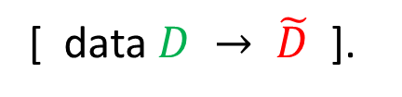
Outsourcing via Reusable G-RAM
$$\tilde{P}$$
$$\tilde{D}$$
$${\tilde{x}}_{i}$$
Client
Server
$$y_{i}=P(x_{i})$$
Client garbles program $P → \tilde{P}$
Pre-processing = $O($ run-time $P)$
Client repeatedly garbles inputs $x_{i}→ {\tilde{x}}_{i}$ .
Server evaluates $\tilde{P}$ on ${\tilde{x}}_{i}$ to get $y_{i}$.
Evaluation time = $O($ run-time $P$)
[ data $D → \tilde{D}$ ].
[ using $\tilde{D}$ ]

Slide 26
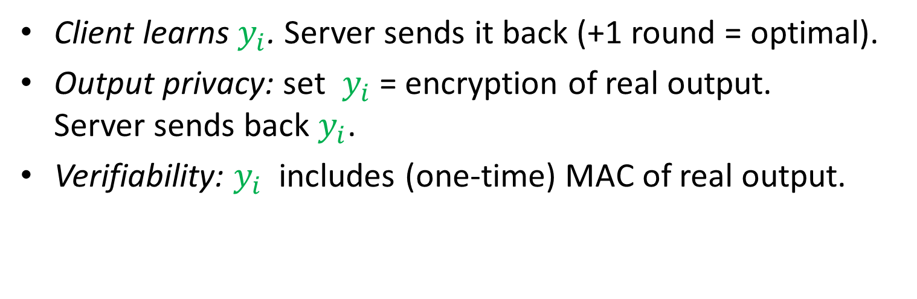

Outsourcing via Reusable G-RAM
$$\tilde{P}$$
$$\tilde{D}$$
$${\tilde{x}}_{i}$$
$y_{i}$
Client
Server
$$y_{i}=P(x_{i})$$
Client learns $y_{i}$. Server sends it back (+1 round = optimal).
Output privacy: set $y_{i}$ = encryption of real output. Server sends back $y_{i}$.
Verifiability: $y_{i}$ includes (one-time) MAC of real output.

Slide 27
Thank You!
Don’t turn me into a circuit!

