Slide 1
Support Vector Machines
Kernels
based on notes by Andrew Ng and Others

Slide 2
Problem definition:
-We are given a set of n points (vectors) :
such that is a vector of length m ,
and each belong to one of two classes we label them
by “+1” and “-1”.
-So our training set is:
- We want to find a separating hyperplane
that separates these points into the two classes.
“The positives” (class “+1”) and “The negatives” (class “-1”).
(Assuming that they are linearly separable)
So the decision function will be

Slide 3
Linear Separators
Which of the linear separators is optimal?

Slide 4
Classification Margin
Distance from example x_{i} to the separator is
Examples closest to the hyperplane are support vectors.
Margin ρ of the separator is the distance between support vectors.
ρ
r

Slide 5
Maximum Margin Classification
Maximizing the margin is good according to intuition and PAC theory.
Implies that only support vectors matter; other training examples are ignorable.

Slide 6
Linear SVM Mathematically
Let training set {(x_{i}, y_{i})}_{i=1..n}, x_{i}∈R^{d}, y_{i} ∈ {-1, 1} be separated by a hyperplane with margin ρ. Then for each training example (x_{i}, y_{i}):
For every support vector x_{s} the above inequality is an equality. After rescaling w and b by ρ/2 in the equality, we obtain that distance between each x_{s} and the hyperplane is
Then the margin can be expressed through (rescaled) w and b as:
w^{T}x_{i} + b ≤ - ρ/2 if y_{i} = -1
w^{T}x_{i} + b ≥ ρ/2 if y_{i} = 1
⇔
y_{i}(w^{T}x_{i} + b) ≥ ρ/2

Slide 7
Linear SVMs Mathematically (cont.)
Then we can formulate the quadratic optimization problem:
Which can be reformulated as:
Find w and b such that
is maximized
and for all (x_{i}, y_{i}), i=1..n : y_{i}(w^{T}x_{i} + b) ≥ 1
Find w and b such that
Φ(w) = ||w||²=w^{T}w is minimized
and for all (x_{i}, y_{i}), i=1..n : y_{i} (w^{T}x_{i} + b) ≥ 1

Slide 8
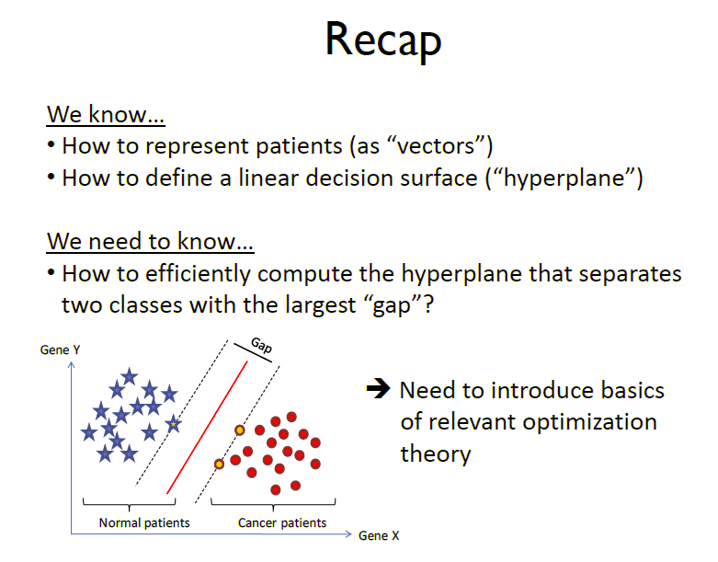

Slide 9
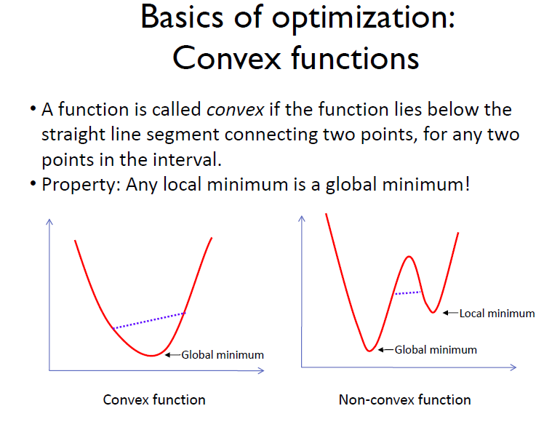

Slide 10
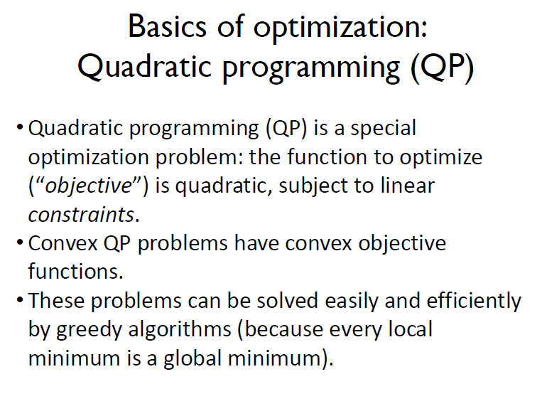

Slide 11
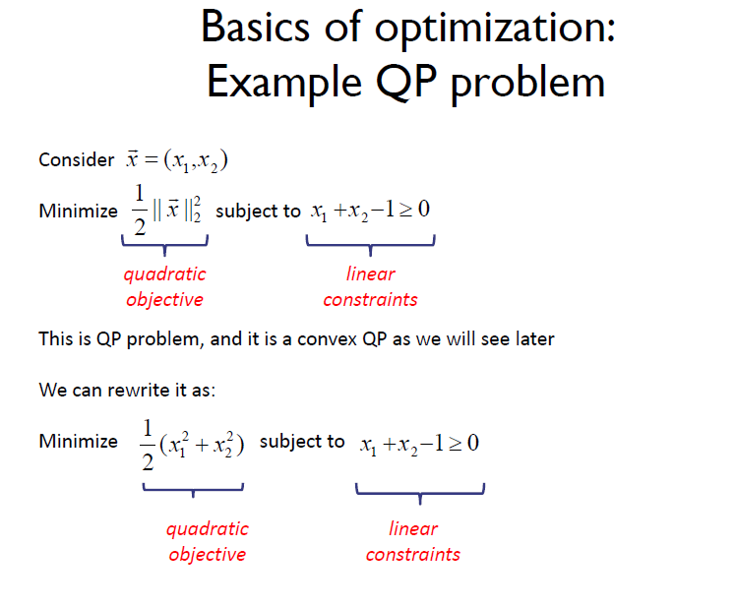

Slide 12
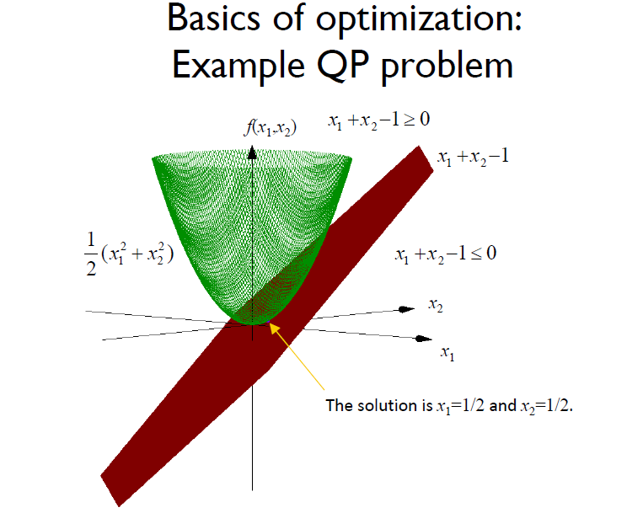

Slide 13

SVM : Linear separable case.
The optimization problem:
Our optimization problem so far:
I do remember the
Lagrange Multipliers from Calculus!
s.t.
-We will solve this problem by introducing Lagrange multipliers associated with the constrains:

Slide 14
constrained optimization
given convex functions f, g₁, g₂, ...., g_{k}, h₁, h₂, ...., hm
the problem
on convex set X,
minimize f (w)
subject to g_{i}(w) ≤ 0 ,for all i
h_{j} (w) = 0 ,for all j
has as its solution a convex is unique (if exists)
set.
If f is strict convex the solution
we will assume all the good things one can imagine about functions f, g₁, g₂, ...., g_{k}, h₁, h₂, ...., hm like convexity, differentiability etc.That will still not be enough though....

Slide 15
equality constraints only
minimize f (w)
subject to h_{j} (w) = 0 ,for all j
define the lagrangian function
L(w, β) = f (w) + ! β_{j}h_{j} (w)
j
Lagrange theorem nec[essary] and suff[icient] conditions for a point
w to be an optimum (ie a solution for the problem above) are the
"
existence of β" such that
δwL( "
w, β) = 0 ; δ
L(w, β) = 0
"
β
j
"
"

Slide 16
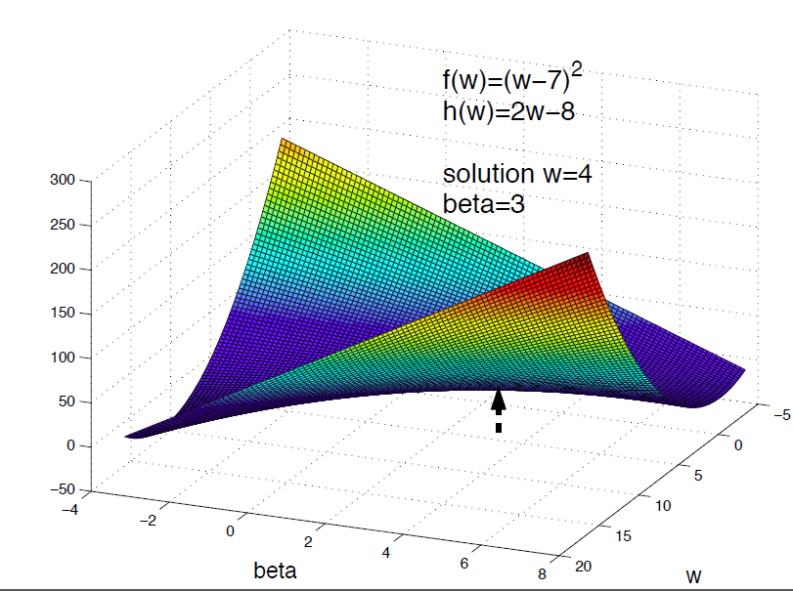
Saddle Point

Slide 18
inequality constraints
minimize f (w)
subject to g_{i}(w) ≤ 0 ,for all i
h_{j} (w) = 0 ,for all j
we can rewrite every inequality constraint h_{j} (x) = 0 as two inequalities
h_{j} (w) ≤ 0 and h_{j} (w) ≥ 0. so the problem becomes
minimize f (w)
subject to g_{i}(w) ≤ 0 ,for all i

Slide 19
Karush Kuhn Tucker theorem
minimize f (w)
subject to g_{i}(w) ≤ 0 ,for all i
were g_{i} are qualiﬁed constraints
define the lagrangian function
L(w, α) = f (w) + ! α_{i}g_{i}(w)
i
KKT theorem nec and suff conditions for a point w to be a solution
"
for the optimization problem are the existence of α" such that
δwL( "
w, α") = 0 ; α#_{i}g_{i}(w) = 0
"
g_{i}( "
w) ≤ 0 ; α#_{i} ≥ 0

Slide 20
KKT - sufficiency
Assume ( "
w, α") satisfies KKT conditions
δwL( "
w, α") = δwf (w) + ^{$k}
w) = 0
α#_{i}δwg_{i}( "
"
i=1
δ L w, α) = g_{i}(w) ≤ 0
α
i
( " " "
α#_{i}g_{i}( "
Then
w) = 0; α#_{i} ≥ 0
f (w) − f ( "
w) ≥ (δwf (w))^{T} (w − w) =
" "
— $_{k}
_{i=1} α#_{i}(δwg_{i}( "
w))^{T} (w − w) ≥ − ^{$k}
w
α#_{i}(g_{i}(w) − g_{i}( " )) =
"
i=1
— $_{k}
_{i=1} α#_{i}g_{i}(w) ≥ 0
so w is solution
"

Slide 21
saddle point
minimize f (w)
subject to g_{i}(w) ≤ 0 ,for all i
and the lagrangian function
L(w, α) = f (w) + ! α_{i}g_{i}(w)
i
w, α") with α#_{i} ≥ 0 is saddle point if ∀(w, α), α_{i} ≥ 0
( "
w, α) ≤ L(w, α") ≤ L(w, α") L( "
"

Slide 22
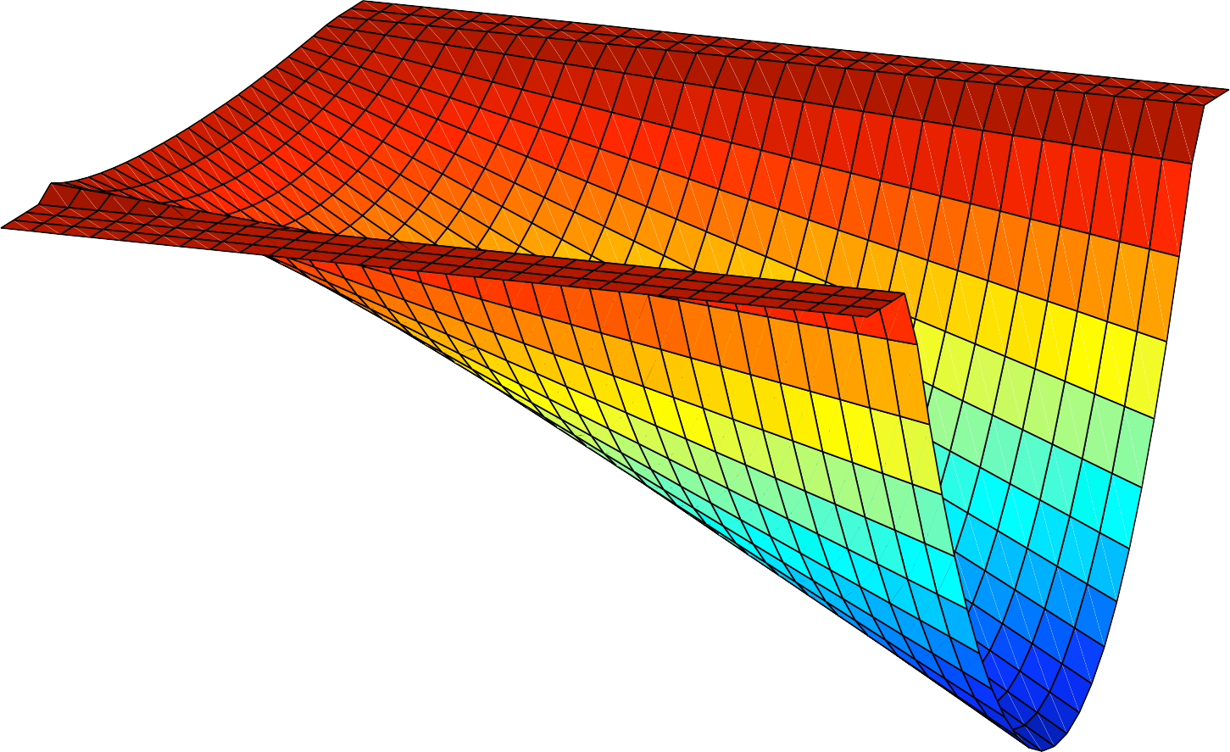
200
0
!200
!400
!600
!800
!1000
!10
!1200
!5
!1400
0
0
2
4
5
13
6
8
10
10
w
alpha

Slide 23
saddle point - sufficiency
minimize f (w)
subject to g_{i}(w) ≤ 0 ,for all i
lagrangian function L(w, α) = f (w) + $_{i} α_{i}g_{i}(w)
w, α") is saddle point
( "
∀(w, α), α_{i} ≥ 0 : L( " , α) ≤ L( " , α") ≤ L(w, α")
w w
then
1.w is solution to optimization problem
"
2.α#_{i}g_{i}(w) = 0 for all i
"

Slide 24
saddle point - necessity
minimize f (w)
subject to g_{i}(w) ≤ 0 ,for all i
were g_{i} are qualiﬁed constraints
lagrangian function L(w, α) = f (w) + $_{i} α_{i}g_{i}(w)
w is solution to optimization problem
"
then
∃α" ≥ 0 such that ( "
w, α") is saddle point
∀(w, α), α_{i} ≥ 0 : L( " , α) ≤ L( " , α") ≤ L(w, α")
w w

Slide 25
constraint qualifications
minimize f (w)
subject to g_{i}(w) ≤ 0 , for all i
let Υ be the feasible region Υ = {w|g_{i}(w) ≤ 0 ∀i}
then the following additional conditions for functions g_{i}
are connected (i) ⇔ (ii) and (iii) ⇒ (i) :
there exists w ∈ Υ such that g_{i}(w) ≤ 0 ∀i
for all nonzero α ∈ [0, 1)^{k} ∃w ∈ Υ such that α_{i}g_{i}(w) = 0 ∀i
the feasible region Υ contains at least two distinct elements, and
∃w ∈ Υ such that all g_{i} are are strictly convex at w w.r.t. Υ

Slide 26
Theoretical Justification for Maximum Margins
Vapnik has proved the following:
The class of optimal linear separators has VC dimension h bounded from above as
where ρ is the margin, D is the diameter of the smallest sphere that can enclose all of the training examples, and m₀ is the dimensionality.
Intuitively, this implies that regardless of dimensionality m₀ we can minimize the VC dimension by maximizing the margin ρ.
Thus, complexity of the classifier is kept small regardless of dimensionality.

Slide 27
Soft Margin Classification
What if the training set is not linearly separable?
Slack variables ξ_{i} can be added to allow misclassification of difficult or noisy examples, resulting margin called soft.
ξ_{i}
ξ_{i}

Slide 28
Soft Margin Classification Mathematically
The old formulation:
Modified formulation incorporates slack variables:
Parameter C can be viewed as a way to control overfitting: it “trades off” the relative importance of maximizing the margin and fitting the training data.
Find w and b such that
Φ(w) =w^{T}w is minimized
and for all (x_{i} ,y_{i}), i=1..n : y_{i} (w^{T}x_{i} + b) ≥ 1
Find w and b such that
Φ(w) =w^{T}w + CΣξ_{i} is minimized
and for all (x_{i} ,y_{i}), i=1..n : y_{i} (w^{T}x_{i} + b) ≥ 1 – ξ_{i,} , ξ_{i} ≥ 0

Slide 29
Soft Margin Classification – Solution
Dual problem is identical to separable case (would not be identical if the 2-norm penalty for slack variables CΣξ_{i}² was used in primal objective, we would need additional Lagrange multipliers for slack variables):
Again, x_{i} with non-zero α_{i} will be support vectors.
Solution to the dual problem is:
Find α₁…α_{N} such that
Q(α) =Σα_{i} - ½ΣΣα_{i}α_{j}y_{i}y_{j}x_{i}^{T}x_{j} is maximized and
(1) Σα_{i}y_{i} = 0
(2) 0 ≤ α_{i} ≤ C for all α_{i}
Again, we don’t need to compute w explicitly for classification:
w =Σα_{i}y_{i}x_{i}
b= y_{k}(1- ξ_{k}) - Σα_{i}y_{i}x_{i}^{T}x_{k} for any k s.t. α_{k}>0
f(x) = Σα_{i}y_{i}x_{i}^{T}x + b

Slide 30
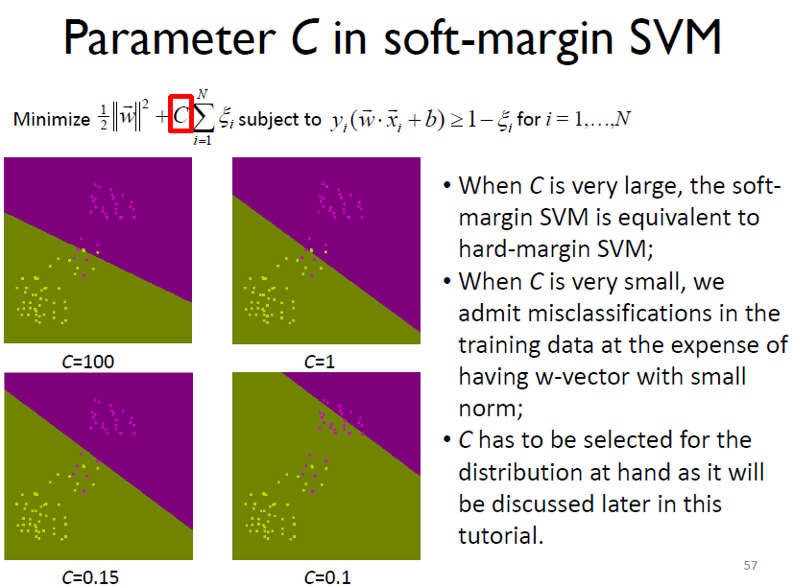

Slide 31
Non-linear SVMs
Datasets that are linearly separable with some noise work out great:
But what are we going to do if the dataset is just too hard?
How about… mapping data to a higher-dimensional space:
0
x
0
x
x²
0
x

Slide 32
Non-linear SVMs: Feature spaces
General idea: the original feature space can always be mapped to some higher-dimensional feature space where the training set is separable:
Φ: x → φ(x)

Slide 33
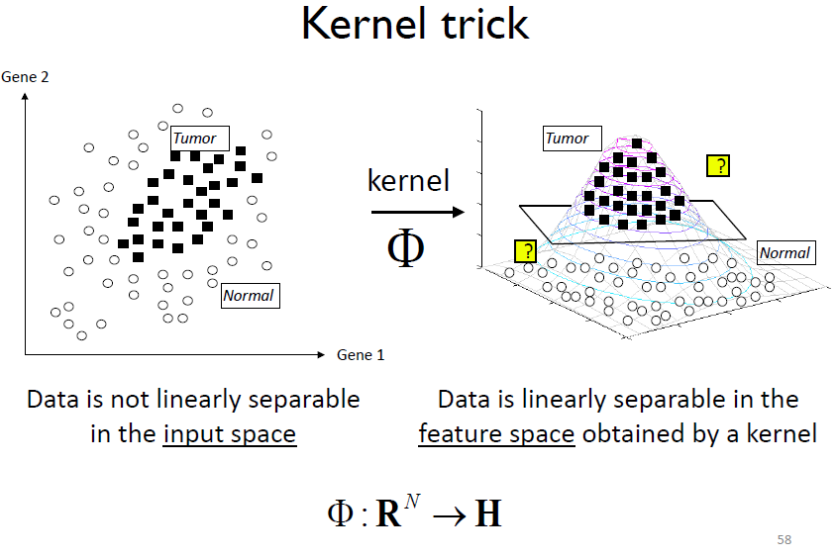

Slide 34
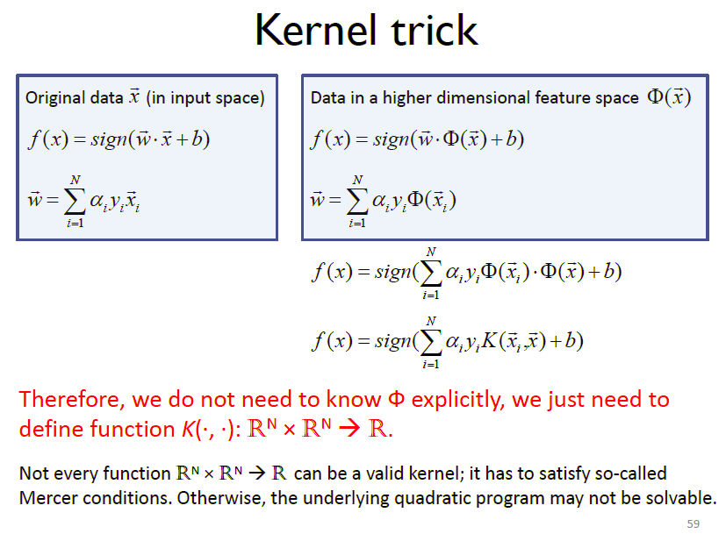

Slide 35
What Functions are Kernels?
For some functions K(x_{i},x_{j}) checking that K(x_{i},x_{j})= φ(x_{i}) ^{T}φ(x_{j}) can be cumbersome.
Mercer’s theorem:
Every semi-positive definite symmetric function is a kernel
Semi-positive definite symmetric functions correspond to a semi-positive definite symmetric Gram matrix:
K(x₁,x₁) | K(x₁,x₂) | K(x₁,x₃) | … | K(x₁,x_{N})
K(x₂,x₁) | K(x₂,x₂) | K(x₂,x₃) |  | K(x₂,x_{N})
… | … | … | … | …
K(x_{N},x₁) | K(x_{N},x₂) | K(x_{N},x₃) | … | K(x_{N},x_{N})
K=

Slide 36
Positive Definite Matrices
  A square matrix A is positive definite if x^{T}Ax>0 for all nonzero column vectors x.
  It is negative definite if x^{T}Ax < 0 for all nonzero x.
  It is positive semi-definite if x^{T}Ax ≥ 0.
  And negative semi-definite if x^{T}Ax ≤ 0 for all x.

Slide 37
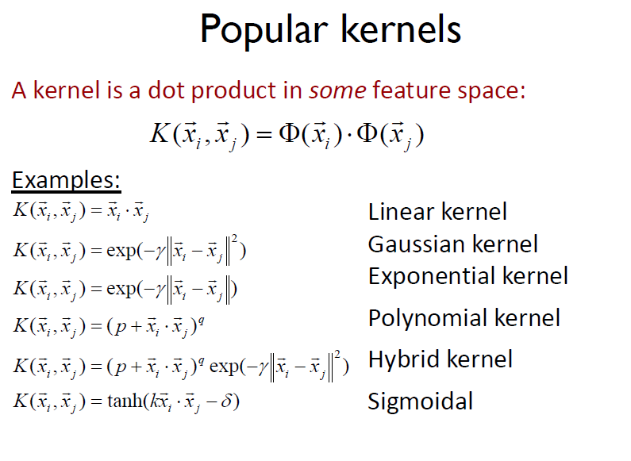

Slide 38
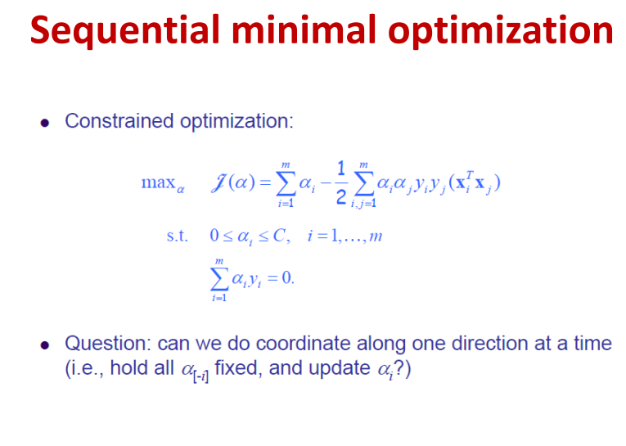

Slide 39
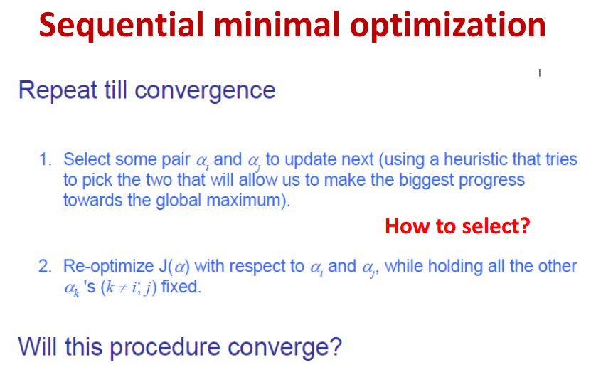

Slide 40
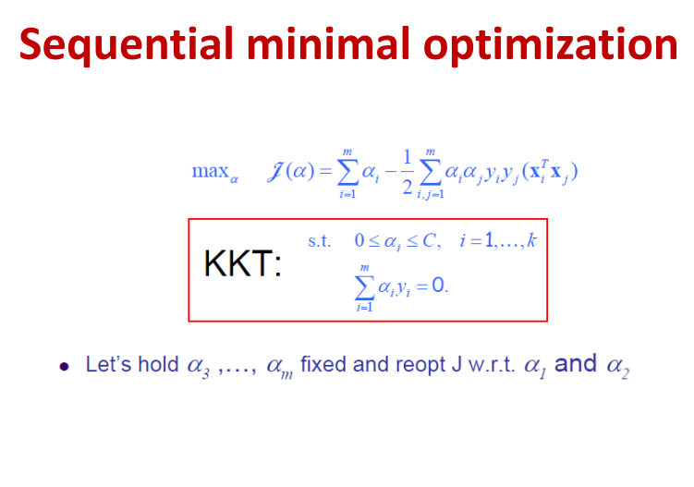

Slide 41
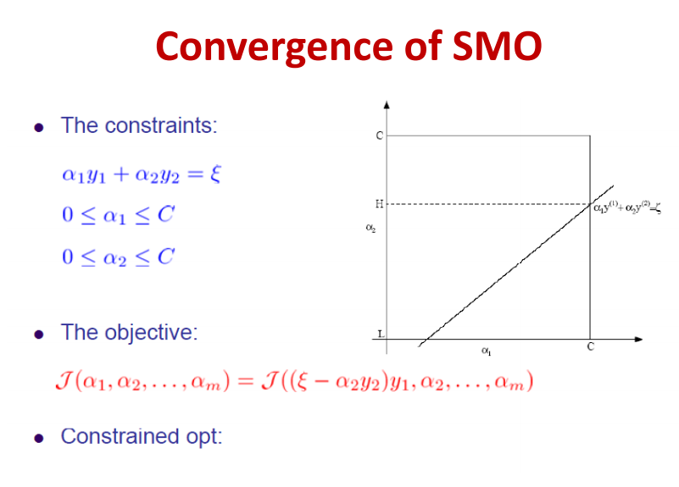

Slide 42
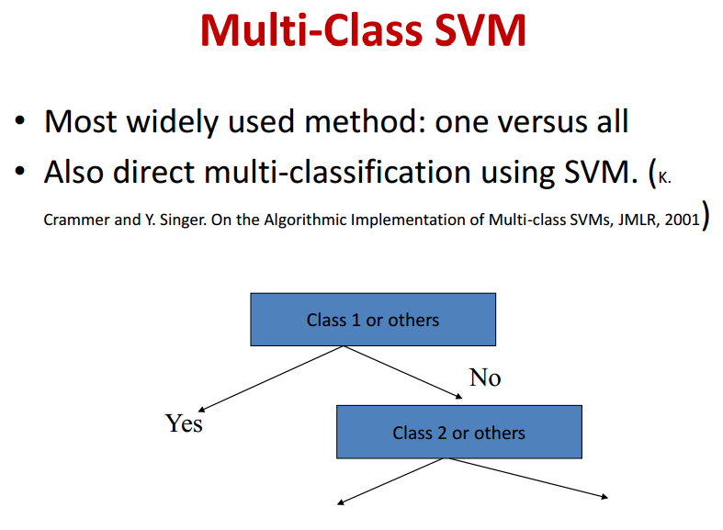

Slide 43
SVM For Multi-class classification: (more than two classes)
There are two basic approaches to solve q-class problems
( ) with SVMs ([10],[11]):
1- One vs. Others:
works by constructing a “regular” SVM for each class i that separates that class from all the other classes (class “ i” positive and “not i” negative). Then we check the output of each of the q SVM classifiers for our input and choose the class i that its corresponding SVM has the maximum output.
2-Pairwise (one vs one):
We construct “Regular” SVM for each pair of classes (so we construct q(q-1)/2 SVMs). Then we use “max-wins” voting strategy: we test each SVM on the input and each time an SVM chooses a certain class we add vote to that class. Then we choose the class with highest number of votes.

Slide 44
Interactive media and animations
SVM Applets
http://www.csie.ntu.edu.tw/~cjlin/libsvm/
http://svm.dcs.rhbnc.ac.uk/pagesnew/GPat.shtml
http://www.smartlab.dibe.unige.it/Files/sw/Applet%20SVM/svmapplet.html
http://www.eee.metu.edu.tr/~alatan/Courses/Demo/AppletSVM.html
http://www.dsl-lab.org/svm_tutorial/demo.html(requires Java 3D)
Animations
Support Vector Machines: http://www.cs.ust.hk/irproj/Regularization%20Path/svmKernelpath/2moons.avihttp://www.cs.ust.hk/irproj/Regularization%20Path/svmKernelpath/2Gauss.avihttp://www.youtube.com/watch?v=3liCbRZPrZA
Support Vector Regression: http://www.cs.ust.hk/irproj/Regularization%20Path/movie/ga0.5lam1.avi

Slide 45
SVM Implementations
LibSVM
SVMLight
Weka
Scikit-learn – Python
Others

