Slide 1
Decision Tree and Tree Ensemble
Cheng Li
Senior Data Scientist at CodaMetrix
chengli.email@gmail.com

Slide 2
supervised learning vs unsupervised learning
Unsupervised learning
(x_i), i=1,2,...,N
clustering (K-means, GMM), dimensionality reduction (PCA)
Supervised learning
(x_i, y_i), i=1,2,...,N
h(x_new)=y

Slide 3
classification vs regression
Classification
  y is a discrete label (e.g., cat vs dog, sport vs business vs politics)
  encode y as integers 1,2,...,K (in an arbitrary order)
  1=sport
  2=business
  3= politics
Regression
  y is a continuous label (e.g., car price)

Slide 4
Supervised learning
Step 1: h=fit_model((x_i,y_i)), i=1,2,...,N
Step 2: y_pred= h(x_new)
representation – how does h look like
e.g., logistic regression: linear model
inference/prediction – how to map x to y
e.g., predict positive if wx>0
training/learning – how to learn h
e.g., maximum likelihood estimation with gradient descent

Slide 5
Different types of features
Numerical: height, weight
Categorical: car_maker (audi, BMW, Ford, etc)
Ordinal feature: education level (high school, bachelor, master, Phd, etc)
One hot encoding for categorical features:
 | car_maker
car_1 | audi
car_2 | BMW
car_3 | Ford
car_4 | BMW
 | car_maker_audi | car_maker_BMW | car_maker_Ford
car_1 | 1 | 0 | 0
car_2 | 0 | 1 | 0
car_3 | 0 | 0 | 1
car_4 | 0 | 1 | 0

Slide 6
Topics for today
A new supervised machine learning model called decision tree
  For classification: decision tree classifier/ classification tree
  For regression: decision tree regressor/ regression tree
  representation
  prediction
  training (major focus)
Ensemble of Decision Trees
  Random forest
  Boosting

Slide 7
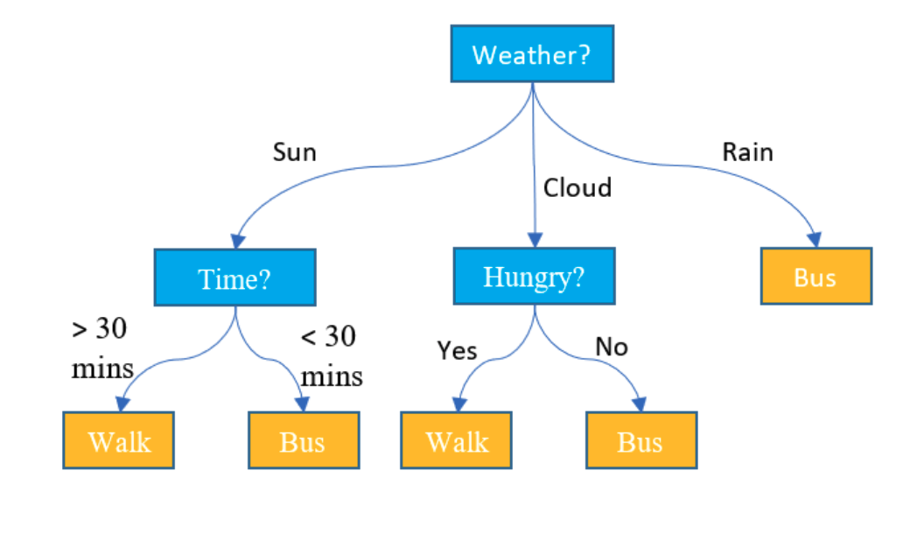
Decision tree classifier: an example
Walk to school or take a bus?
Image source: https://www.displayr.com/what-is-a-decision-tree/

Slide 8
Decision tree classifier: an example
root
Walk to school or take a bus?
split rule
leaf node
Image source: https://www.displayr.com/what-is-a-decision-tree/

Slide 9
Decision tree classifier: make prediction/decision
Walk to school or take a bus?
x=(sunny, 40mins, hungry), y = walk
x=(sunny, 20mins, not hungry), y = bus
x=(cloudy, 20mins, not hungry), y = walk
Image source: https://www.displayr.com/what-is-a-decision-tree/

Slide 10
classification tree: representation and prediction
a set of if-then rules
can handle both binary and multi-class classification
can handle numerical, ordinal and categorical features (directly or through one-hot encoding)
partition space into regions
decision boundary can be highly complex and non-linear
decision boundary is not smooth

Slide 11
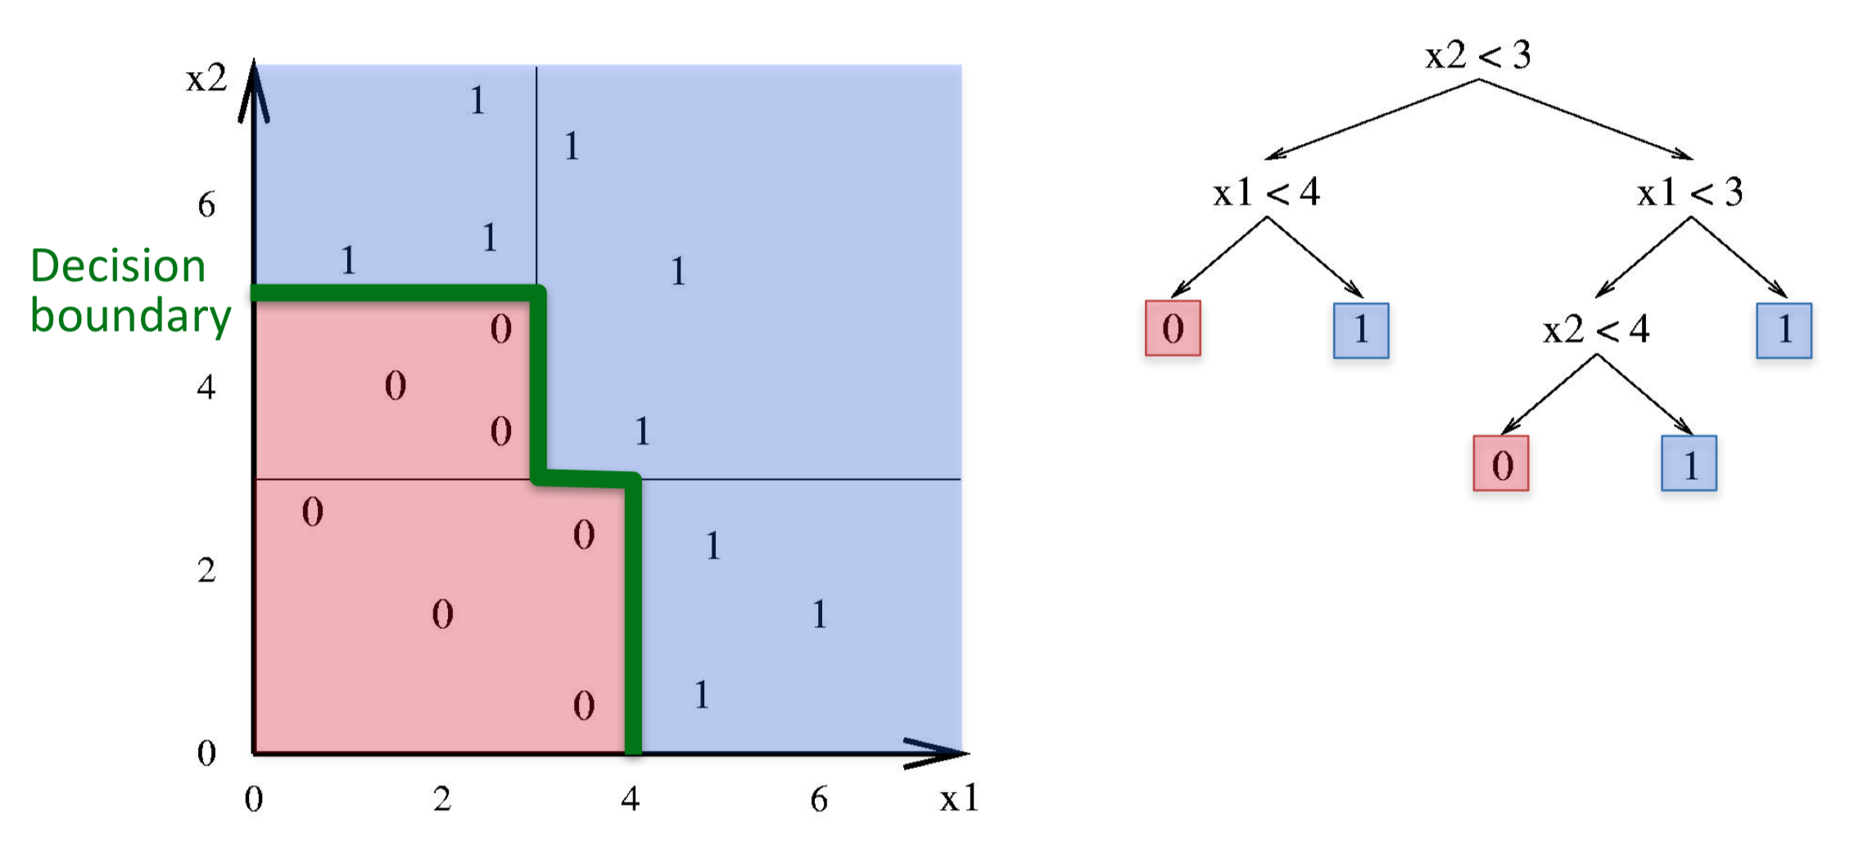
classification tree: representation and prediction
Divide feature space into axis-parallel rectangles and
output one label in each rectangle
Image source: https://www.cc.gatech.edu/~bboots3/CS4641-Fall2018/Lecture2/02_DecisionTrees.pdf

Slide 12
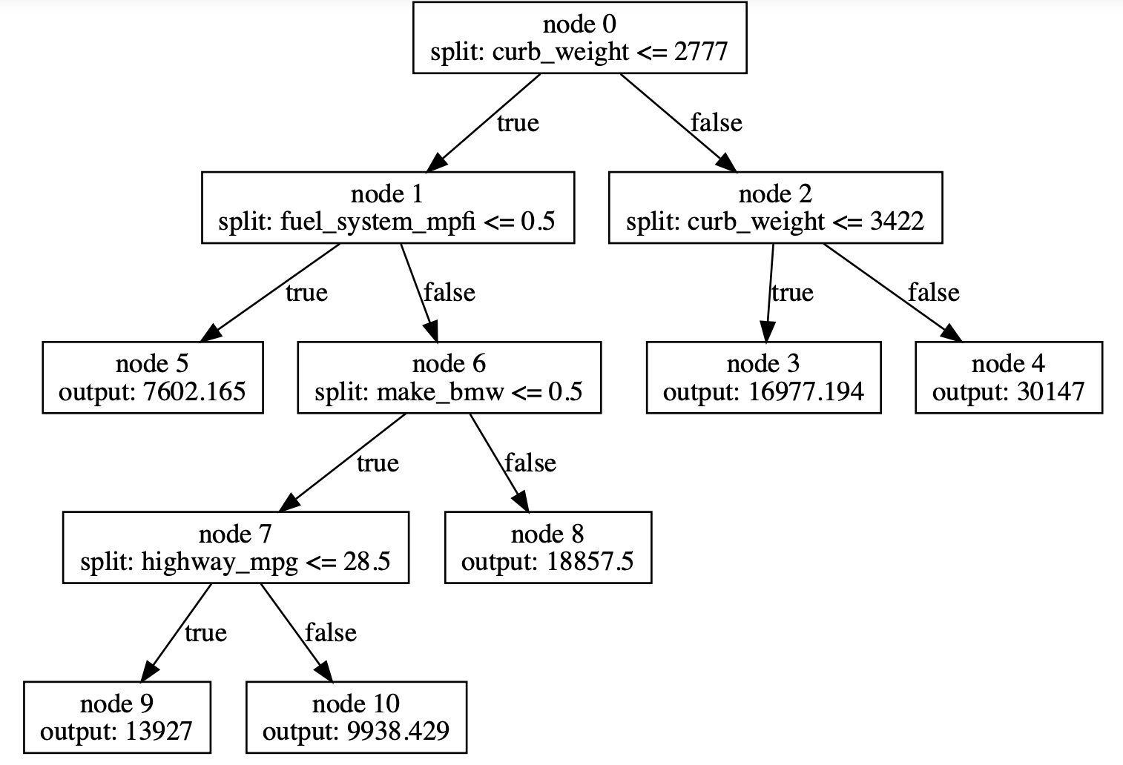
Regression Tree: example
Estimate car price
car=(curb weight=2337,
fuel_system=mpfi,
maker=ford,
highway_mpg=30,
num_doors=4,
body_style=sedan)
price predicted by tree =9938.429
note some features are not used

Slide 13
regression tree: representation and prediction
a set of if-then rules
can handle numerical, ordinal and categorical features (directly or through one-hot encoding)
partition space into regions
output a constant in each region
prediction function is not smooth

Slide 14
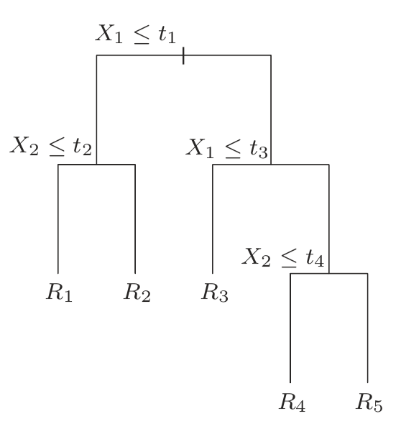
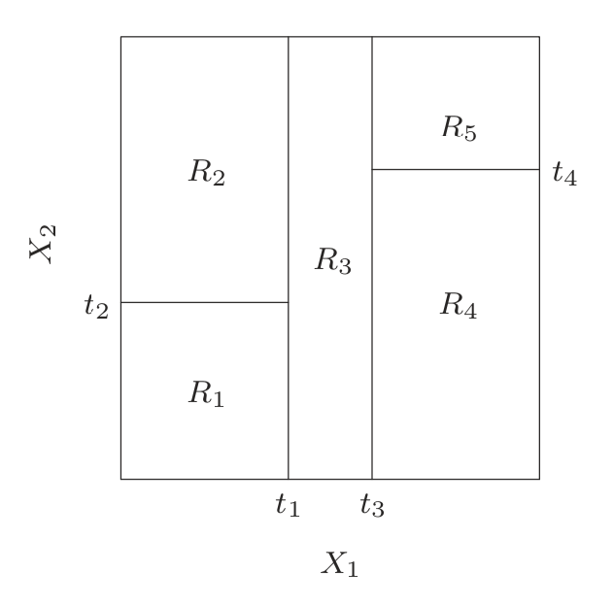
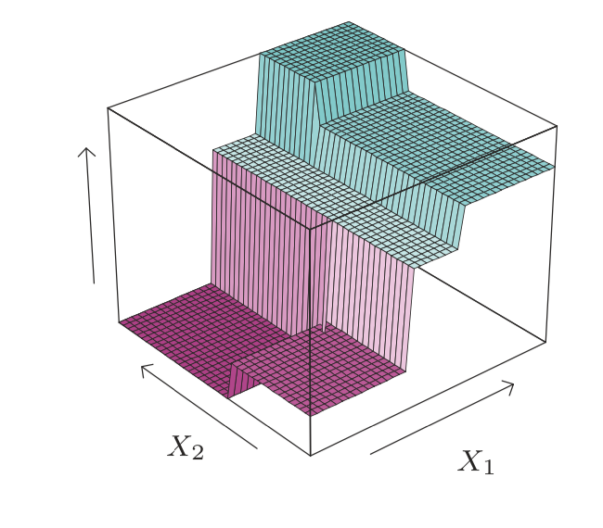
Regression Tree: representation and prediction
Figure from Hastie, Trevor, Robert Tibshirani, and Jerome Friedman. The elements of statistical learning: data mining, inference, and prediction. Springer Science & Business Media, 2009.

Slide 15
Decision Tree Training (major focus for today)
Regression Tree Training (slightly easier)
Classification Tree Training (similar, slightly harder)
Very different from logistic regression and neural network training!
Search based, not gradient-descent based

Slide 16
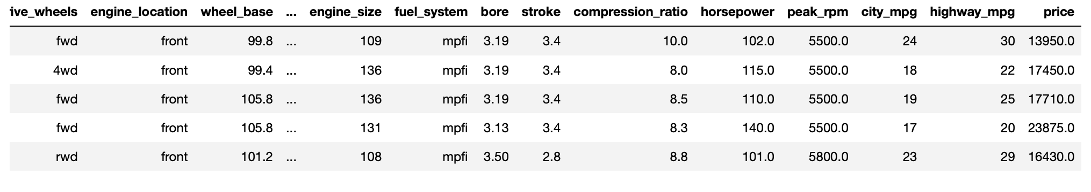
How to train a regression tree
Car price prediction data:
downloaded from https://archive.ics.uci.edu/ml/machine-learning-databases/autos/imports-85.data

Slide 17
How to train a regression tree
What do we need to figure out from data?
  tree structure
  node split criteria (feature and threshold)
  leaf node output
Goal: build a tree that fits the data well
fits the data well = has low squared error

Slide 18
How to compute the squared error
Dataset (x_i,y_i), i=1,2,...,N
regression tree: h
For each instance x_i, send it to the tree to get a prediction h(x_i)
Compute the squared error of the prediction
Sum over all instances

Slide 19
How to compute the squared error
feature_color | label | prediction | SE
red | 1 | 2 | (2-1)^2
red | 2 | 2 | (2-2)^2
green | 10 | 12.75 | (12.75-10)^2
green | 12 | 12.75 | (12.75-12)^2
red | 2 | 2 | (2-2)^2
green | 14 | 12.75 | (12.75-14)^2
red | 3 | 2 | (2-3)^2
green | 15 | 12.75 | (12.75-15)^2
root
color=green
color=red
output=12.75
labels=10,12,14,15
output=2
labels=1,2,2,3
total SE=16.75

Slide 20
How to compute the squared error
Since regression outputs a constant at each leaf node
We can also break down the error by leaf nodes
For each leaf node, look at all data falling into that leaf node, compute squared error at the node
Sum over all leaf nodes

Slide 21
How to compute the squared error
root
color=green
color=red
output=12.75
labels=10,12,14,15
output=2
labels=1,2,2,3
SE=(10-12.75)^2+(12-12.75)^2+(14-12.75)^2+(15-12.75)^2=14.75
SE=(1-2)^2+(2-2)^2+(2-2)^2+(3-2)^2=2
total SE=2+14.75=16.75

Slide 22
How to compute the squared error
Breaking down by instance is useful when we evaluate test set error
Breaking down by leaf node is useful during regression tree training

Slide 23
How to train a regression tree
Goal: find the tree with the lowest SE among all possible trees (up to certain size) .
KEY: group instances with similar labels to the same node
root
color=green
color=red
output=12.75
labels=10,12,14,15
output=2
labels=1,2,2,3

Slide 24
How to train a regression tree
Goal: find the tree with the lowest SE among all possible trees (up to certain size)
Finding the exact solution is hard.
Function not smooth -> gradient descent not applicable
Practical solution: a greedy search procedure with an exhaustive search subroutine
  Start at the root
  find a leaf node and split it into two nodes to reduce squared error as much as possible
  repeat

Slide 25
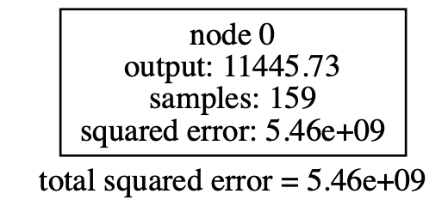
How to train a regression tree
Start with a single node
Output= average of all training labels (why?)

Slide 26
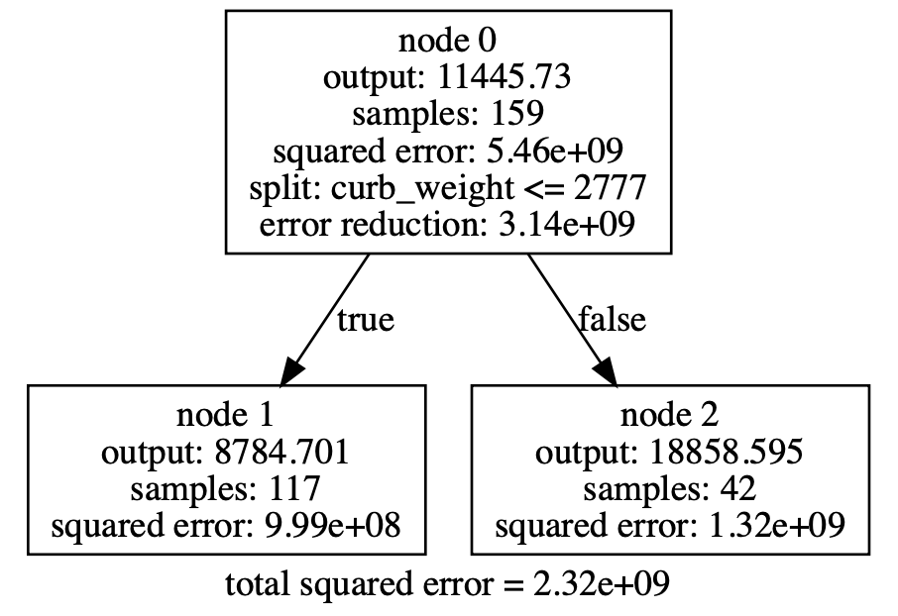
How to train a regression tree
Split node 0 into node 1 and node 2
Output of each leaf node = average of y in each node (why?)

Slide 27
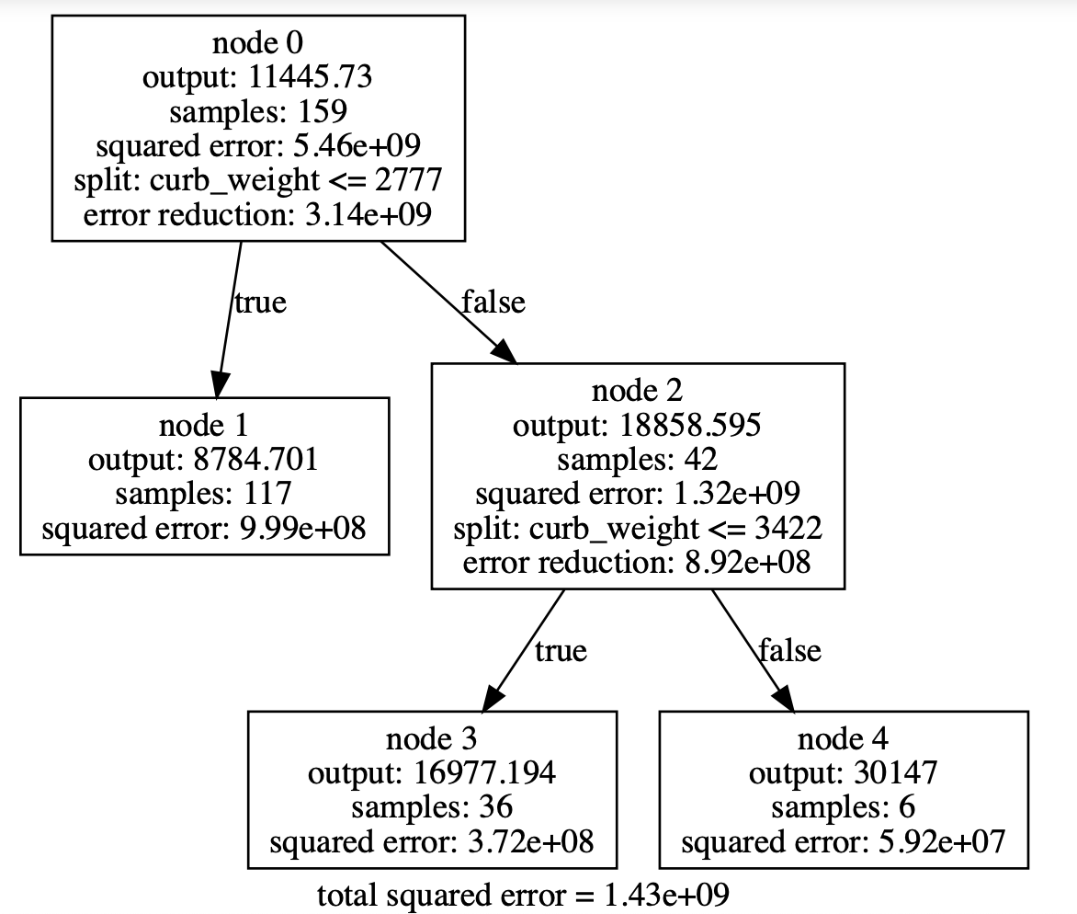
How to train a regression tree
Split node 2 into node 3 and node 4

Slide 28
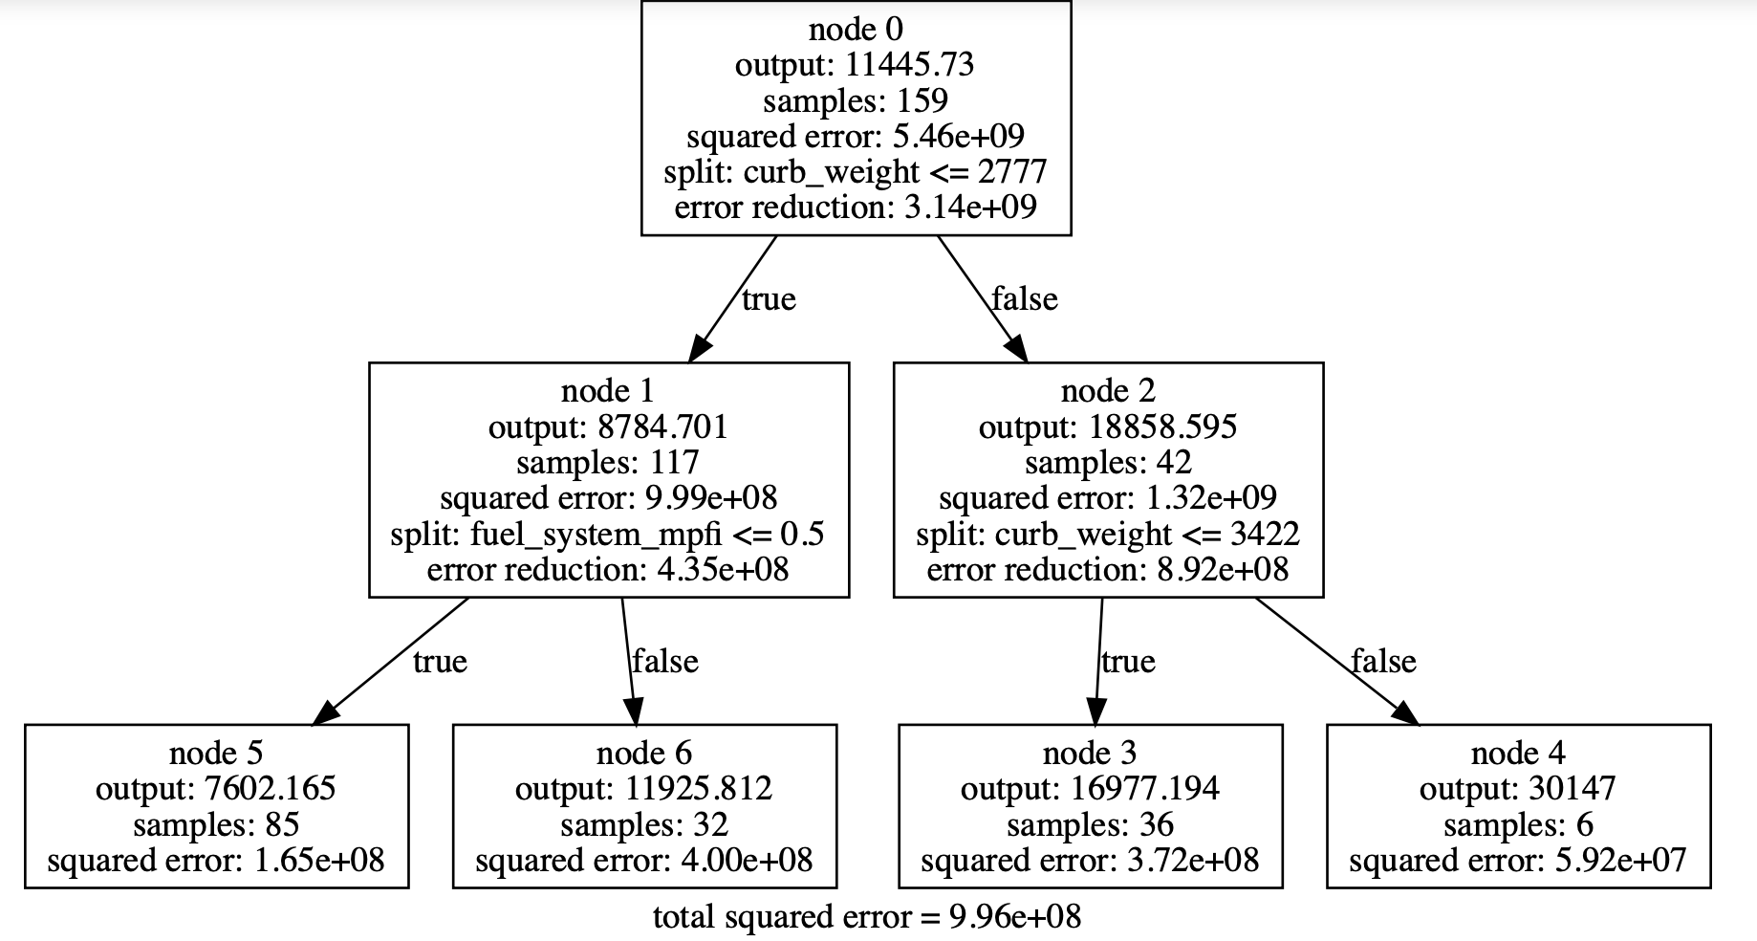
How to train a regression tree
Split node 1 into node 5 and node 6

Slide 29
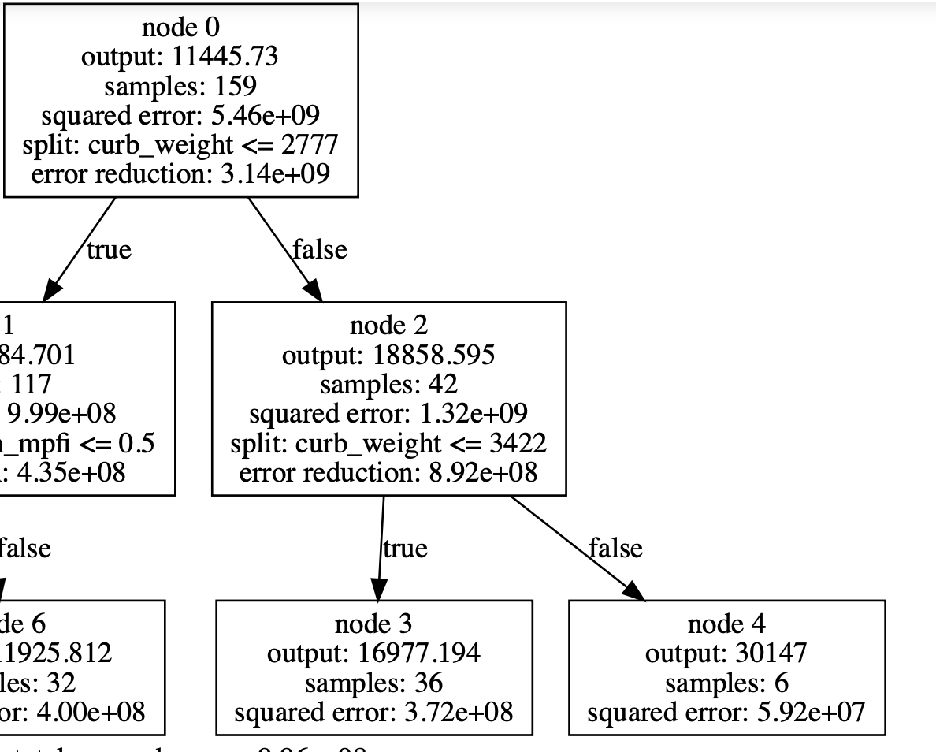
How to train a regression tree
Grow the tree by splitting one node into two nodes:
a split is defined by
(node, feature, threshold)
example:
split node #2 based on feature curb_weight at threshold 3422.0

Slide 30
How to train a regression tree
Greedy search: Instead of finding the best tree directly, we start with an existing tree and find the best node to add to the current tree
How to grow the tree by one node?
  Exhaustive search!
  Given the current tree, try all possible new trees by growing one node, and pick the tree with the lowest squared error
  (Equivalently), Given the current tree, try all possible splits at all leaf nodes with all possible features and thresholds, and pick the split
  (node, feature, threshold) with the highest error reduction of squared error

Slide 31
How to train a regression tree
def find_split(tree, data):
for each leaf node:
for each feature:
for each threshold:
compute the reduction of squared error if we were to split this
node based on this feature at this threshold
return (node, feature, threshold) with the highest error reduction

Slide 32
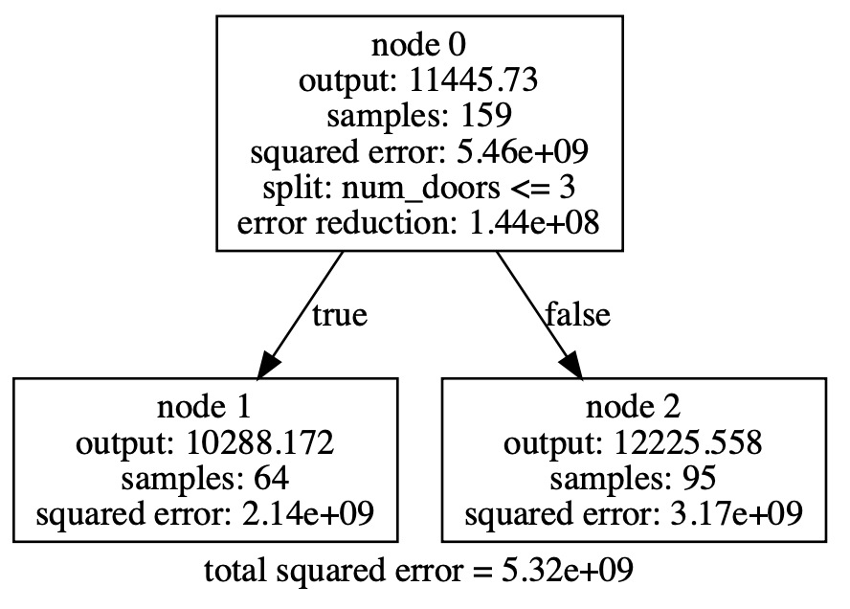
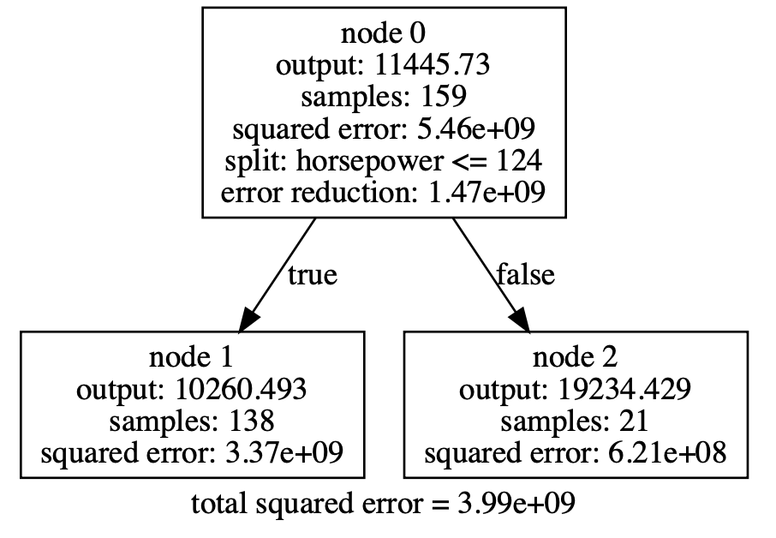

How to train a regression tree
Compare splits with different features
vs

Slide 33
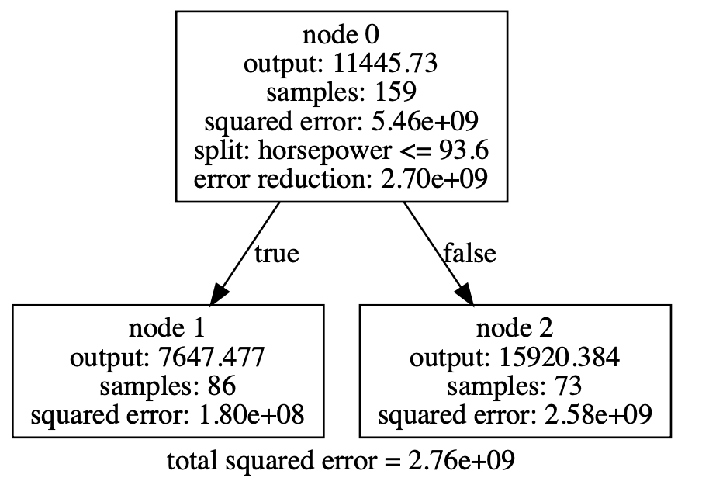
How to train a regression tree
Compare splits with the same feature but different thresholds
vs

Slide 34
How to train a regression tree
Exercise: prove reduction of squared error is always non-negative

Slide 35
How to train a regression tree
def fit_tree(data):
tree = Root( )
while(tree.size < desired size):
(node, feature, threshold) = find_split(tree, data)
split the selected node into 2 children based the selected feature
and threshold
set output of each new node to its average label
return tree
exhaustive search
greedy
search

Slide 36
How to train a regression tree
Efficient implementation
Store the best split found at each leaf node for later use
For a given feature, compute the squared errors at all thresholds within one scan of all values
  pre-sorting
  bucketing
Training Complexity = O(#instances x #features x #nodes)
If data is sparse: Complexity = O(#non-zeros x #nodes)

Slide 37
Regularization
Very deep trees give low training SE but high test SE due to overfitting
Max tree depth
Max # nodes
Min # samples per node
Terminate when reduction of SE is too small
Terminate when validation/test SE goes up

Slide 38
How to train a classification tree
Data = (x_i, y_i), i=1,2,...,N
y_i is a discrete class label
Similar to regression tree training:
Start with one node
Each time, split one node into two to reduce error
Try to group instances with the same label to the same node
Only 2 differences:
 | regression tree | classification tree
node output | average label | majority label
error reduction | squared error | entropy

Slide 39
How to train a classification tree
Entropy measures the uncertainty of a probability distribution
P=[p_1,p_2,...,p_K]
Note log is 2-based, and 0log0=0
Example: How much uncertainty is in the coin flip result?

Slide 40
How to train a classification tree
Entropy measures the uncertainty of a probability distribution
P=[p_1,p_2,...,p_K]
Note log is 2-based, and 0log0=0
Example:

Slide 41
How to train a classification tree
Compute entropy at a node
Suppose the dataset has 3 classes (k=1,2,3)
A node contains 5 samples from class 1, 4 samples from class 2, and 1 samples from class 3
label distribution P=[0.5, 0.4, 0.1]
Entropy of the node H(P) measures the impurity of the labels
10 samples
label count = [5, 4, 1]
label distribution=[0.5, 0.4, 0.1]
entropy = 1.361

Slide 42
How to train a classification tree
10 samples
label count = [5, 4, 1]
label distribution=[0.5, 0.4, 0.1]
entropy = 1.361
feature_1<=0.7
feature_1>0.7
6 samples
label count = [4, 1, 1]
label distribution=[0.67, 0.17, 0.17]
entropy = 1.256
4 samples
label count = [1, 3, 0]
label distribution=[0.25, 0.75, 0]
entropy = 0.811
Reduction of entropy (information gain)

Slide 43
How to train a classification tree
What not using reduction of classification error?
--it does not favor pure nodes
10 samples
label count = [5, 5]
label distribution=[0.5, 0.5]
entropy = 1
error=5
10 samples
label count = [5, 5]
label distribution=[0.5, 0.5]
entropy = 1
error=5
feature_1<=0.7
feature_1>0.7
feature_3<=2.5
feature_3>2.5
5 samples
label count = [4, 1]
label distribution=[0.8, 0.2]
entropy = 0.722
error=1
5 samples
label count = [1, 4]
label distribution=[0.2, 0.8]
entropy = 0.722
error=1
7 samples
label count = [5, 2]
label distribution=[0.714, 0.286]
entropy = 0.863
error=2
3 samples
label count = [0, 3]
label distribution=[0, 1]
entropy = 0
error=0
classification error reduction: 3 for both
entropy reduction: 0.278 for first split, and 0.396 for the second split

Slide 44
How to train a classification tree
Exercise: prove reduction of entropy is always non-negative

Slide 45
How to train a classification tree
def find_split(tree, data):
for each leaf node:
for each feature:
for each threshold:
compute the reduction of entropy if we were to split this
node based on this feature at this threshold
return (node, feature, threshold) with the highest error reduction

Slide 46
How to train a classification tree
def fit_tree(data):
tree = Root( )
while(tree.size < desired size):
(node, feature, threshold) = find_split(tree, data)
split the selected node into 2 children based the selected feature
and threshold
set output of each new node to its majority label
return tree

Slide 47
Advantages of Decision Tree
Interpretability
Fast training and prediction
Automatic feature selection
Handle mixed feature types
Insensitive to monotone transformations of inputs

Slide 48
Disadvantages of Decision Tree
Instability: a small change in the data can result in a very different tree. A change in the top split can affect all splits below it.
Lack of smoothness: piecewise constant
Difficulty in Capturing Additive Structure
Because of these reasons, people in practice use an ensemble of trees as opposed to a single tree.

Slide 49
Demo of implementation
Capture as much information as possible for debugging
feature, threshold, samples, squared error, reduction, etc
Export the tree to a text file and visualize it using a package (e.g., graphviz)
online tutorial: https://mljar.com/blog/visualize-decision-tree/

Slide 50
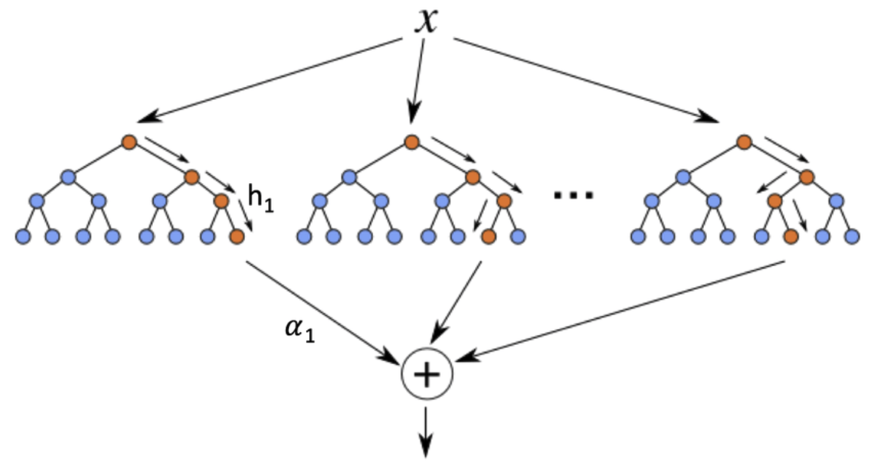
Ensemble of Trees
--average many tree predictions
Image source: https://www.researchgate.net/figure/Schematic-diagram-of-a-boosted-ensemble-of-decision-trees_fig2_325632132

Slide 51
Different types of tree ensembles
Random Forest
-- train many trees independently, each on a random subset of features and data points
Boosting
-- train many trees sequentially, the next tree is trained to fix errors made by previous trees
  Adaboost
  Gradient Boosting

Slide 52
Random forest
For k=1,2,...,K (in parallel):
  sample a subset of instances (with or without replacement) and subset of features
  train a tree h_k on sampled data
Final prediction
for regression: h_ensemble (x)= h_1(x) + h_2(x) + ... + h_K(x)
for classification: h_ensemble (x)= the label which gets predicted the most in h_1(x), h_2(x),..., h_K(x)

Slide 53
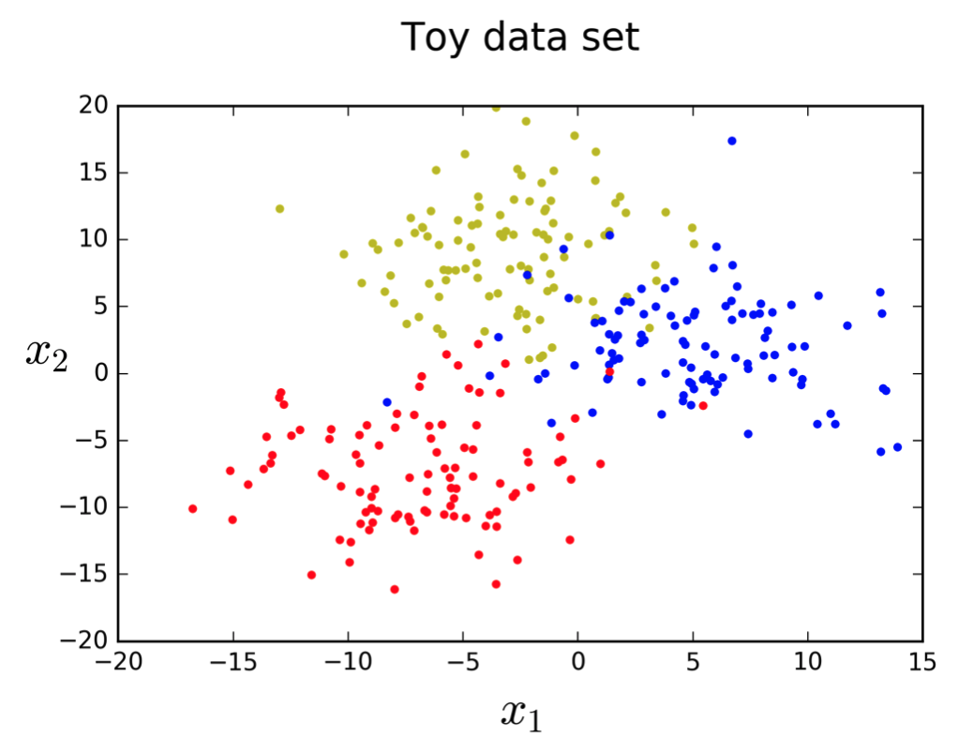
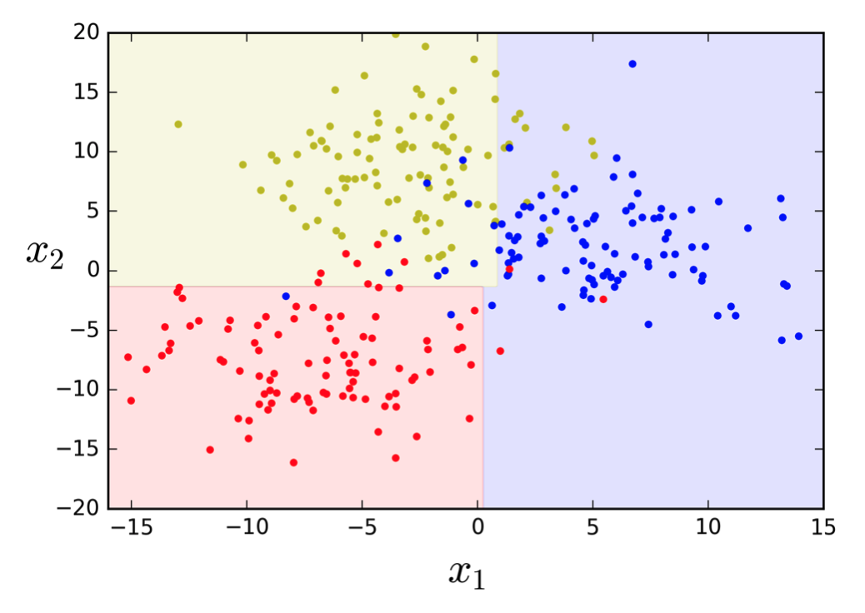
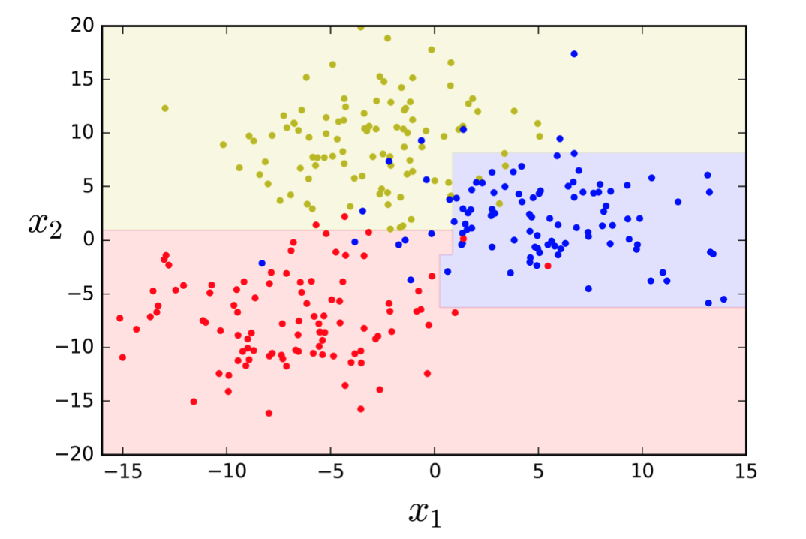
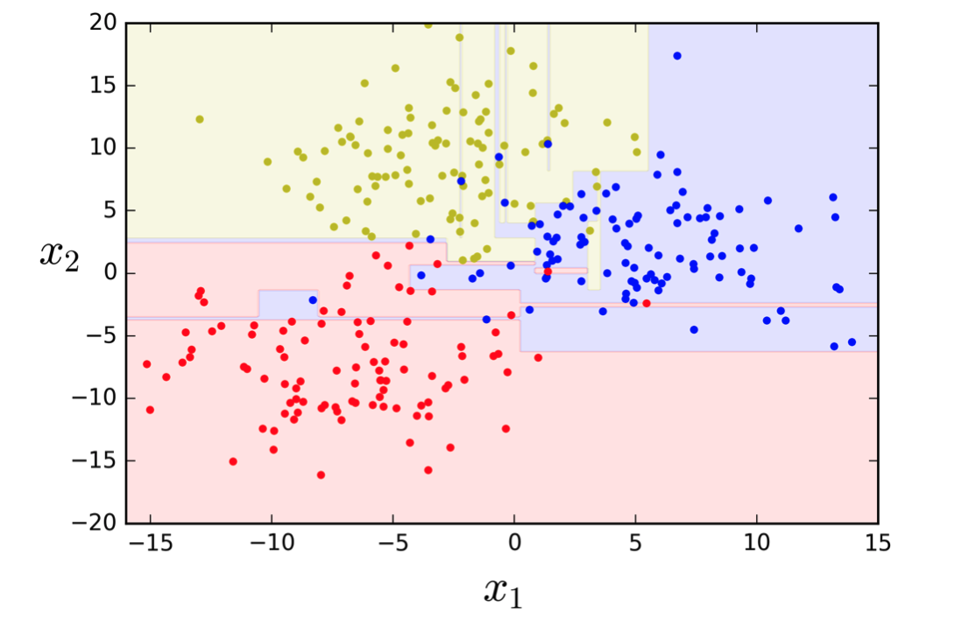
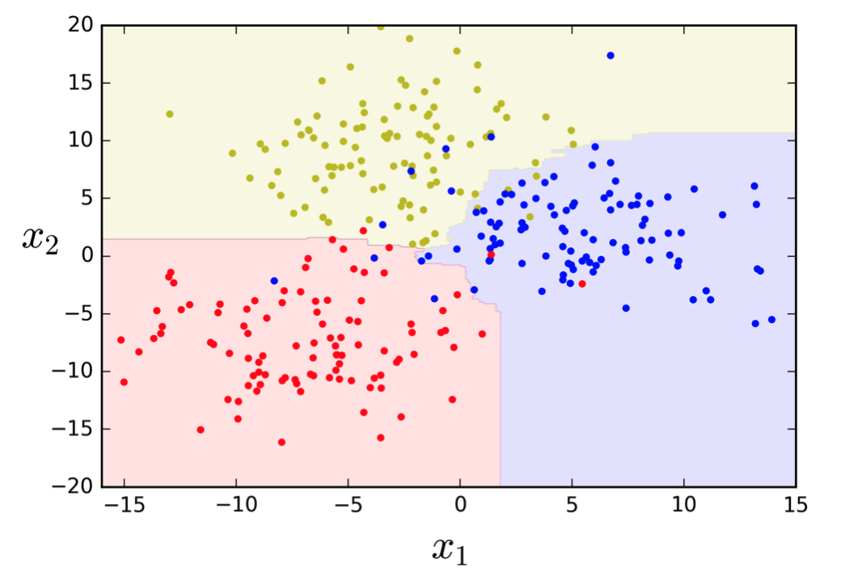
Why is ensemble better than a single tree?
shallow tree
deeper tree
very deep tree
random forest
Image source: http://luisvalesilva.com/datasimple/random_forests.html

Slide 54
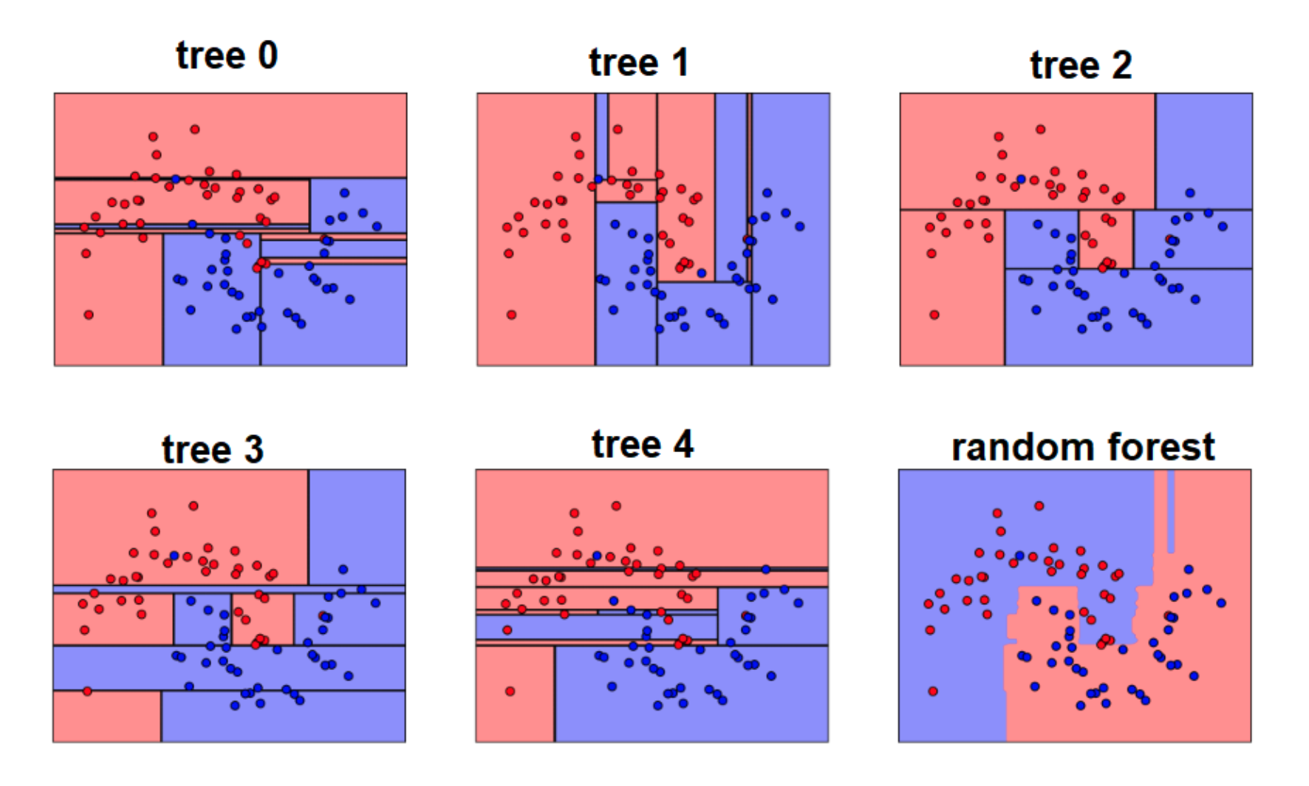
Why is ensemble better than a single tree?
Different trees have different boundaries
The average boundary is a lot more smooth
Image source: https://medium.com/@nadir.tariverdiyev/machine-learning-algorithms-ensemble-methods-bagging-boosting-and-random-forests-7d3df7adfab8

Slide 55
Adaboost for classification
Given a classification data set (x_i, y_i), i=1,2,...,N
assign a weight w_i to each data point
for k=1,2,...,K sequentially
  train a classification tree h_k on weighted data (w_i, x_i, y_i)
  adjust weight based on h_k:
  if h_k(x_i)=y_i, decrease w_i; otherwise increase w_i
h_ensemble (x)= the label which gets predicted the most in h_1(x), h_2(x),..., h_K(x)

Slide 56
Gradient boosting for regression
Given a regression data set (x_i, y_i), i=1,2,...,N
train the first tree h_1 on (x_i, y_i), i=1,2,...,N
train the second tree using the residual of the first tree as label
train h_2 on (x_i, y_i – h_1(x_i)), i=1,2,...,N
train the third tree using the residual of the first and the second trees as label
train h_3 on (x_i, y_i - h_1(x_i) – h_2(x_i)), i=1,2,...,N
repeat...
Final prediction
h_ensemble (x)= h_1(x) + h_2(x) +...+ h_K(x)

Slide 57
Gradient boosting for binary classification
slightly more complicated
similar to logistic regression: h(x)= 1 if score f(x)>0
prediction probability p(y=1|x) = 1/(1+exp(-f(x))
except that score f(x) = h_1(x)+h_2(x)+...+h_K(x) is from an ensemble of regression trees
train next regression tree to fit residual of predicted probability
train next h on (x_i, y_i – p(y=1|x_i))
For more details, see https://www.chengli.io/tutorials/gradient_boosting.pdf

Slide 58
Intuition about Ensemble
Ensemble reduces the variance (sometimes also bias) of the prediction
Ensemble works best when the trees are diverse and complementary to each other
Random forest produces diverse and complementary trees by training each tree on a different subset of samples/features ➔ different X
Adaboost produces diverse and complementary trees by forcing later trees to put more emphasis on examples misclassified by previous trees ➔ different weights/distributions of X
Gradient Boosting produces diverse and complementary trees by forcing later trees to fit residuals of previous trees ➔ different Y

Slide 59
When to Use Trees and Tree Ensembles
Tabular data
data with extracted numerical/categorical/ordinal features
(e.g., car price prediction and many Kaggle competitions)
→ use gradient boosting to win prize
Image, text, audio
→ use deep neural network instead

Slide 60
Questions?

