Slide 1
Access Final Fall 2014 Query 9
Karl Lieberherr

Slide 2
Query 9: how many courses have been taught by a single instructor during 2011.
Query plan
Select 2011 courses and their instructors. Then we only have to deal with CourseIDs and InstructorIDs. A nice reduction. Selection Pattern.
Eliminate duplicates because an instructor might have taught the same course several times. Required Elimination of Duplicates.
Count courses per instructor. CountForOther Pattern.
List courses who have one instructor. Selection Pattern.
Count those courses. CountForSelf Pattern.

Slide 3
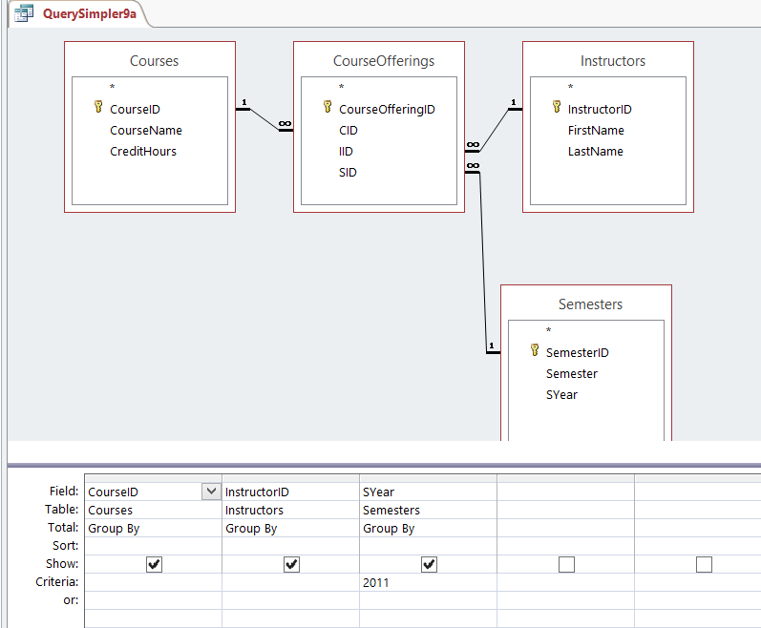
Combines steps 1 and 2.

Slide 4
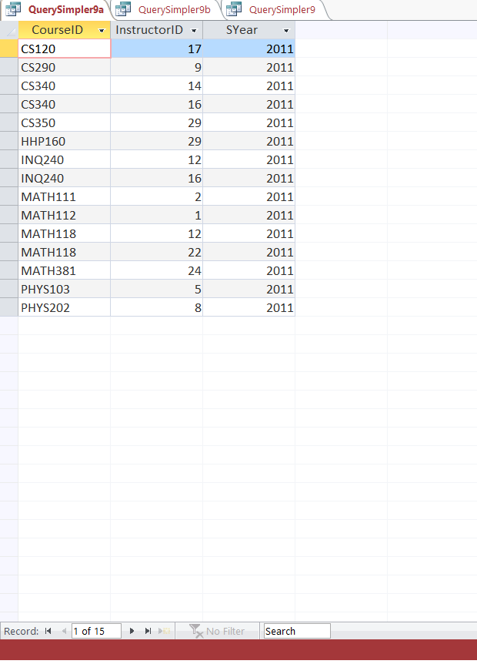
Output

Slide 5
Alternative for 9a
Use property sheet and select: Unique Values = YES.
Replaces group-by.

Slide 6
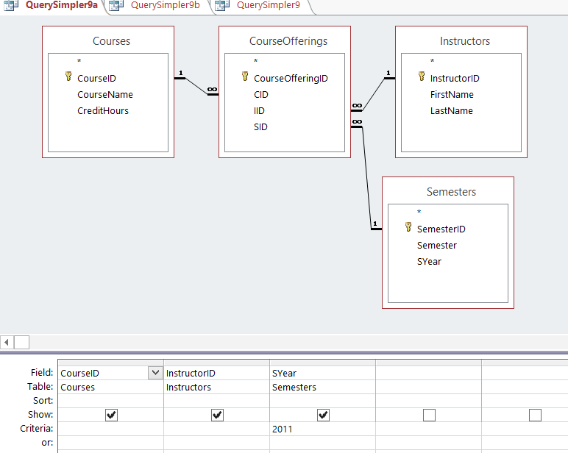
see property
sheet next slide.

Slide 7
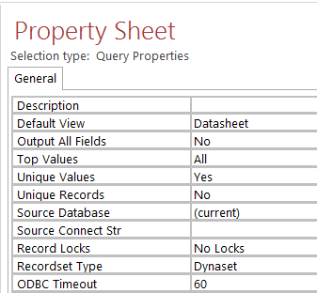
Unique Values

Slide 8
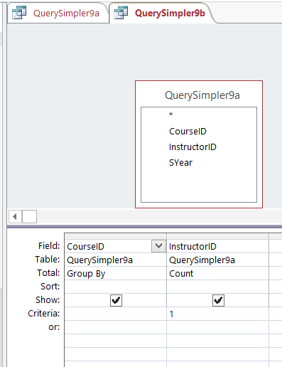
Combine 3 and 4.

Slide 9
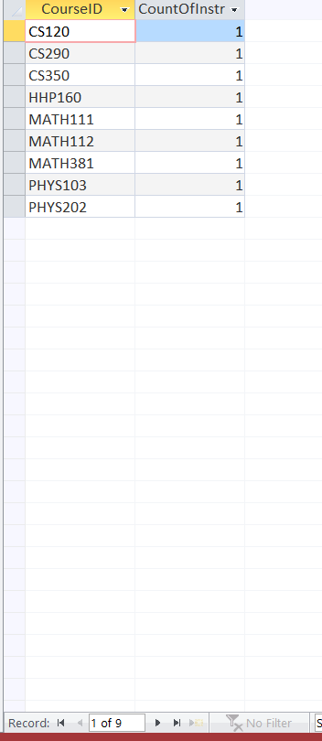
Output

Slide 10
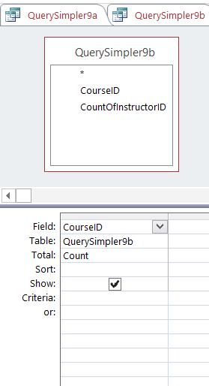
Step 5

Slide 11
Deviation from Principle of Least Information
Combining a totals-query with a selection query is considered ok because first the aggregation is done followed by the selection.
It is a convenient abbreviation. We can still see the intermediate results by developing the query incrementally.

