Slide 1
Debates / Socratic Method for Computational Problems
Version 2
Karl Lieberherr
Based on Ahmed Abdelmeged’s Dissertation

Slide 2
Contents
Defining interpreted logical formulas
Defining semantic games for interpreted logical formulas
Examples, including deriving a simple algorithm involving numbers.
Evaluation of semantic games
  Debate graph
  Merit graph

Slide 3
What you learn
A standard logical notation to define computational problems precisely.
How to argue about claims and computational problems and convincingly demonstrate that your solution is right.
Maintain balance: make sure that your solution is not underrated and the solution of others is not overrated.

Slide 4
What is a debate?
Based on semantic games in logic.
The game is defined by the structure of a logical formula which defines a computational problem.
Therefore we define first the standard way to structure logical formulas.

Slide 5
Propositional Logic
We refer to your favorite programming language where you have Boolean variables and Boolean operators: and, or, not.
Example: (A or B) and (!A or !B).
Propositional logic is not powerful enough to express interesting computational problems.
  Need predicate logic: introduce predicates and quantifiers

Slide 6
Predicate Logic
Predicates
  G(x,y,z)
  A predicate describes a property of objects, or a relationship among objects represented by the variables.

Slide 7
Quantification
Concepts
  Universal quantifier
  Existential quantifier

Slide 8
Forming propositions from predicates
A predicate with variables can be turned into a proposition by applying one of the following two operations to each variable:
  Assign a value to the variable
  Quantify the variable using a quantifier (Universal or Existential)

Slide 9
Universal Quantifier
ForAll x: P(x)
Universal quantifier and connective and.
  ForAll x: P(x)
  P(c1) and P(c2) and P(c3) and (Pc4) (if the domain of x only contains 4 elements)

Slide 10
Existential Quantifier
Exists x: P(x)
Existential quantifier and connective or.
  Exists x: P(x)
  P(c1) or P(c2) or P(c3) or (Pc4) (if the domain of x only contains 4 elements)

Slide 11
Order of Quantifiers
The positions of the same type of consecutive quantifiers can be switched.
The positions of different types of quantifiers can not be switched.

Slide 12
Well-Formed Formulas (wffs)
Syntax Rules
Important for game definition.
We consider logical formulas which are interpreted in some structure defined by a signature.
The signature specifies the constant symbols, relation symbols and function symbols.
We think of a structure as a set of classes with methods (defining the functions and relations).

Slide 13
Terms
Any variable is a term.
Any constant symbol from the signature is a term.
An expression of the form f(t1, … ,tn), where f is an n-ary function symbol, and t1, … ,tn are terms, is again a term.

Slide 14
Atomic Formulas
If t1 and t2 are terms then t1=t2 is an atomic formula.
If R is an n-ary relation symbol, and t1, … ,tn are terms, then R(t1, … ,tn) is an atomic formula..

Slide 15
Formulas
(well-formed formulas)
The set of formulas is defined to be the smallest set containing the set of atomic formulas such that
  ! φ is a formula when φ is a formula
  (φ and ψ) and (φ or ψ) are formulas when φ and ψ are formulas
  (Exists x φ) is a formula when x is a variable and φ is a formula
  (ForAll x φ) is a formula when x is a variable and φ is a formula

Slide 16
Claim⟨φ, A⟩
φ is a well-formed formula.
A is a structure, often consisting of several substructures. Think of A as a collection of data types that are needed to define the claim.
  φ refers to the functions defined in those data types.

Slide 17
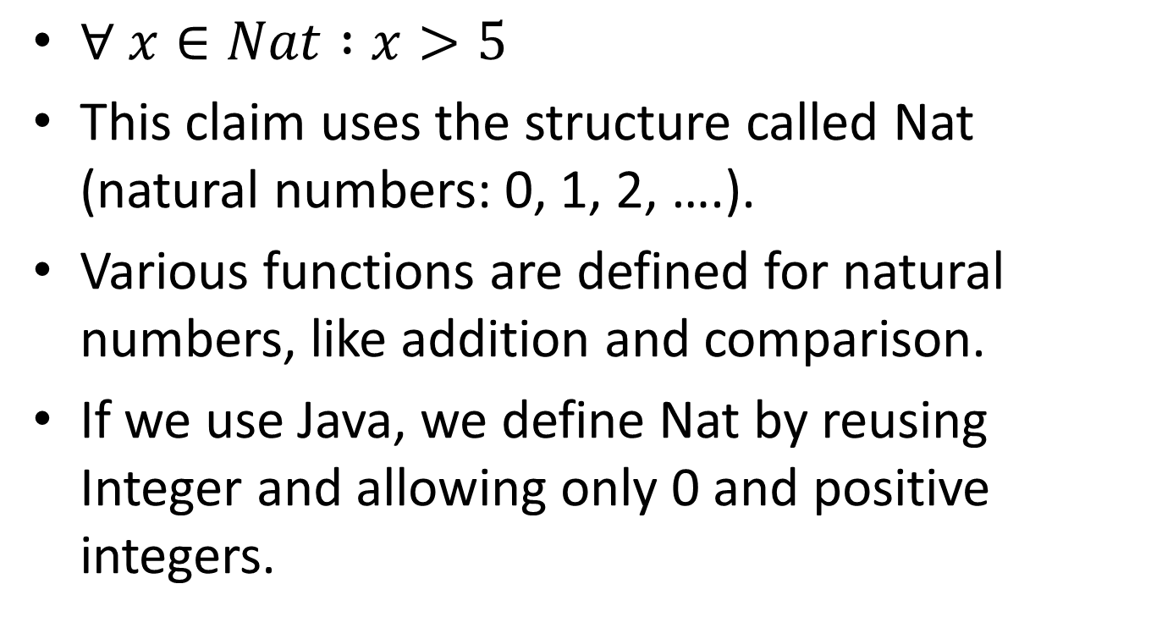
Example
$∀ x∈Nat :x>5$
This claim uses the structure called Nat (natural numbers: 0, 1, 2, ….).
Various functions are defined for natural numbers, like addition and comparison.
If we use Java, we define Nat by reusing Integer and allowing only 0 and positive integers.

Slide 18
Structure A is very important
A is defined in your favorite programming language.
A may consist of complex programs.
The sentence φ in claim⟨φ, A⟩ is interpreted in (or uses) structure A.
We use quantifiers only to express the requirements in a
  Clean, correct way
  Get interesting debates

Slide 19
Semantic Games (SGs) for interpreted formulas
A semantic game for a given claim⟨φ, A⟩ is a game played by a verifier and a falsifier, denoted SG(⟨φ, A⟩, verifier, falsifier), such that:
  A |= φ <=> the verifier has a winning strategy for φ.

Slide 20
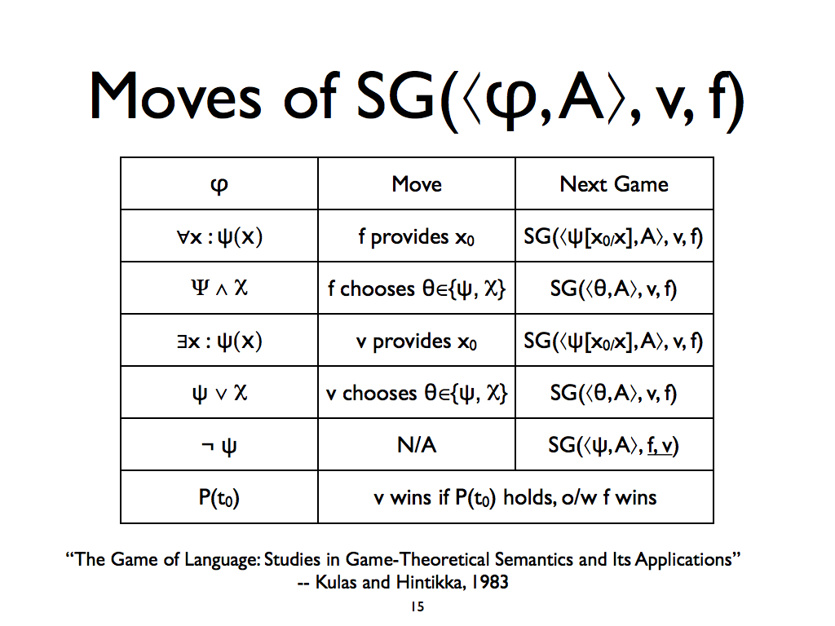

Slide 21
Rule-based Algorithm
The input to this algorithm is a logical sentence and two players, one playing the verifier role and the other the falsifier role. The players assign values to variables and choose from subexpressions for “and” and “or”
The output is one of the players: the winner.

Slide 22
Algorithmic Languages
Most of the time we use imperative languages for expressing algorithms.
Imperative
Functional
Rule-based
Special-purpose (not Turing complete): decision-trees, finite state machines, etc.

Slide 23
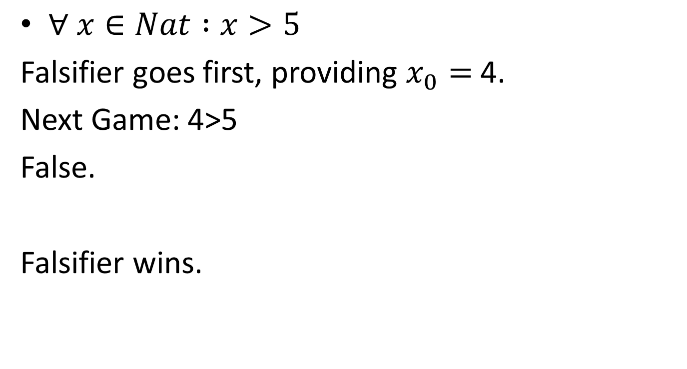
Rules &Examples
$∀ x∈Nat :x>5$
Falsifier goes first, providing $x_{0}=$4.
Next Game: 4>5
False.
Falsifier wins.

Slide 24
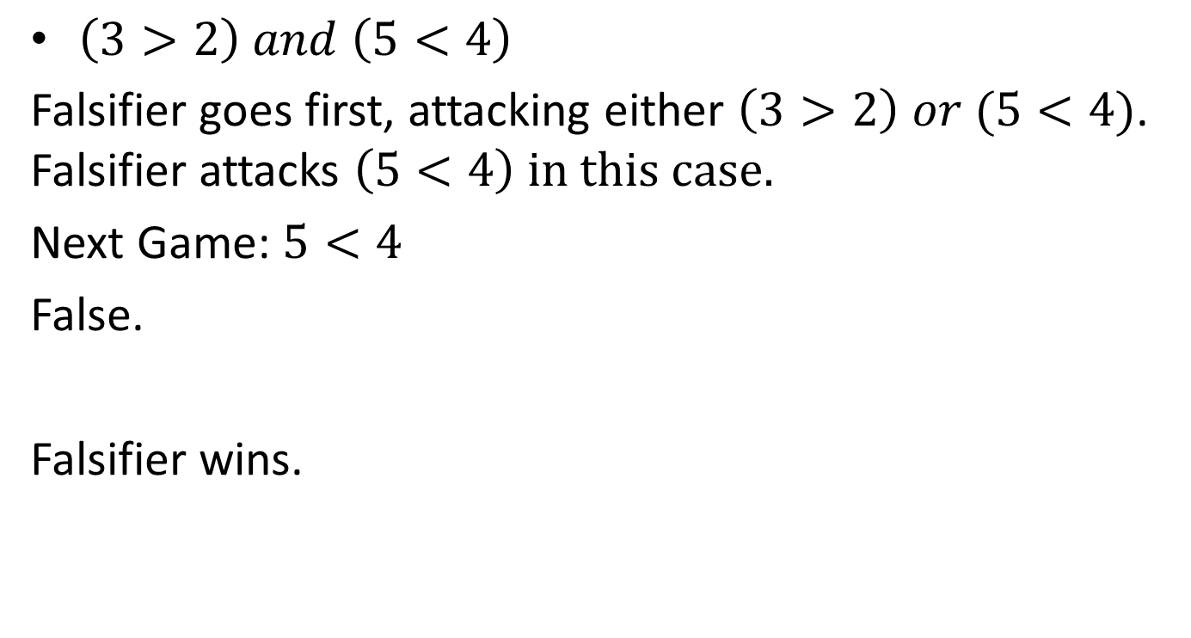
Rules &Examples
$\left(3>2\right) and \left(5<4\right)$
Falsifier goes first, attacking either $\left(3>2\right) or (5<4)$. Falsifier attacks $\left(5<4\right) in this case.$
Next Game: $5<4$
False.
Falsifier wins.

Slide 25

Rules &Examples
$∃ x∈Nat:x>5$
Verifier goes first, providing $x_{0}=6$
Next Game: 6>5.
True.
Verifier wins.

Slide 26
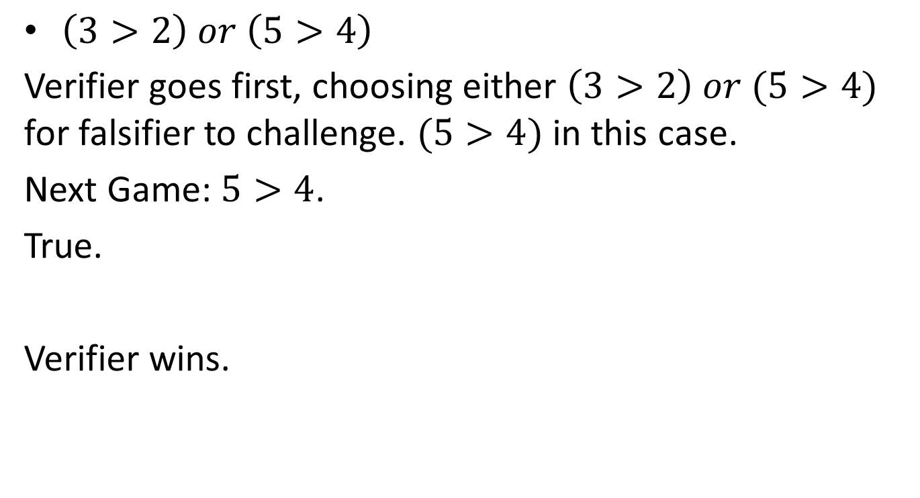
Rules &Examples
$\left(3>2\right) or \left(5>4\right)$
Verifier goes first, choosing either $\left(3>2\right) or (5>4)$ for falsifier to challenge. $(5>4)$ in this case.
Next Game: $5>4$.
True.
Verifier wins.

Slide 27
Rule-based Algorithm must handle errors
Illegal objects are provided. x in X means that only objects in set X are allowed.
Any game rule violation, e.g., an atomic predicate which is true is evaluated as false.
Player who commits violation loses the game independent of whether player is forced. It counts as a fault.
Rationale: The player had a chance to win but instead he violated the game rules.

Slide 28
Strategies
A strategy is a set of functions, one for each potential move.

Slide 29
Truth and Clever Algorithms
We are not just interested in WHETHER a claim is true but WHY it is true.
We are NOT asking for a PROOF why a claim is true but for a constructive demonstration that the claim is true.
Having a proof is ideal but is not required for supporting a claim. It is enough knowing the CLEVER algorithms without having a proof why they work.

Slide 30
Examples
Toy Example
Silver Ratio Example
  Illustrate incremental development of winning strategy

Slide 31
Toy Example
S(c ∈ [0,2]) = ∀x ∈ [0,1]: ∃ y ∈ [0,1]: x + y > c
S(c) is true for c ∈ [0,1) and false for c ∈ [1,2]
Best strategy:
  for the falsifier: x=0
  for the verifier: y=1

Slide 32




Toy Example: SG Trace
,
,
)
SG(∀x ∈ [0,1]: ∃ y ∈ [0,1]: x + y > 1.5
Provides 1 for x
Weakening (too much!)
,
,
)
SG(∃ y ∈ [0,1]: 1 + y > 1.5
Provides 1 for y
Strengthening
SG( 1 + 1 > 1.5
,
,
)
Wins

Slide 33
Example: Lab Definition
φ(c ∈ C)= ∀ x ∈ X ∃ y ∈ Y : p(x,y,c)
  B(ingran): φ(c₀) true: verifier
  K(arl): φ(c₀) false: falsifier

Slide 34
Silver Ratio Lab
φ(c ∈ C)= ∀ x ∈ X ∃ y ∈ Y : p(x,y,c)
X = [0,1]
Y = [0,1]
C = [0,1]
p(x,y,c) = x*y + (1-x)*(1-y²) >= c
φ(0.5) is true
φ(0.7) is false

Slide 35
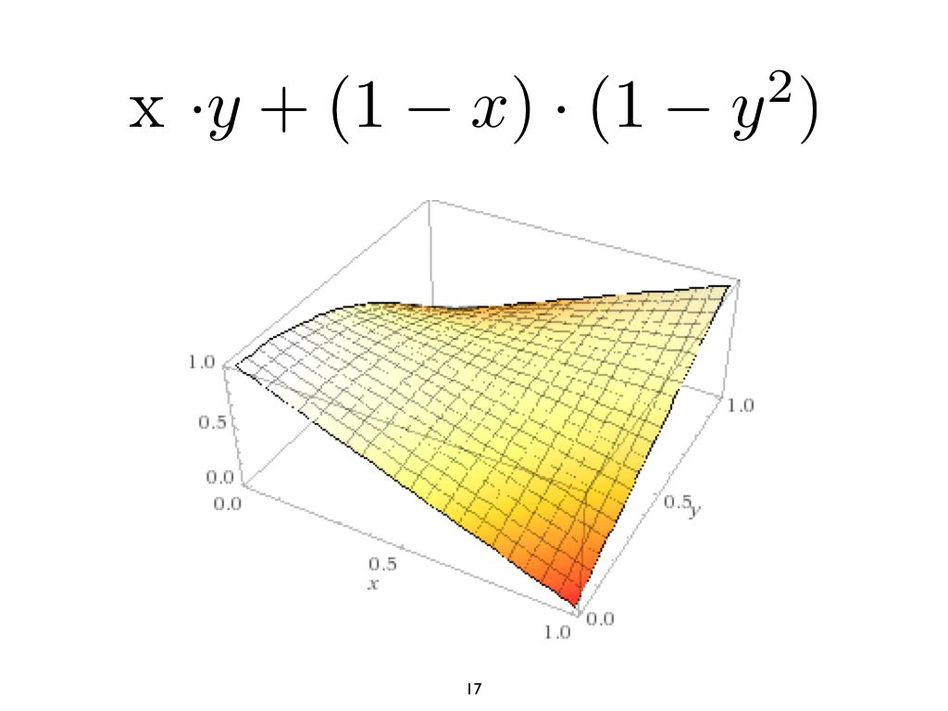

Slide 36
Example
φ(c ∈ C)= ∀ x ∈ X ∃ y ∈ Y : p(x,y,c)
  B(ingran): φ(c₀) true: verifier
  K(arl): φ(c₀) false: falsifier
  Experiment
    K:x₀ B:y₀ p(x₀,y₀,c₀) true
      objective evidence for B to be stronger than K.
        K must have made at least one mistake, while B might have been perfect.
          if φ(c₀) true, K took the wrong side.
          if φ(c₀) false, K chose the wrong x₀

Slide 37
Example (continued 1)
φ(c ∈ C)= ∀ x ∈ X ∃ y ∈ Y : p(x,y,c)
  B(ingran): φ(c₀) true: verifier
  K(arl): φ(c₀) true: verifier
  Experiment 1
    B(ingran): φ(c₀) true: verifier
    K(arl): φ(c₀) false: forced falsifier
      K:x₁ O:y₁ p(x₁,y₁,c₀) true
        no evidence that Bingran is stronger

Slide 38
Example (continued 2)
φ(c ∈ C)= ∀ x ∈ X ∃ y ∈ Y : p(x,y,c)
  Z(hengxing): φ(c₀) true: verifier
  K(arl): φ(c₀) true: verifier
  Experiment 2
    K(arl): φ(c₀) true: verifier
    Z(hengxing): φ(c₀) false: forced falsifier
      Z:x₂ K:y₂ p(x₂,y₂,c₀) false
        objective evidence that Zhengxing is stronger. Karl must have made at least one mistake, while Zhengxing might have been perfect.

Slide 39
Silver Ratio
claim
G(c) = ForAll x in [0,1] Exists y in [0,1]: x*y + (1-x)*(1-y^2) >= c
A specification of an algorithm:
Write a program which takes an x as input and
produces a y as output so that the above condition holds.

Slide 40
Winning Strategy developed incrementally
Strategy chosen depends on c.
  G(0.5)
  G(0.615)
  G(0.616)

Slide 41
Silver Ratio
G(1/2)
winning strategy for verifier:
f(x,y) = x*y + (1-x)*(1-y^2)
if x>1-x : y=1. f(x,y)=x > 1/2
1-x>x : y=0. f(x,y)=1-x > 1/2
1-x=x : y=1. f(x,y)=1/2
formal debate:
falsifier x=0.75
verifier y=1
0.75>0.5 verifier wins

Slide 42
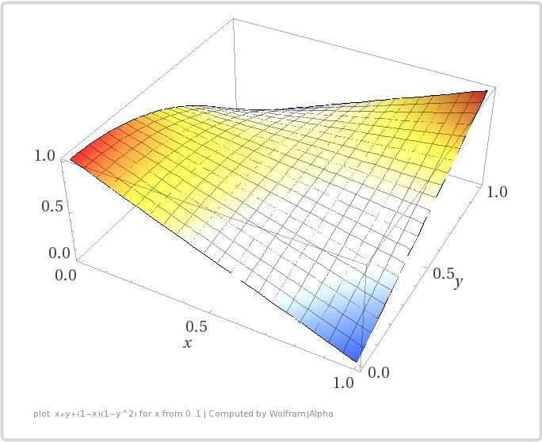

Slide 43
Silver Ratio
G(0.615)
winning strategy for verifier:
Choose y=x.
Result: x^3-x+1
minimize x^3-x+1
local minimum at x=1/sqrt(3) =
min{x^3-x+1}~~0.6151 at x~~0.57735
formal debate:
falsifier x=0.58
verifier y=0.58
x^3-x+1 where x = 0.58
Result: 0.615112 > 0.615

Slide 44
Silver Ratio
G(0.616)
formal debate 1:
falsifier x=0.3
verifier y=0.3
Result 0.727
verifier wins
formal debate 2:
x=0.57735
y=0.57735
Result 0.6151 < g(0.616)
verifier loses!!!!!!!!!!!!!!!

Slide 45
Silver Ratio
Question:
Is G(0.616) really true?
What is the winning strategy?
The winning strategy is an algorithm which maps an x to a y
such that f(x,y)>=0.616 holds for all x in [0,1].
Homework:
Find such an algorithm.

Slide 46
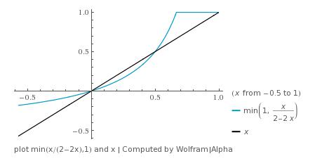
Silver Ratio

Slide 47
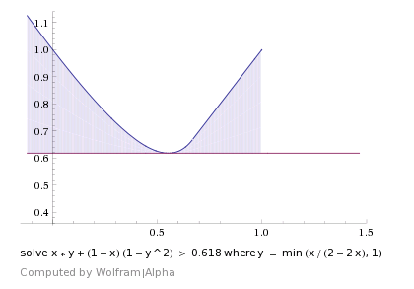
Silver Ratio

Slide 48
Example: Silver Ratio
For
  A potential falsifier strategy is: provideX(c){ 0.5 }.
  A potential verifier strategy is: provideY(x, c){ x }.
SP=G

Slide 49
Example: SG Trace
SG(
,
,
)
Provides 0.5 for x
Weakening (too much!)
SG(
,
,
)
Provides 0.5 for y
Strengthening
SG(
,
,
)
Wins

Slide 50
SG Properties
(Relevant to our approach)
SG winners drive their opponents into contradiction.
Faulty verifier (falsifier) actions can produce a false (true) claim from a true (false) one.
Faulty actions will be exposed by a perfect opponent leading to a loss.
Winning against a perfect verifier (falsifier) implies that the claim is false (true).
Losing an SG implies that either you did a faulty action or you were on the wrong side.

Slide 51
Avatar
Avatar
View lab as a language L of all claims that can be formulated in the lab.
L_{true} (L_{false}) is the set of true (false) claims in L.
There is a set of required functions S_{true} used to defend claims in L_{true} and another set of required functions S_{false} for L_{false}.
The burden of demonstrating the correctness of the required functions is divided among two participants.

Slide 52
Avatar
Avatar
S_{true} and S_{false} are certificates that can be used to defend the true and false claims.
A perfect avatar for a claim family is a pair (S_{true}, S_{false}), where the side chosen by the avatar is the winner side of SG(c, S_{true} , S_{false}).
An avatar (S_{true} , S_{false}) applied to a claim c is used to
  take a side on c
  defend the side taken

Slide 53
Example Avatar for
Silver Ratio Lab
Avatar
Defending SilverRatio(c)
  if SilverRatio(c)
    use S_{true}: when given an x, construct y
    else use S_{false}: construct x
Issue: In practice the avatars may be buggy.
Issue: humans might have to help the avatar.

Slide 54
Generalizing SGs
First ask participants for their favorite side (u is a participant).
If both choose the same side, force one to play the devil’s advocate.
Winner | Forced | Payoff (u, !u)
u | None | (1, 0)
u | u | (1, 0)
u | !u | (0, 0)

Slide 55
Temporary Summary
Use formal debates about claims to improve your algorithmic solutions and learn from others.
Works for other STEM areas.

Slide 56
Evaluation
We focus only on losses in non-forced side.
Definition: A fault is a game a player loses while taking its chosen side.
The lower the player’s score, the better the player’s rank.
We represent debate results as a graph, called the debate graph, but we focus only on a subgraph, called the merit graph, for the purpose of evaluation. The merit graph only contains the games where a player had a fault.

Slide 57
Merit Graph different sides
V Verifier
F Falsifier
fixed claim c
debate
Mike:F
Susie:V
Mike-Susie: 0-1
Susie offers learning opportunity to Mike
Susie teaches Mike
tie impossible
or
source
not forced
Mike:F
Susie:V
Mike-Susie: 1-0
Merit graph only shows debates where winner has merit.
target wins
teaches source

Slide 58
same sides
red does not count because
loser is forced.
Both Mike and Susie want to be verifiers.
One student becomes devil’s advocate.
possibilities:
  Mike:forced loses against Susie:non-forced
  Mike:forced wins against Susie:non-forced
  Mike:non-forced loses against Susie:forced
  Mike:non-forced wins against Susie:forced
source
not forced
Mike:V
Susie:V
target wins

Slide 59
Merit Graph same sides
fixed claim c
Mike:V
Susie:V
Mike-Susie: 0-1
or
Mike:V
Susie:V
or
Mike-Susie: 1-0
source
not forced
Mike:V
Susie:V
Mike-Susie: 1-0
Mike-Susie: 0-1
or
Mike:V
Susie:V
target wins

Slide 60
Regular Debate Graph same sides
source is forced
fixed claim c
target wins
Mike:V
Susie:V
Mike-Susie: 0-1
Mike-Susie: 1-0
Red edges are in regular debate graph but not in merit graph.
Merit graph only shows debates where winner has merit.
source
not forced
target wins

Slide 61
Why Merit Graph
Allows us to quickly find meritorious students by looking at debate outcomes.
  Find students with minimal number of outgoing edges.
Students assign each other merit without involving teaching staff (which must define the claim to be debated. Claim is about current learning module).

Slide 62
Properties of Merit Graph
Perfect student has outdegree 0.
If there is a debate between two students taking opposite sides, there will be an edge in the merit graph.

Slide 63
Merit Graph for Claim c
F falsifier
V verifier
Edge: source loses in non-forced
position to target.
x: counts outgoing edges.
2
Kunal:F
Cong:V
0
1
Gaurav:F
perfect
Possible scenario:
Gaurav and Kunal have misunderstood claim c and they think it is false.
Cong wins a debate with both of them applying the winning strategy she found
for c. Kunal and Gaurav have two debates, one of which Gaurav wins while Kunal
is in non-forced position, which indicates
that Gaurav has a somewhat better understanding. But still, he took the wrong
side.

Slide 64
Counting wins does not find meritorious students
2/1
2/0
Brandon:F
Kunal:F
Cong:V
0/3
1/4
Gaurav:F
blue: counting wins
x: counts outgoing edges
2/0
Mike:F
1/0
Zach:F
Denial of Truth Attack
Gaurav is not the perfect student
Other students helped him to distort the truth

Slide 65
Fault Counting
Has a unique role!

Slide 66
Beating Functions
A beating function can be represented as a labeled graph giving the results of all semantic games comprising a tournament between a finite set of players.
Let S={sv,sf} be the set of sides: verifier and falsifier. We use a beating function b^{P}:P x P x S x S x S -> N. b^{P}(pw,pl,swc,slc,sw) denotes the number of semantic games won by player pw against pl, where pw chooses to take side swc, and pl chooses to take side slc, and sw is the actual side taken by pw.

Slide 67
Ranking Relations and Functions
B^{P} is the set of all possible beating functions for a given finite set of players P.
A ranking relation is a reflexive, transitive and complete binary relation.
R^{P} is the set of all possible rankings of a given set of players.
A ranking function <=: B^{P} -> R^{P} associates some ranking to every beating function.

Slide 68
Ranking Relation
Example for 6 players
p1
0 faults
Self-loops
Not shown
3 faults
p2
p3
4 faults
p4
6 faults
p5
p6

Slide 69
We do Fault Counting for Evaluating Players
Fault counting leads to a ranking of players which has several desirable properties.
  Limited collusion effect: for any two arbitrary players px and py, the rank of px w.r.t. the rank of py cannot be improved by manipulating games whose outcome px cannot control.
  Regard for Wins and Losses: A win cannot worsen a rank and a loss cannot improve a rank.

Slide 70
We do Fault Counting for Evaluating Players (2)
Fault counting leads to a ranking of players which has several desirable properties.
  Local Fault Based: for all pairs of players px and py the relative rank of px and py depends only on the number of faults made by px or py.
  Neutrality: Any permutation of the players which preserves the beating relationship, also preserves the order relationship.
  Most refined: …

Slide 71
Justification for Fault Counting
Fault Counting is the only ranking function that has the above properties.

Slide 72
Game Tree Example inspired by MinCounterfeitBall()
Claim
  MCB()=
    ForAll n
      Exists q
        C(n,q) and (ForAll p<q: !C(n,p))
        where C(n,q)=
          Exists T
            ForAll m
              P(T,m,n,q)

Slide 73
ForAll n Exists q: (C(n,q) and (ForAll p<q: !C(n,p)))
C(n,q)=Exists T ForAll m: P(T,m,n,q)
n0
Exists q: (C(n0,q) and (ForAll p<q: !C(n0,p)))
C(n,q)=Exists T ForAll m: P(T,m,n,q)
q0
C(n0,q0) and (ForAll p<q0: !C(n0,p))
C(n,q)=Exists T ForAll m: P(T,m,n,q)
choose
Exists T ForAll m: P(T,m,n0,q0)
ForAll p<q0: !(Exists T ForAll m: P(T,m,n0,p))
T0
p0
ForAll m: P(T0,m,n0,q0)
!(Exists T ForAll m: P(T,m,n0,p0))
m0
role switch
P(T0,m0,n0,q0)
Exists T ForAll m: P(T,m,n0,p0)
T0
P(T0,m0,n0,p0)
ForAll m: P(T0,m,n0,p0)
m0

Slide 74
Explanation
The game-tree is defined by the rule-based program for semantic games.
Nodes with ForAll or “and” are controlled by ForAll player.
Nodes with Exists or “or” are controlled by Exists player.
In shaded nodes roles are switched.

Slide 75
Observations
Sentences get smaller and smaller as we move towards the roots.
The picture represents a very bushy tree because there are many choices for the values x0.
At the leaves we have atomic sentences evaluated in the underlying structure.
The depth of the game tree is 7 moves.

Slide 76
Observations
Each move requires “intelligence” except the role switches.

Slide 77
Conclusions
Technology to engage students in giving feedback to each other and learning from each other and grading each other fairly.
Grading mistakes are impossible.
Suitable for online debates in large online classes.

Slide 78
Extra slides

Slide 79
Bound variables
An appearance of a variable in a well-formed-formula (wff) is said to be bound if either a specific value is assigned to it or it is quantified.
If an appearance of a variable is not bound, it is free.
Scope of a quantifier is given by parentheses or brackets.

