Slide 1
CS 3200 Database design Introduction
Kathleen Durant
Spring 2013
Northeastern University

Slide 2
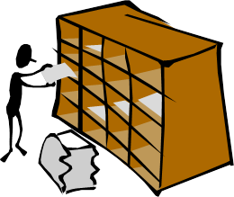
Lecture 1 Outline
Course Logistics
Goals of the course
The 5 W’s
What, why, where, who, when of DBs
Brief History and fun facts of DBs
The Relational Model
Properties of a RDMS

Slide 3
Course Information
Website:
http://www.ccs.neu.edu/home/kathleen/cs3200/index.htm
Professor:
kathleen@ccs.neu.edu
314 WVH
Teaching Assistant
?
Available ??
Prerequisites
Grading
Homework
Project
3 small assignments
Midterm
Final

Slide 4
Goals of the Course
Learn the theory behind relational databases
Relational model, relational algebra, relational calculus
Learn to design and represent a data schema
Entity relational model
Given a data schema, create and manipulate a database using SQL
Translate an ERM schema into SQL
Become familiar with the functionality provided by SQL
Strengths as well as its limitations
Understand the internal workings as well as the functionality provided by a database management system
Concurrency-control, transactions, indexes
Gain some industry knowledge and a historical perspective on databases
Codd, Stonebraker, Ellison, Date, Boyce, Wong, Chamberlin
Oracle, Ingres, IBM, Teradata, MySql, Postgres
Bachman vs. Codd debate

Slide 5
5W’s: What is a database?
“an organized set of data that is stored in a computer and can be looked at and used in various ways”
Oxford English Dictionary
“one or more large structured sets of persistent data, usually associated with software to update and query the data”
Free On-Line Dictionary of Computing
“ a comprehensive collection of related data organized for convenient access, generally in a computer. ”
Dictionary.com
Good start but not very precise !!

Slide 6
5 W’s: What is a DB, DBMS?
Database = very large, integrated collection of data.
Entities (e.g., students, courses)
Relationships (e.g., Jill is taking CS 3200)
Database Management System (DBMS) = software
package designed to store and manage databases
Definitions will be more precise as semester progresses!!

Slide 7
5W’s: Where are databases?
History
Database development analogous to the development of written language: humans needed a reliable means for transmitting information, maintaining financial accounts, keeping historical records (i.e. business transactions)
Where’s the money?
Traditionally databases were found on mainframes at large entities such as corporations, hospitals and the government
Airline Reservation Systems – Data items are: single passenger reservations; Information about flights and airports; Information about ticket prices and tickets restrictions.
Banking Systems – Data items are accounts, customers, loans, mortgages, balances, etc.
Corporate Records – Data items are: sales, accounts, bill of materials records, employee and their dependents
Failures are not tolerable. Concurrent access must be provided
Today
Databases are behind almost everything you do on the Web.
Google searches.
Queries at Amazon, eBay, etc.
Databases can exist on any computer and at no cost!
Personal computer: ACCESS, MySQL
Servers: Oracle, SQL Server
Data Warehouses:TeraData

Slide 8










5W’s: Where are the largest DB’s ?
World Data Centre for Climate – 6 Petabytes
National Energy Research Scientific Computing Center (NERSC) – 2.8 petabytes
AT&T – 312 Terabytes
Google – 91 million searches per day
Sprint - 70,000 call record insertions per second
ChoicePoint – 250 Terabytes on Americans
YouTube – 45 Terabtyes
Amazon - 42 terabytes of data on 59 million
CIA – all content digitized: growth rate of 100 articles per month
Library of Congress – index for the library: growth rate of 10,000 items per day
http://www.comparebusinessproducts.com/fyi/10-largest-databases-in-the-world
Notes:
Max Planck Institute for Meteorology and German Climate Computing Centre
Lawrence Berkeley National Laboratory and the U.S. Department of Energy

Slide 9
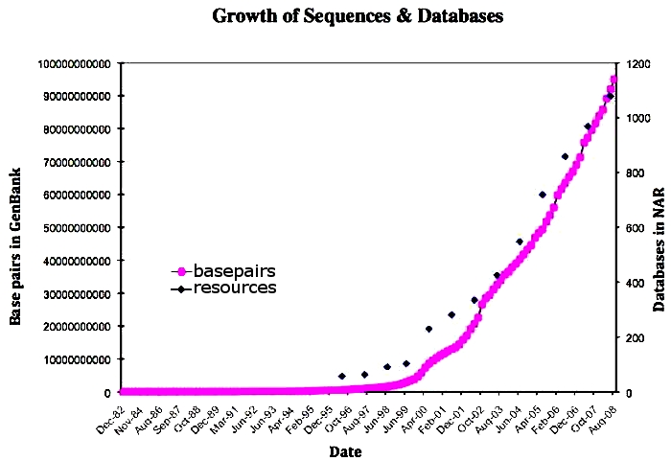
5W’s Where: Growth in Genetic data
Explosion of available genetic data through advances in automatic genetic sequencing techniques
Amount of genetic data doubling every 18 months
http://www.ncbi.nlm.nih.gov/genbank/
http://www.nature.com/scitable/topicpage/genomic-data-resources-challenges-and-promises-743721

Slide 10
5 W’s: When did DBs get their start?
Three Eras of Database Technology
Pre-relational
File systems
Hierarchical and network systems
The revolution: relational database technology
Codd’s 1970 paper + 10 years
Post-relational era
new organizations of data, more complex data
influence of object technology
more complex applications (e.g., distributed, web-based, and parallel)

Slide 11
Collection of Files
5W’s When: Storage of data
60’s
70's
80's
90’s
00’s
10’s
Hierarchical
Network
Relational
Object Bases
Knowledge Bases, Ontologies
NoSQL, BigTable, SimpleDB

Slide 12

When: Pre-RDB File-based data
File technology was the first attempt to automate manual filing systems
Collection of applications that each define and manage their own files
File: collection of records with structure linked to a specific application and a computer language or library that provides data access
Data storage and retrieval must be coded explicitly in each application

Slide 13

When: Pre-RDB – Hierarchical and Network Systems
Software systems without underlying organized discipline
Lack of data independence
File-based view of data structures as records (on disk storage) + links: mixture of physical and logical worlds
User view dependent on physical details
Not relevant for information needs or data concept
Modern view: links = semantic relationships + physical access paths
Navigation through the data via programming
No high-level query language - all database accesses imply procedural programming
Programming = navigation governed by physical access paths
long and complex programs
Oriented towards one-record-at-a-time navigational programming
complex, necessarily-manual performance optimization
Example: Integrated Data Services (IDS) developed at GE by Charlie Bachman in the 1960s

Slide 14
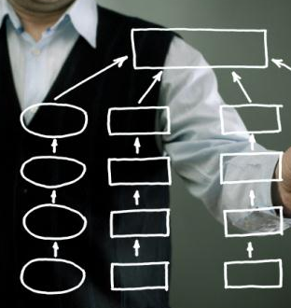
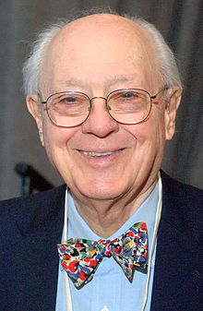
5W’s: When: RDB revolution
Codd’s paper: ‘A relational model of data for large shared data banks’ (1970)
Linked the representation and operations on data to set theory
Just a theory no database implementation
Date @ IBM starts development of R
Boyce & Chamberlin develop SEQUEL based on relational algebra
Stonebraker @ UC Berkeley starts development of Ingres
Stonebraker, Wong develops QUEL based on relational calculus
Bachman vs. Codd debate
1974 @ ACM SIGMOD
IDS Database Architect & Guru
Mathematician

Slide 15

5W’s: When: Post-revolution
New organizations of data
Non-normalized relations
Object technology and object-relational systems
hierarchical data encapsulation for an object (multiple tables for one object)
Semi-structured and unstructured data (XML)
Vertical databases
New functionionality
Distribution
Heterogeneity (multi-databases, interoperability)
Active databases (triggers) and deduction
ERP packages (application-oriented tasks common to many organizations)
Data analysis (data warehouses and data mining)
More complex data domains (e.g., design, geography, molecular biology, electronic commerce)
Relaxation of the ACID test for DBMS
http://slashdot.org/topic/bi/sql-vs-nosql-which-is-better/

Slide 16
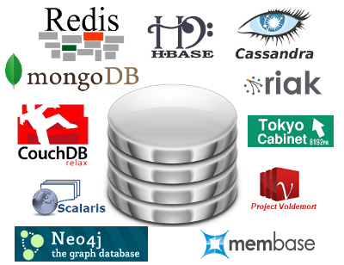

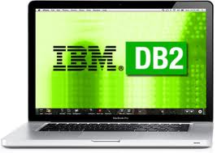












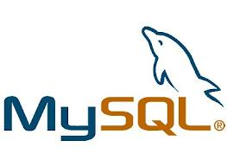


5 W’s: Who are the corporate players?
Open Source
RDB Companies
Computer
Companies
Notes:
Relational DBMS companies – Oracle, Sybase – are among the largest software companies in the world.
IBM offers its relational DB2 system. With IMS, a nonrelational system, IBM is by some accounts the largest DBMS vendor in the world.
Microsoft offers SQL-Server, plus Microsoft Access for the cheap DBMS on the desktop, answered by “lite” systems from other competitors.
OpenSource: mySQL, postgreSQL
hyperdex

Slide 17


5W’s: Who are the RDB pioneers?
E. Codd
IBM
relational model
M. Stonebraker
UC Berkleley Ingres DB
C. Date
IBM
System R
Notes:
Codd gave us the relational model. Then proved that predicate calculus and predicate algebra are equivalent, extended Boyce Normal form. Their project, known as INGRES (Interactive Graphics and Retrieval System),^{[6]} was one of the first systems (along with System R from IBM) to demonstrate that it was possible to build a practical and efficient implementation of the relational model.

Slide 18
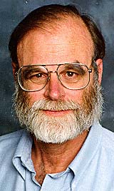

5W’s: Who are the RDB pioneers?
J. Gray
IBM
Transactions
Db locking
Ray Boyce
IBM
SEQUEL
Normal form
D. Chamberlin
IBM
SEQUEL ->SQL
XQUERY
Notes:
Gray – database locking mechanism, commit mechanism

Slide 19
5 W’s: Why databases?
Persistent Storage – Database not only provides persistent storage but also efficient access to large amounts of data
Reduced processing time
Programming Interface – Database allows users to access and modify data using powerful query language. It provides flexibility in data management
Reduced application development time
Transaction Management – Database supports a concurrent access to the data
Data independence and efficient access
Data integrity and security
Uniform data administration
Concurrent access, recovery from crashes

Slide 20
Data Models: Representation
Data model = collection of concepts for describing data.
Relational data model
Object oriented database model (OODMS)
XML data model
NoSQL database model
Schema = description of a particular collection of
data, using a given data model.
The relational data model is the most widely used model today.
Main concept: relation= table
rows and columns
Every relation has a schema
Describes the columns or fields
Strength is in its simplicity
 | Name | Age | …
Person1
Person2
Person3
…

Slide 21
Levels of abstraction
View1 View 2 ……. View k
Many views
Views describe how users see the data.
One conceptual schema
Conceptual schema defines the logical structure
One physical schema
Physical schema describes the files and indexes used.
Conceptual
Schema
Physical
Schema

Slide 22
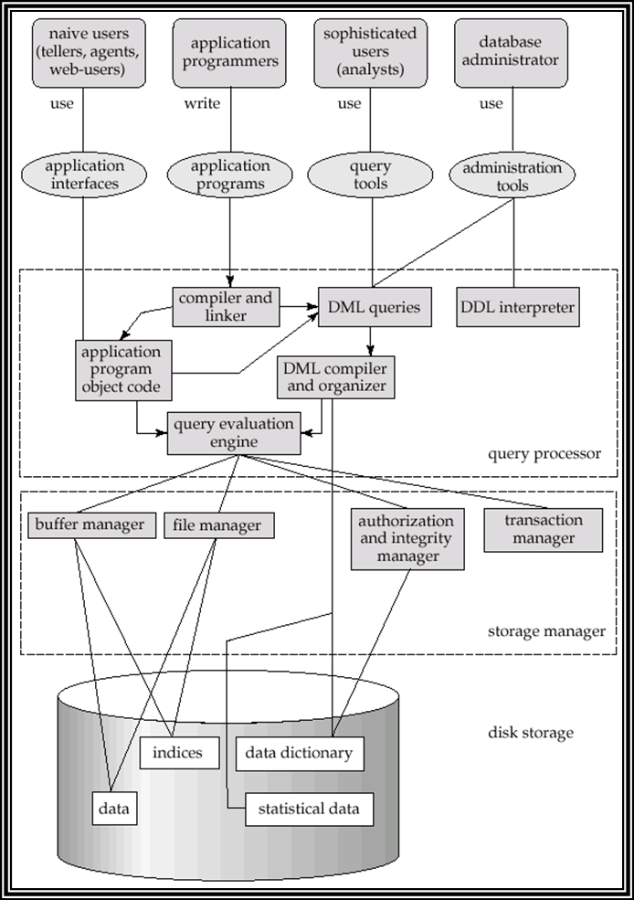
Layered Architecture of a DBMS

Slide 23
Properties of a DBMS
Atomicity
All or no changes done by a transaction
Consistency
Only valid data written to the DB
Isolation
Multiple transactions happening at the same time do not effect each other
Durability
Changes committed to the DB are not lost
ACID test: important attributes of a DBMS

Slide 24
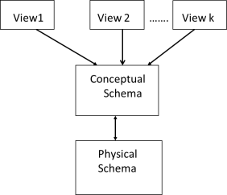
Data Independence
Applications are insulated from the physical layout of the data
Logical data independence: Protection from changes in logical structure of data
Define a ‘view’ with the old logical structure
Physical data independence: Protection from
changes in physical structure of data.
Query and update logical structure, not physical structure

Slide 25

Concurrency control
Concurrent execution of user programs is essential for good DBMS performance
Because disk accesses are frequent and relatively slow, it is important to keep the CPU humming by working on several user programs concurrently.
Interleaving actions of different user programs can lead to inconsistency
E.g., check is cleared while account balance is being computed.
DBMS ensures such problems do not arise: users and programmers can pretend they are using a single-user system.
Notes:
So how does a database system makes each user believe they are the only user of the database

Slide 26
Transaction processing
Transaction = atomic sequence of database actions (costly operations: reads/writes or disk access).
Each transaction, executed completely, must leave the DB in a consistent state if DB is consistent when the transaction begins.
Users can specify integrity constraints on the data, and the DBMS will enforce these constraints.
Beyond this, the DBMS does not really understand the semantics of the data.
E.g., it does not understand how the interest on a bank account is computed.
Thus, ensuring that a transaction (run alone) preserves consistency is ultimately the user’s responsibility!

Slide 27
Scheduling concurrent transactions
Scheduler
DBMS ensures that the execution of {T1,..., Tn} is equivalent to some serial execution of T1’,..., Tn’.
Before reading/writing an object, a transaction requests a lock on the object, and waits till the DBMS gives it the lock.
All locks are released at the end of the transaction
Strict 2 Phase locking protocol (2PL).
2PL = If an action of Ti (say, writing X) affects Tj (which perhaps reads X), one of them, say Ti, will obtain the lock on X first and Tj is forced to wait until Ti completes; this effectively orders the transactions.
What if Tj already has a lock on Y and Ti later requests a lock on Y? (Deadlock!) Ti or Tj is aborted and restarted!
Important to identify deadlocks and restart one of the transactions

Slide 28
Log file operations
1
2
3
4
The following actions are recorded in the log:
Ti writes an object: The old value and the new value
Log record must go to disk before the changed page
Ti commits/aborts: A log record indicating this action
Log records chained together by transaction id
Quick/easy to undo a specific transaction
e.g., to resolve a deadlock
Log is often duplexed and archived on “stable” storage.
All log related are handled transparently by the DBMS activities
Includes: all concurrency control related activities such as lock/unlock, dealing with deadlocks etc.

Slide 29
Ensuring Atomicity
DBMS ensures atomicity (all-or-nothing property) even if system crashes in the middle of a transaction
How?: Keeps a log (history) of all actions carried out by the DBMS while executing a set of transactions
Before a change is made to the database, the corresponding log entry is forced to a safe location. Write ahead logging protocol (WAL protocol)
After a crash, the effects of partially executed transactions are undone using the log.
Thanks to WAL, if a log entry was not saved before the crash, corresponding data change was not applied to the database

Slide 30
Conclusion
Data and databases are ubiquitous
DBMS are used to maintain, query large datasets
Benefits include recovery from system crashes, concurrent access, quick application development, data integrity and security
Levels of abstraction give data independence
A DBMS typically has a layered architecture
Data, data models and DBMS have been evolving for over 50 years
Mathematical theory led the way to a powerful relational data model
Relational revolution started with Codd’s paper
Data represented as tables – operations defined by set theory
ACID properties necessary requirements for a RDMS
Relaxation or additional properties give rise to new data models
Object oriented data model (OODMS)
XML data model
NoSQL data model
New data models developed to address the evolution of data

