Slide 1
File Storage and Indexing
Lesson 13
CS 3200
Kathleen Durant

Slide 2
Today’s Topics
Overview of data flow: External storage to RAM
File organizations available
Effects on DBMS performance
Introduction to indexes
Clustered vs. Unclustered
Model for evaluating the cost of DB operations for the different file organizations
Methods available for improving system performance
Indexes and when to use them or not to use them (while evaluating a query)

Slide 3
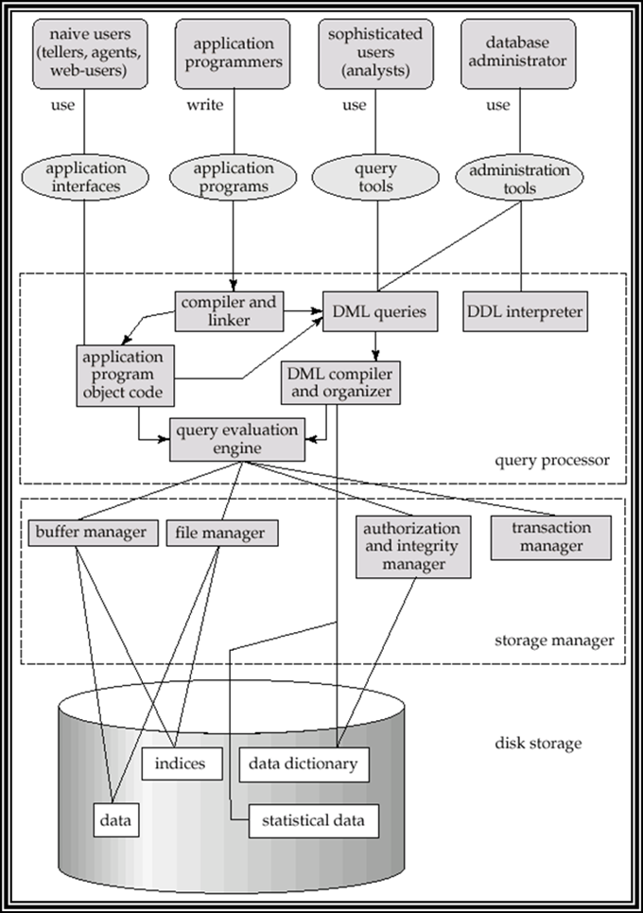
Transactions Page buffer Recovery
SQL
Interface
Properties of DBMS
What
topics have we covered so far ?
Glossed over
Translating
transactions to
database actions

Slide 4

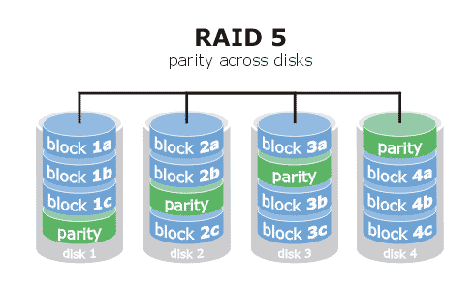
Where can you store a database?
Disks: Can retrieve random page at fixed cost
But reading several consecutive pages is much cheaper than reading them in random order
Tapes: Can only read pages in sequence
Cheaper than disks; used for archival storage
Flash memory: Starting to replace disks due to much faster random access
Writes still slow, size often too small for DB applications
Arrays of disks
Cover in later chapter

Slide 5
Why care about storage mechanism?
DB performance depends on time it takes to get the data from the storage system
I/O operations are slow
It’s all about expectations
If you are reading lots of data then it’s OK to take a while
If you are reading a small amount of data it should be quick
Goal: store the data in an order that will make it easy to find / identify a particular record(s)

Slide 6
Data on external storage
File organization: Method of arranging a file of records on external storage.
Record id (rid) is sufficient to physically locate record
Page Id and the offset on the page
Index: data structure for finding the ids of records with given particular values faster
Architecture: Buffer manager stages pages from external storage to main memory buffer pool. File and index layers make calls to the buffer manager.

Slide 7
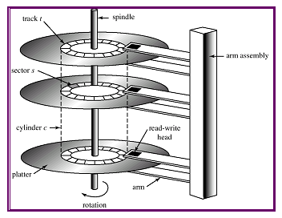
Components of a disk
Platters spin
E.g., 10K rpm
Arm assembly is moved in or out to position a head on a desired track.
Tracks under heads make a cylinder.
Only one head reads or writes at any one time.
Block size is a multiple of a sector size (which is fixed).
512 bytes (old), 4096 bytes (new)

Slide 8
Accessing a disk page
Time to access (read/write) a disk block:
Seek time (moving arms to position disk head on track)
Rotational delay (waiting for block to rotate under head)
Transfer time (actually moving data to/from disk surface)
Seek time and rotational delay dominate.
Seek time typically a little below 9msec (consumer disks)
Rotational delay around 4msec on average (7.2K rpm disk)
Transfer rate disk-to-buffer of 70MB/sec (sustained)
Key to lower I/O cost: reduce seek/rotation delays.
Hardware vs. software solutions ?

Slide 9
Arranging Pages on Disk
`Next’ block concept:
blocks on same track, followed by
blocks on same cylinder, followed by
blocks on adjacent cylinder
Blocks in a file should be arranged sequentially on disk (by `next’), to minimize seek and rotational delay.
For a sequential scan, pre-fetching several pages at a time is a big win!
Notes:
23

Slide 10
Disk Space Management
Lowest layer of DBMS software manages space on disk.
Higher levels call upon this layer to:
allocate/de-allocate a page
read/write a page
Request for a sequence of pages must be satisfied by allocating the pages sequentially on disk! Higher levels don’t need to know how this is done, or how free space is managed.
Notes:
24

Slide 11
Buffer Management in a DBMS
Page Requests from Higher Levels
BUFFER POOL
disk page
free frame
MAIN MEMORY
DISK
choice of frame dictated
by replacement policy
DB
Data must be in RAM for DBMS to operate on it!
Table of <frame#, pageid> pairs is maintained.
Notes:
4

Slide 12
File structure types
Heap (random order) files
Suitable when typical access is a file scan retrieving all records.
Sorted Files
Best if records must be retrieved in some order, or only a `range’ of records is needed.
Indexes = data structures to organize records via trees or hashing.
Like sorted files, they speed up searches for a subset of records, based on values in certain (“search key”) fields
Updates are much faster than in sorted files.

Slide 13
Record Formats: Fixed Length
F1
F2
F3
F4
L1
L2
L3
L4
Base address (B)
Address = B+L1+L2
Information about field types same for all records in a file; stored in system catalogs.
Finding i’th field requires scan of record.
Notes:
9

Slide 14
Page Formats: Fixed Length Records
Slot 1
Slot 1
Slot 2
Slot 2
. . .
Free
Space
. . .
Slot N
Slot N
Slot M
N
1
. . .
1
1
0
M
number
of records
M ... 3 2 1
number
of slots
PACKED
UNPACKED, BITMAP
Record id = <page id, slot #>. In first alternative, moving records for free space management changes rid; may not be acceptable.
Notes:
11

Slide 15
Indexes
An index on a file speeds up selections on the search key fields for the index
Any subset of the fields of a relation can be the search key for an index on the relation
Search key is not the same as a key in the DB
An index contains a collection of data entries, and supports efficient retrieval of all data entries k* with a given key value k.

Slide 16
What is data entry k*?
Three options depending on what level
Data record with key value K (actual tuple in the table)
<k, rid of a data record with search key value k>
So not the record itself the recordid (where to get the record
<k, list of rids of data records with a search key k>

Slide 17
Alternative 1 – actual data record
Actual data record stored in index
Index structure is a file organization for data records (instead of a Heap file or sorted file).
At most one index on a given collection of data records can use Alternative 1.
Otherwise, data records are duplicated, leading to redundant storage and potential inconsistency.
If data records are very large, # of pages containing data entries is high. Implies size of auxiliary information in the index is also large, typically.

Slide 18
Alternative 2 and 3
Data entries typically much smaller than data records. So, better than Alternative 1 with large data records, especially if search keys are small.
Large records take up space in the index – still have to maneuver around the portion of index structure used to direct the search, which depends on size of data entries, is much smaller than with Alternative 1.
Alternative 3 more compact than Alternative 2, but leads to variable-sized data entries even if search keys are of fixed length.
Extra cost for accessing data records in another file
Index only return rids

Slide 19
Index classification
Primary vs. secondary: If search key contains primary key, then called primary index.
Unique index: Search key contains a candidate key.
Clustered vs. unclustered: If order of data records is the same as, or `close to’, order of data entries, then called clustered index.
Alternative 1 implies clustered, in practice, clustered also implies Alternative 1 (since sorted files are rare).
A file can be clustered on at most one search key.
Cost of retrieving data records through index varies greatly based on whether index is clustered or not.

Slide 20
Clustered vs. Unclustered Index
Suppose Alternative 2 is used for data entries, and that the data records are stored in a Heap file
To build a clustered index, first sort the Heap file (with some free space on each page for future inserts)
Overflow pages may be needed for inserts. (Thus, order of data records is close to but not identical to sort order.

Slide 21
Clustered vs. Unclustered Index
Index
File
Data
File
Data records
Data records
CLUSTERED
UNCLUSTERED

Slide 22
Hash-based Indexes
Good for equality selections
Index is a collection of buckets. Bucket = primary page plus 0 or more overflow pages
Hashing function h: h(r) = bucket in which record r belongs/ h looks at the search key fields of r.
If alternative (1) is used, the buckets contain the data records , otherwise they contain <key,rid> or <key, rid-list> pairs

Slide 23
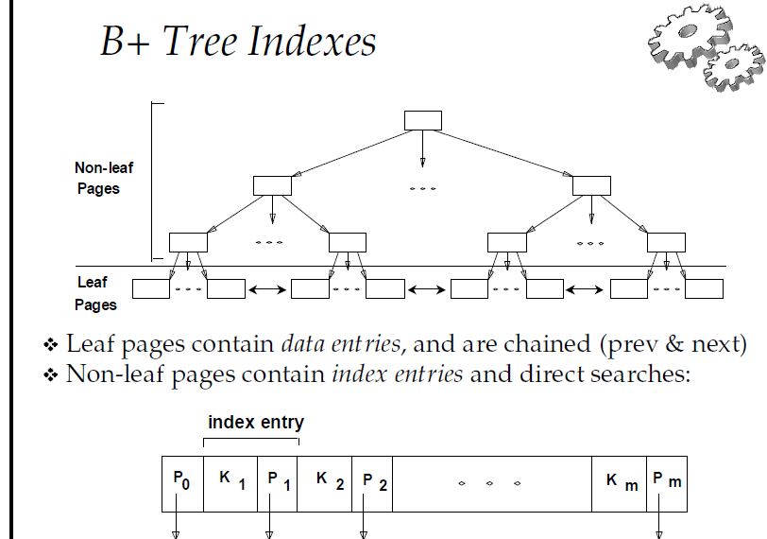
B+ Tree Indexes

Slide 24
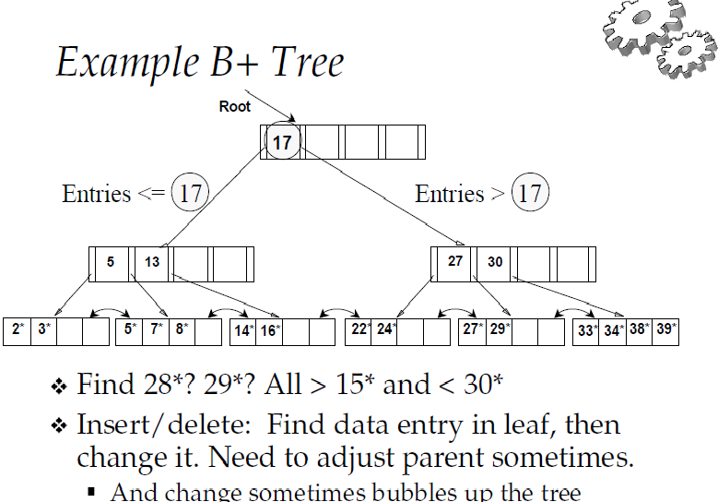
Example: B+ Tree

Slide 25
Cost Model Analysis
We ignore CPU costs, for simplicity:
B: The number of data pages (Blocks)
R: Number of records per page (Records)
D: (Average) time to read or write a single disk page
Measuring number of page I/O’s
ignores gains of pre-fetching a sequence of pages; thus, even I/O cost is only approximated
Average-case analysis; based on several simplifying assumptions
Far from Precise but Good enough to show the overall trends!

Slide 26
Comparing File Organization
Heap files (random order; insert at eof)
Sorted files, sorted on attributes <age, sal>
Clustered B+ tree file, Alternative 1, search key <age, sal>
Heap file with unclustered B + tree index on search key <age, sal>
Heap file with unclustered hash index on search key <age, sal>

Slide 27
Operations to compare
Scan: Fetch all records from disk
Equality search
Range selection
Insert a record
Delete a record

Slide 28
Assumptions for the File Organizations
Heap Files:
Equality selection on key; exactly one match.
Sorted Files:
Files compacted after deletions.
Indexes:
Alternatives 2, 3: data entry size = 10% of record size
Tree: 67% occupancy (AUC for 1 std dev. ).
Implies file size = 1.5 data size
Hash: No overflow buckets.
80% page occupancy => File size = 1.25 data size

Slide 29
Assumptions for Operations
Scans:
Leaf levels of a tree-index are chained.
Need to scan the index data-entries plus actual file scanned for unclustered indexes.
Range searches:
We use tree indexes to restrict the set of data records fetched, but ignore hash indexes.
Why can’t we use hash index?

Slide 30
Heap File – not sorted, no index
Scan – need to read all records
Number of data pages B X Time to read a page D BD
Equality search
On average need to search ½ the file to find a random record
½ (number of data pages B X time to do a read D ) .5BD
Range search
Data not sorted so have to read all records to make sure you get them all
Number of data pages B X Time to read a page D BD
Insert a record
2 I/O operations: read the page then write the page 2D
Delete a record
1 write plus the search to the current page search + D

Slide 31
Sorted file – Data records sorted
Scan – need to read all records
Number of data pages B X Time to read a page D BD
Equality search
Use a binary search to locate first page to satisfy criterion
average Log2B reads to locate random record X cost of a read Dlog2B
Range search
Use a binary search to locate first page to satisfy criterion Dlog2B
Also need a read for every other page that satisfies the criterion Dlog2B + # matching pages
Insert a record
Search to the page for the insertion + BD
Delete a record
Search to the page for the deletion + BD

Slide 32
Clustered file
Scan – need to read all records - typically more pages since only 67% occupancy (1.5)
1.5 X Number of original data pages B X Time to read a page D 1.5BD
Equality search
Find first leaf page to satisfy criterion in logF1.5B
Number of disk reads logF1.5B X Time to read page D
Range search
Find first page to satisfy criterion in logF1.5B
Subsequent leaf nodes are read until you hit a record not satisfying the condition LogF1.5B + # matching pages X time to read a page D
Insert a record
Search to the page for the insertion + BD
Delete a record
Search to the page for the deletion + BD

Slide 33
Unclustered file – tree index
Scan – need to read all leaf pages - typically more pages since only 67% occupancy (1.5); but smaller data entry in index .1(1.5) = .15B
Read all data pages cost = BD(R + .15) Expensive!
Equality search
Find first leaf page to satisfy criterion in logF.15B
Number of disk reads (1 + logF.15B) X Time to read page D
Range search
Find first page to satisfy criterion in logF.15B
Subsequent leaf nodes are read until you hit a record not satisfying the condition D(LogF.15B + # matching pages )
Insert a record
Insert the data record in the file 2D
Find insertion spot in index DLogF.15B, do insertion D => D(3 + LogF.15B)
Delete a record
Search to the page for the deletion + 2D (index + data write)

Slide 34
Unclustered file – hash index
Scan – need to read all leaf pages - typically pages only 80% occupancy (1.25); but smaller data entry in index .1(1.25) = .125B
Read all data pages for every record cost = RBD
Read index = .125BD Total = RDB + .125BD Expensive!
Equality search
Find read index page D
Read data page D
Range search – no help from index since hashing value
Read entire heap file BD
Insert a record
Read , write data record 2D + C
Read, write index 2D + C Total cost (4D)
Delete a record
Search to the page for the deletion + 2D (index + data write)

Slide 35
Understand the workload
For each query in the workload
Which relations does it access?
Which attributes are retrieved?
Which attributes are involved in selection/join conditions?
How selective are these conditions likely to be?
For each update in the workload
Which attributes are involved in selection/join conditions?
The type of update (INSERT/DELETE/UPDATE) and the attributes that are affected.

Slide 36
Choosing an index
What indexes should we create?
Which relations should have indexes?
What field(s) should be the search key?
Should we build several indexes?
For each index, what kind of an index should it be?
Clustered?
Hash or tree?

Slide 37
Choice of indexes
One approach:
Consider the most important queries in turn.
Consider the best plan using the current indexes, and see if a better plan is possible with an additional index. If so, create it.
Must understand how a DBMS evaluates queries and creates query evaluation plans.
Before creating an index, must also consider the impact on updates in the workload.
Trade-off: Indexes can make queries go faster, updates
slower. Require disk space, too.

Slide 38
Index selection guideline
Attributes in WHERE clause are candidates for index keys.
Exact match condition suggests hash index.
Range query suggests tree index.
Clustering is especially useful for range queries; can also help on equality queries if there are many duplicates.
Multi-attribute search keys should be considered when a WHERE clause contains several conditions.
Order of attributes is important for range queries.
Such indexes can sometimes enable index-only strategies for important queries: when only indexed attributes are needed.
For index-only strategies, clustering is not important.
Try to choose indexes that benefit many queries.
Since only one index can be clustered per relation, choose it based on important queries that would benefit the most fromclustering.

Slide 39
Examples of cluster index
B+ tree index on E.age can be used to get qualifying tuples.
How selective is the condition?
Is the index clustered?
Consider the GROUP BY query.
If many tuples have E.age > 10,
using E.age index and sorting the
retrieved tuples may be costly.
Clustered E.dno index may be better!
Equality queries and duplicates:
▪Clustering on E.hobby helps!
SELECT E.dno
FROM Emp E
WHERE E.age>40
SELECT E.dno, COUNT (*)
FROM Emp E
WHERE E.age>10
GROUP BY E.dno
SELECT E.dno
FROM Emp E
WHERE E.hobby=Stamps

Slide 40
Indexes with composite key search
age | sal
21 | 80
22 | 10
24 | 20
25 | 75
Examples of composite key
Index using
Lexicographic order.
Composite Search Keys: Search on a combination of fields.
Equality query: Every field value is equal to a constant. E.g. wrt <sal,age> index:
age=20 and sal =75
Range query: Some field value is not a constant. E.g.: age =20; or age=20 and sal > 10
Data entries in index sorted by search key to support range queries.
Lexicographic order, or Spatial order
age
21
22
24
25
Name | Age | Sal
Bob | 22 | 10
Cal | 21 | 80
Joe | 24 | 20
Sue | 25 | 75
Sal | Age
80 | 21
75 | 25
20 | 24
10 | 22
sal
10
20
75
80
Data records
Sorted by name
Date entries in index
Sorted by <sal,age>
Date entries
Sorted by <sal>

Slide 41
Composite Search Keys
To retrieve Emp records with age=30 AND sal=4000, an index on <age,sal> would be better than an index on age alone or an index on sal.
Choice of index key orthogonal to clustering etc.
If condition is 20<age<30 AND 3000<sal<5000:
Clustered tree index on <age,sal> or <sal,age> is best.
If condition is age=30 AND 3000<sal<5000:
Clustered <age,sal> index much better than <sal,age>
index.
Composite indexes are larger, updated more often.

Slide 42
Index-only plans
A number of queries can be answered without retrieving any tuples from one or more of the
relations involved if a suitable index is available.
SELECT D.mgr FROM Dept D, Emp E WHERE D.dno=E.dno
SELECT D.mgr, E.eid FROM Dept D, Emp E WHERE D.dno=E.dno
SELECT E.dno, COUNT(*) FROM Emp E GROUP BY E.dno
SELECT E.dno, MIN(E.sal) FROM Emp E GROUP BY E.dno
<edno>
<E.dno,E.eid>
Tree index
<E.dno>
<E.dno,E.sal> Tree index
.

Slide 43
When to use index-only plans?
Index-only plans are possible if the key is <dno,age> or we have a tree index with key <age,dno>
Which is better?
What if we consider the second query?
SELECT E.dno, COUNT (*) FROM Emp E WHERE E.age=30 GROUP BY E.dno
SELECT E.dno, COUNT (*) FROM Emp E WHERE E.age>30 GROUP BY E.dno

Slide 44
Summary: File Organization
Many alternatives file organizations exists, each appropriate in some situations
If selection queries are frequent, sorting the file or building an index is important
Hash-based indexes only good for equality search
Sorted files and tree-based indexes best for range search; also good for equality search
Files rarely kept sorted in practice; B+ tree index is better
Index is a collection of data entries plus a way to quickly find entries with given search key values

Slide 45
Summary: Index
Data entries can be actual data records, <key, rid> pairs, or <key, rid-list> pairs.
Choice orthogonal to indexing technique used to locate data entries with a given key value.
Can have several indexes on a given file of data records, each with a different search key.
Indexes can be classified as clustered vs. unclustered and primary vs. secondary.
Differences have important consequences for utility/performance.

Slide 46
Summary: Workload to Index
Understanding the nature of the workload and performance goals essential to developing a good design.
What are the important queries and updates?
What attributes and relations are involved?
Indexes must be chosen to speed up important queries (and perhaps some updates).
Index maintenance overhead on updates to key fields.
Choose indexes that can help many queries, if possible.
Build indexes to support index-only strategies.
Clustering is an important decision; only one index on a given relation can be clustered!
Order of fields in composite index key can be important.

