Slide 1
Tips on Presentation Format
September 2016
In class, you will use a simple presentation format, but I will expect you make sure your slides are well-structured and clean.
This document is designed to give you some helpful tips based on past experience.

Slide 2
The examples, coming up later, are actual slides from prior classes, where I show you simple ways they could have been improved.
First, though, I’ve just got some helpful hints for you. Note that these tips are not intended to be slides in presentations! A slide presentation to convey these tips would be done differently. You rarely would put so many words on your slides, for instance.
The tips are in this presentation just to keep the information together.

Slide 3
Why this format?
It is visually simple, so you can spend your time focused on content and ideas
It helps you chunk your ideas into nuggets, or complex ideas into strings of nuggets
It helps you to avoid too much time spent on a slide

Slide 4
Why this format? (cont.)
You must practice ahead of time, because the slides will auto-advance
That means you will get the timing of your nuggets right
And you will work on smooth transitions between ideas

Slide 5
Progression
At first, you will give short (1 minute) presentations
Later, the same format will be used for much longer presentations
You will get the hang of it

Slide 6
Trust me
Some students eventually like this format and actually use it after the course to help them structure other presentations
Other students abandon it after the class
I promise you … using this format for the class will help you improve your presenting skills, regardless of your experience

Slide 7
The most important tip
Most critical: good ideas
Almost as critical: clarity
Avoid distractions from clear ideas:
  Fancy formatting (you must use this format)
  Clip art
  Stock images
  Animations that do not enhance clarity
  Animation sounds

Slide 8
Avoiding mistakes
While this format isn’t fancy, it will prevent you from making major design mistakes
You can’t go too wrong, in other words
However, it still requires a lot of thought to make a good presentation

Slide 9
Presentation tips (cont.)
Convey important ideas compellingly
  Clearly
  With energy
  With enthusiasm
Know your slides very well so you could do your presentation without them if you really needed to

Slide 10
Presentation tips (cont.)
Too much text is a killer
People can’t read and listen to you at the same time. Therefore, best is
  To put keywords or (meaningful) visuals on slides
  Say what you need to say

Slide 11
Presentation tips (cont.)
Become your own best critic to reduce verbiage
Analyze every point. Does each one
  Say what you mean to say
  With as few words as possible?

Slide 12
Presentation tips (cont.)
For each point
  Use consistent formatting
  Minimize unneeded punctuation
  Keep a parallel structure
  (e.g., in a bullet list, make them all actions, or make them all declarative statements, or nouns, etc. For example, in this list, each point starts with a verb.)

Slide 13
Presentation tips (cont.)
Remove misspelling and awkward wording
Apply the slide style format properly so titles in exact same place

Slide 14
Presentation tips (cont.)
Regarding titles:
  Apply the slide style format properly so the titles are in the exact same place on each slide
  Slide headings should summarize
  (e.g., avoid “Continued...”. Better is [Topic] (Cont.), for example.)

Slide 15
Presentation tips (cont.)
If you are asked for a take away slide, make sure it is a point to remember: A take away slide is not an outline
If you use images (which is good … as long as they are not clip art or stock images), each image should have a point … it should help get an idea across

Slide 16
Ban sloppiness
If you are sloppy in your slides
  Someone will think you may be sloppy in your other work too
  The actual ideas you have will not come across as compellingly

Slide 17
Examples
Following are actual slides presented in classes with notes indicating what could have been improved....
Please avoid these problems in your own work. Train yourself to spot them.
You need to look at these in PowerPoint presenter view. For each slide, first try to predict what could be improved, then look at my comment.

Slide 18
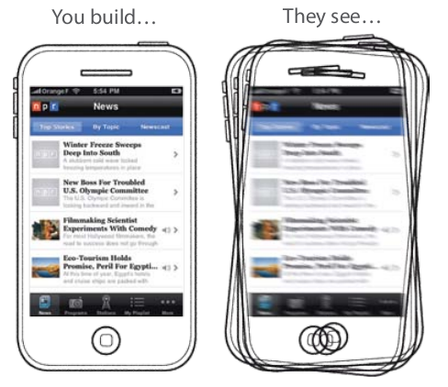
Take away
How to make this slide better:
Make sure no images are fuzzy that are not supposed to be (e.g., image on left). Use proper resolution.
Tapworthy P7

Slide 19
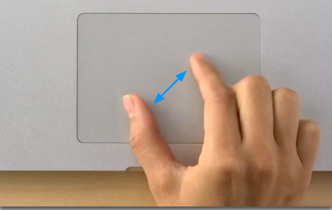
1. Easy to learn
How to make this slide better:
Don’t put bullets for single items.
You can make the image bigger and there is enough resolution to do so, so do.
Why Apple rocks?
Ctrl + + (IE)
ctrl
+
http://support.apple.com/kb/ht4721

Slide 20
1. Easy to learn
Why Apple rocks?
Ctrl + + (IE)
ctrl
+
http://support.apple.com/kb/ht4721

Slide 21

A bad example
How to make this slide better:
Do not have single item indented structure. Only use an indented bullet if there is more than one item
When I press new game
  I do want to start quickly
When I enter the game the 2nd time
  I do not need to be asked about the tutorial
https://play.google.com/store/apps/details?id=com.ea.game.tetris2011_na

Slide 22
A bad example
When I press new game
I do want to start quickly
When I enter the game the 2nd time
I do not need to be asked about the tutorial
https://play.google.com/store/apps/details?id=com.ea.game.tetris2011_na

Slide 23
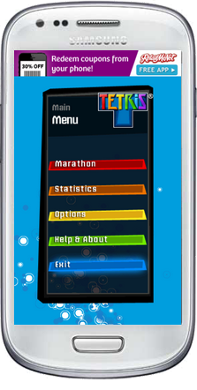
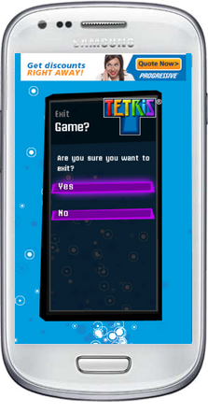
A bad example
How to make this slide better:
Notice how the title moves from the prior slide to this one. It looks sloppy.
Main menu
Waste my time
Screenshot from TRTRIS EA

Slide 24
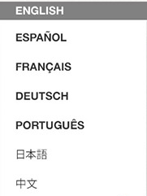
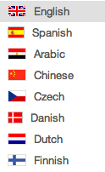
3. Easy settings
How to make this slide better:
Align these two images at the top. They are slightly misaligned. See the next slide.
Easy to understand
Good idea?
Screenshot on page http://flagsarenotlanguages.com/blog/2012/09/bab-la-flag-overload/

Slide 25

3. Easy settings
Easy to understand
Good idea?
Screenshot on page http://flagsarenotlanguages.com/blog/2012/09/bab-la-flag-overload/

Slide 26



National flag ≠ language
How to make this slide better:
Some images need a black border, especially those with white at edges. See next slide.
http://www.worldaccent.com/blog/2012/09/flags-multilingual-website-navigation.html
These two national flags come from the item Switzerland and Canada on Wikipedia

Slide 27
National flag ≠ language
http://www.worldaccent.com/blog/2012/09/flags-multilingual-website-navigation.html
These two national flags come from the item Switzerland and Canada on Wikipedia

Slide 28
A secret in Android
How to make this slide better:
-> notation is sloppy
“Go to settings”
Go settings
-> About device
-> triple tap Android Version

Slide 29
A secret in Android
Go to “Settings”
Click “About device”
Triple tap “Android Version”

Slide 30
5. Easy gestures
People are too lazy or busy to learn
How to make this slide better:
“Lazy” is a word with negative connotations. Best to avoid it whenever talking about users

Slide 31
Take away
As easy as possible
  Easy to learn, to react
  Easy settings, gestures, buttons
Are we designing apps for dummies?
How to make this slide better:
The take away message should always be concrete messages to remember.

Slide 32
Take away
Programming Android in C/C++
Using NDK
Bringing your game to Android
Troubleshooting, Tips and Tricks
How to make this slide better:
This take away message is an outline, not specific important points to be remembered.

Slide 33
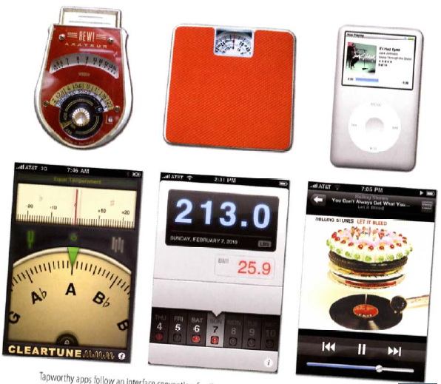
Physical Feel
You have to consider how your app looks and also feels
Try to make your app feels like real physical device
How to make this slide better:
Avoid sloppy-looking images (here not even straight). Always include the source.
“Feel” should be “feel”. Be consistent with capitalization and punctuation across slides.

Slide 34
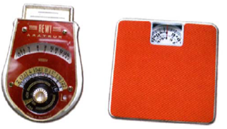
What is to feel like a real device?
Place important info at the top and controls to the bottom
People are used to work with real devices and feel more comfortable working with them
How to make this slide better:
Makes sure your English is perfect: “People are used to work”

Slide 35
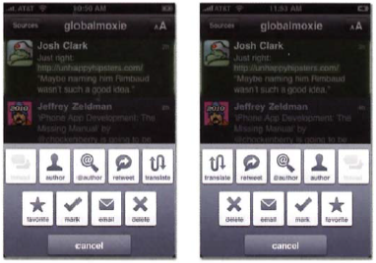
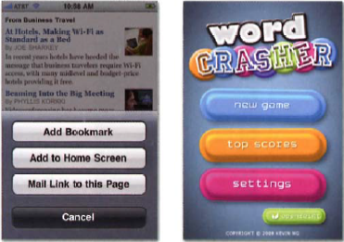
Who is your user?
2 most common tactics:
Offer a setting for the most common buttons for left-handed people
Or just make layout equally useful for all people
How to make this slide better:
For 20s, there is too much info on this slide.
Also, put 1 pixel black border around images and they will look just slightly sharper.
Source of all images should be noted.

Slide 36
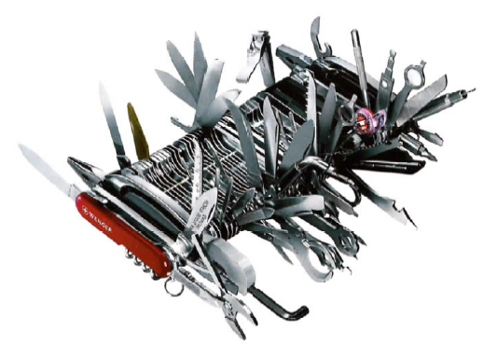
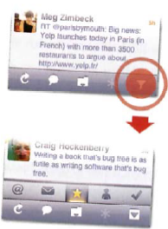
Don`t crowd your screen
  Some phones limit number of buttons on the screen.
Hide advanced options
How to make this slide better:
Please do not use clip art.
Bottom image is rotated, fuzzy, and not credited.
← Quickoffice app offers secondary tools in popover menus when you tap an icon in the main toolbar

Slide 37
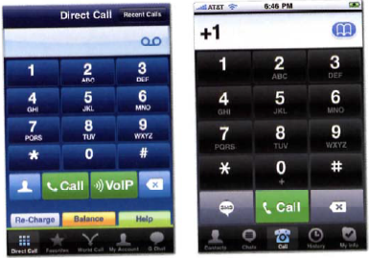
Crowding example
Don`t make your users play wheel of fortune
How to make this slide better:
See how the bullets and text doesn’t align on the left? It looks sloppy.
(See prior slides for image comments)
Call Global App:
Skype App:
Hint: place buttons taking user to another menu (screen) away from most used buttons hence thumb`s hot zone

Slide 38
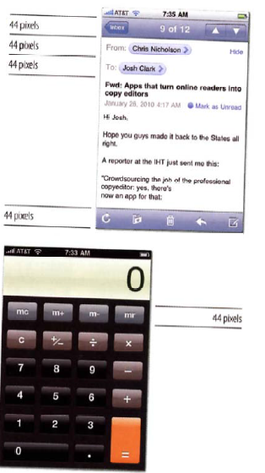
The magic number is 44
44pixels=7mm with 163 ppi
resolution (iPhone 4)
Can be different for different
phones:
Nexus 4 has 318ppi
Nexus 5 has 441ppi
Galaxy S3 306ppi
Galaxy S4 441ppi
How to make this slide better:
Here the bullet indentation is not correct. The 2nd line should be indented. This looks sloppy.

Slide 39
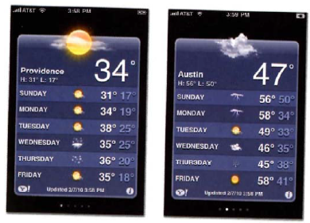
Do you really need scrolling?
“Out of sight, out of mind” rule
Scrolling requires both extra thought and extra swipes, designers need to reduce both
E.g. Accuweather app
uses card-like forecasts
for each city
How to make this slide better:
Here’s another example of indenting. Little things like this impact your credibility.
Accuweather.com app:

Slide 40
Take away
How to make this slide better:
The message here is great. A true take away (vs an outline).
But can it be done with fewer words?
And make sure all are actions; be consistent in lists.
There is also a typo.
And use ‘ not `
See next slide…
Place primary controls in the “hot zone”
The practical minimum size for any tap target is finger size (~7mm)
Be a scroll skeptic
Place important info at the top and controls to the bottom
Don`t crowd your design
All of these are recommendations, not laws, stay creative

Slide 41
Take away
Place primary controls in “hot zone”
Size all buttons for fingers (~7mm)
Be a scroll skeptic
Place important info at the top
Place controls at the bottom
Don’t crowd your design
Follow guidelines, but also stay creative
See how much improved this is?
Also, note the parallel structure. Each point is an action, that starts with a verb.

Slide 42
Take away
How to make this slide better:
This is more of an outline than a take away slide. It does not tell me, specifically, the most important few points I need to remember.
What are the critical factors that make your app popular(or not) among users?
Success factors you must focus on when developing an app

Slide 43
The big picture
An app is tapworthy if it makes your users’ lives better by
  Helping them get stuff done
  Make them laugh
  Stay connected
  Fill downtime
How to make this slide better:
The first point doesn’t need a bullet because there is no second bullet at that level.
The list does not have a consistent structure. Help them… Make them…
Compare this slide to the next one…

Slide 44
What’s tapworthy?
An app that helps users
  Get stuff done
  Laugh
  Stay connected
  Fill downtime

Slide 45
How to make it tapworthy?
Every tap should have a payoff:
  Information
  Delight
  A completed task
  A sense of satisfaction
You must design for an economy of time, attention and screen space
How to make this slide better:
2nd level should be a list with bullets.
Reduce wordiness

Slide 46
How to make it tapworthy?
Every tap has a payoff:
  Information
  Delight
  Completed task
  Sense of satisfaction
Design for economy of:
  Time
  Attention
  Screen space

Slide 47
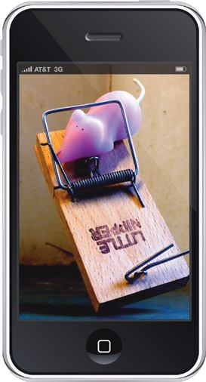
“Good” app ideas
Build a better mousetrap?
  4000+ patents for mousetrap
  designs but only 20 successful
Reinventing the wheel?
  Do it differently
How to make this slide better:
No need for a 2nd indented level if there is only one point on that level.
It’s good there is a reference for the image, but a shorter link would be fine, such as by using bit.ly
See the next slide…
http://librairie.immateriel.fr/fr/read_book/9781449381653/ch02

Slide 48
“Good” app ideas
Build a better mousetrap?
  Out of 4000+ patents of
  mousetrap designs, only
  20 successful
Reinventing the wheel?
Do it differently
This is now a little visually cleaner.
However, it’s not clear what the nugget/point really is here. That could be made better, I suspect.
http://bit.ly/2cIfC7j

Slide 49

Mindset 1: I’m microtasking
Mobile devices are for convenience and context, ideal for microtasks
The best mobile apps often
offer:
  Quick access
  Simplicity
  Tuning for short but frequent hits.
How to make this slide better:
No clip art or stock images that don’t convey real information.
Be consistent in punctuation. (Why is there a . After hits?
Reduce words where possible
http://www.adigaskell.org/blog/2013/10/23/the-use-of-task-in-a-social-business/

Slide 50
Mindset 1: I’m microtasking
Mobile devices are used
  For convenience
  In context
  For microtasks
The best mobile apps offer
  Quick access
  Simplicity
  Tuning for short, frequent hits

Slide 51
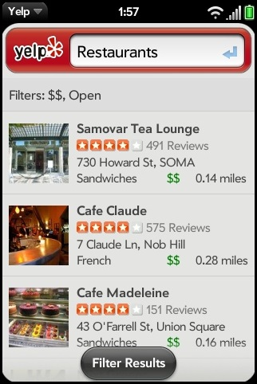
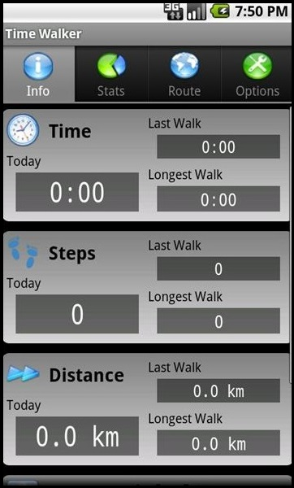
Mindset 2: I’m local
How to make this slide better:
Two phone images from a phone of different widths looks just a tad sloppy.
http://officialblog.yelp.com/2009/08/mobile-mania-part-tres-yelp-now-with-100-more-pre.html
http://www.brighthub.com/mobile/google-android/articles/105748.aspx

Slide 52
Throw away most of the ideas
During the initial planning of your app, brainstorm as many features you can think of that will make your app unique
  Then throw most of these ideas out
Think big but build small
  Your app should do only just about as much as what the users need
How to make this slide better:
Lots of words here. Better to reduce and organize…
See next slide…

Slide 53
Throw ideas out
Plan
Brainstorm
  Target uniqueness
  Target only what user most needs
  Think big, build small
Then throw ideas out

Slide 54
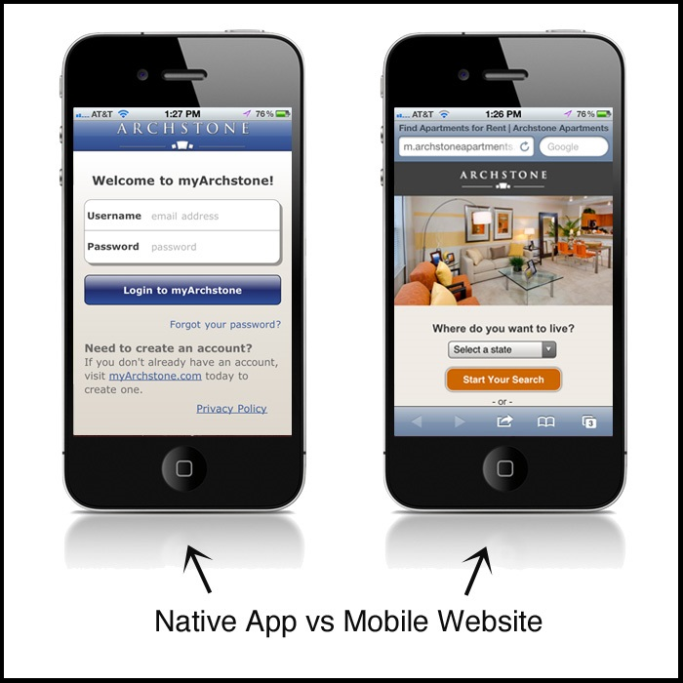
Web v/s Mobile experience
How to make this slide better:
This is a good slide assuming the points that are made are clear. Using less text and more imagery is useful when you can.
The title here has punctuation inconsistencies with other slides (and a typo)
http://www.freshtilledsoil.com/native-app-vs-mobile-website/

Slide 55
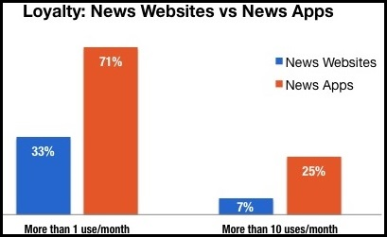
Web v/s Mobile: How to win
Efficiency is a feature
  Compact, speedy and ready
Native polish makes
content shine:
Save it for later
  Caching of data
How to make this slide better:
Any graph will take time to absorb. There is too much info on this slide. You can and should be able to explain complex ideas, but you have to break up the explanation into 20s nuggets. A complex graph could require one slide, or more than one. If more than one, using animations to highlight what you want someone to be paying attention to as you explain it, can help.
The use of bullets in the text can be cleaned up (don’t have single bullets at the same level)
http://www.localytics.com/blog/2012/news-apps-3x-more-engaging-than-news-websites/

Slide 56
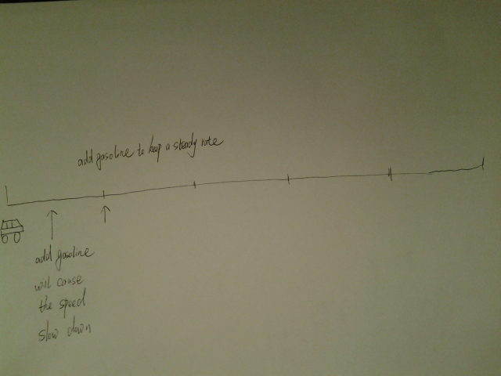
Game mode
A car race game related to the mode
Each fetch corresponds to adding gasoline to the car.
Adding gasoline too frequent will slow down the car.
A proper eating speed will result in a high rank of the car.
How to make this slide better:
Using scans of sketches is ok, but make sure the text is neat and can be read from the back of the room.
Thresholding to make the sketch black and white (without the gray background) would also help.

Slide 57
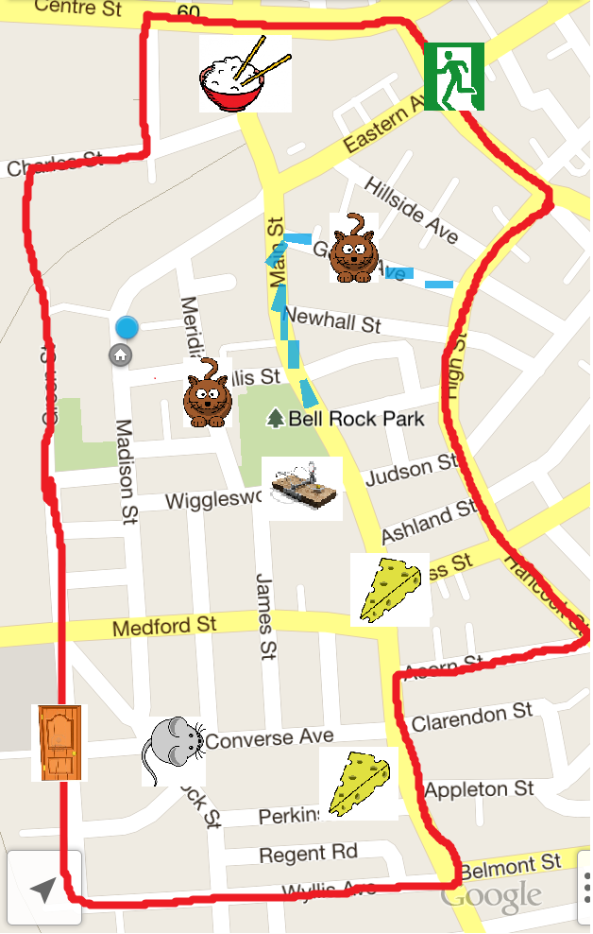
Mock screen
Exit
How to make this slide better:
The image on this slide (with the labels) is good, but the placement of the image looks messy.
The font in the subject line was changed from the required format and looks sloppy relative to other slides now.
Moving route
Cat
mousetrap
You!

Slide 58
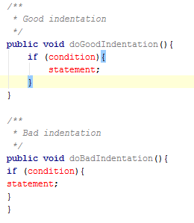
Indentation
How to make this slide better:
Avoid excessive punctuation (e.g., “!!!!”). Looks very unprofessional. In fact, avoiding all “!” is probably a good goal. Only rarely are they truly needed.
Code sample is good but text is a bit small and image is not quite sharp.
It would help to highlight important parts of the code.
Don’t use Tabs!!!!
Most companies use between 2 and 4 spaces

Slide 59
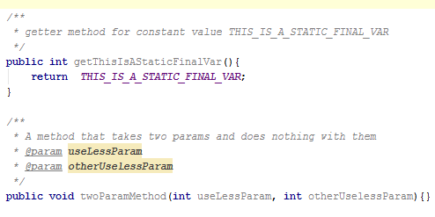
White Space
How to make this slide better:
Too much info on this slide and code is too small.
Text on left can be cleaned up.
The title is not consistent with the other slides. Should be “White space”
1 line
  Methods
  Local vars and first statement
  Logical statements
2 lines
  Class and interface definitions
Blank spaces

Slide 60
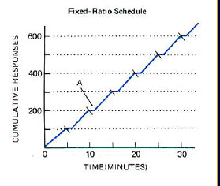
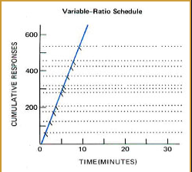
Basic Sorts of Contingency Ⅱ
How to make this slide better:
This slide is about a complex concept. It probably needs to be split into two to give the viewer time to understand it. The graphs should be bigger so the axes can be read.
There is no need for a bullet for one idea.
The title capitalization should be fixed.
One Basic Sort---Ratio schedule/Ratio
Ratio
Fix Ratio Schedule | Variable Ratio Schedule

Slide 61
Take away
Code conventions are important because
Improve readability of code
Reduce logic errors in your code and debugging time
How to make this slide better:
Reduce words
Avoid compound sentences
Make take away an action to follow
For example…

Slide 62
Take away
Use code conventions to improve:
Code readability
Logic errors
Debugging time

Slide 63
Naming conventions
Avoid using abbreviations
E.g use firstName instead of fn
Avoid names that are very similar
E.g product and products
Avoid generic names
E.g number or temp
How to make this slide better:
Reduce words
Fix typos
Show computer terms in a computer font
For example…

Slide 64
Naming conventions
Avoid…
Abbreviations
firstName instead of fn
Similar names
product and products
Generic names
number or temp or j
If you get sick of bullets and think this looks too cluttered, you can use tables to get a different look that visually separates the main ideas and the examples more. An example is next…

Slide 65
Naming conventions
Avoid…
Abbreviations | firstName instead of fn
Similar names | product and products
Generic names | number or temp or j

Slide 66
Variable naming conventions
Variable names should use mixed case letters
E.g firstName
Use English descriptions for names
Use plural names for array
E.g testScores instead of testScore
How to make this slide better:
Reduce words
Fix typos
Show computer terms in a computer font
Include missing info (e.g., lists
Use new examples from prior slide
For example…

Slide 67
Variable naming conventions
Use…
Mixed case
lastNameUser instead of
lastnameuser
English descriptions
loginNames instead of lgnnms
Plural names for arrays/lists
testScores instead of testScore
The next slide might be even cleaner…
(Assuming you are talking through it)

Slide 68
Variable naming conventions
Use…
Mixed case
lastnameuser → lastNameUser
English descriptions
lgnnms → loginNames
Plural names for arrays/lists
testScore → testScores

Slide 69
Constant naming conventions
All upper case e.g TAX_RATE
Use named constants for numbers other than 0 or 1
How to make this slide better:
Use format consistent with previous slides
Reduce words
Show computer terms in a computer font
Explain 2nd bullet (not clear)
For example…

Slide 70
Constant naming conventions
Use…
Upper case w/ underscores
TAX_RATE instead of taxRate
Constants instead of “magic numbers”
PI instead of 3.14159
ACCELERATION_VALUE instead of 15.21
MAX_NUM_PEOPLE instead of 100
The next slide shows why the table can be a nice format to use. This slide here seems a bit cluttered with the examples (which you want to have).
With several of these types of slides in a row, though, you would need to be consistent in your style.

Slide 71
Constant naming conventions
Use…
Upper case with “_” | taxRate → TAX_RATE
Named constants instead of “magic numbers” | 3.14159 → PI 15.21 → ACCEL_VALUE 100 → MAX_NUM_PEOPLE

Slide 72
File header comments
Identification information about program and author
E.g
  /*
  * Created on : dd-mm-yy
  * Author : author
  *
  *-----------------------------------------------------------------------------
  * Revision History (Release 1.0.0.0)
  *-----------------------------------------------------------------------------
  * VERSION AUTHOR DESCRIPTION OF CHANGE
  *-----------------------------------------------------------------------------
  */
How to make this slide better:
Don’t use a single bullet. If there is only one bullet at any level, you don’t need bullets at that level!
Put the code in some sort of highlighted box
Use courier for code

Slide 73
File header comments
Info about program and author
  /*
  * Created on : dd-mm-yy
  * Author : author
  *
  *------------------------------------------
  * Revision History (Release 1.0.0.0)
  *------------------------------------------
  * VERSION AUTHOR DESCRIPTION OF CHANGE
  *------------------------------------------
  */

Slide 74
Single line comments
Provide overviews or summaries of chunks of code
E.g
  // Compute the sum of scores
  sumOfScores = 0;
  for (int i = 0; i < scores.length; i++)
  sumOfScores = sumOfScores + scores[i];
How to make this slide better:
Don’t use a single bullet. If there is only one bullet at any level, you don’t need bullets at that level!
Put the code in some sort of highlighted box
Use courier for code

Slide 75
Single line comments
Summaries of chunks of code
Example:
How to make this slide better:
This can still be improved a little. See the difference between this slide and the next one?
Little details like alignment and centering matter.
  // Compute the sum of scores
  sumOfScores = 0;
  for (int i = 0; i < scores.length; i++)
  sumOfScores = sumOfScores + scores[i];

Slide 76
Single line comments
Summaries of chunks of code
Example:
  // Compute the sum of scores
  sumOfScores = 0;
  for (int i = 0; i < scores.length; i++)
  sumOfScores = sumOfScores + scores[i];

Slide 77
Blank space
A keyword followed by parenthesis should be separated by a space
  while (true) {
  …
  }
Add space after commas in argument lists
All binary operators except . should be separated from their operands by spaces
sum += score1 + score2;
How to make this slide better:
This slide has a lot of verbiage for not a lot of information, and for the most part it is not as interesting material as other information that could be presented. I’d remove it altogether and select better content.

Slide 78
Beta test
How to make this slide better:
The first three points are related. Show a picture of the developer console and circle the place where you can get this information. That would make the slide more visual (remove the text) and more helpful. We are more likely to remember it. You might only be able to 2 and need to split the slide.
The last point should be moved to a different slide. There is not time to make it, and it is a different thought.
Crash reports are available
You can filter alpha and beta reports
Find optimization tips
Fully test your app yourself too!

Slide 79
Optimize
Link your developer console with Google Analytics to get data about the users and their engagement with your app
CSV exports to download the full data set
You can compare old versions with new ones to see if you’re going in the right direction
How to make this slide better:
Bullets 1 and 3 are actions. I’m not sure what bullet 2 is. All your bullets should be of the same type.
Remove wordiness.
Show us how to do this on images of the developer console.

Slide 80
Take away
Target the right users and devices for your app
Release a beta test version of your app as soon as possible
Take full advantage of the stage rollouts once your app is published
Finally use the data that Google makes available to you to optimize your app
How to make this slide better:
Reduce verbiage. See next…

Slide 81
Take away
Target specific users and devices
Release beta test version early
Stage rollouts
Optimize with Google’s data

Slide 82
How large is the market
3 out of 4 android users play games
100 million new users in six months
How to make this slide better:
You could find a graph with market trends and show the trend line, rather tah just the 100 million bullet.
The 100 million stat should reference a source and probably indicate the date because it is important to know if one sees the slide how old the info is (“100 million new users between Jan-June 2013”)
Fix typo: android -> Android

Slide 83
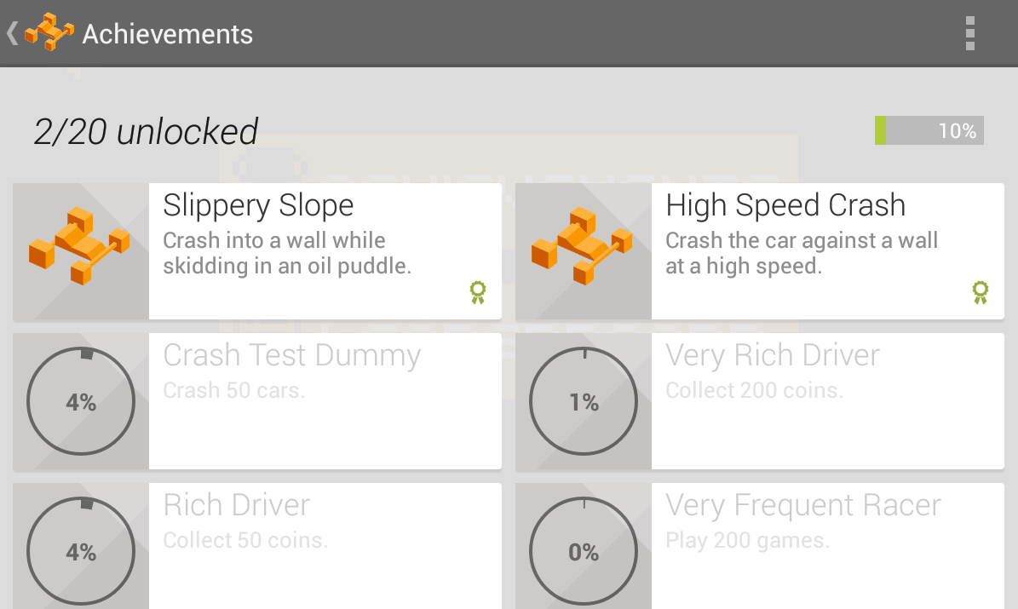
Achievements View
How to make this slide better:
1 pixel black boarder around all images
Check that the title capitalization is consistent with all other slides (here it is all capped)
Align reference link to left of image
https://developers.google.com/games/services/android/images/Achievements_Android.png

Slide 84
Achievements view
https://developers.google.com/games/services/android/images/Achievements_Android.png

Slide 85
Take away
Android game market is huge
Take advantage of Google Play Games Service
Have Global vision
Be innovative
How to make this slide better:
All these points are too vague. For example, what does “Be innovative” mean? What does “Have Global vision” (with a typo) mean?
More precision would help this slide.

