Slide 1
Parser Adaptation and Projection with Quasi-Synchronous Grammar Features
David A. Smith (UMass Amherst)
Jason Eisner (Johns Hopkins)

Slide 2
This Talk in a Nutshell
now
or
never
Parser adaptation
Learned by Quasi-Synchronous Grammar
im
Anfang
in
the
beginning
Parser projection
Unsupervised
Supervised

Slide 3
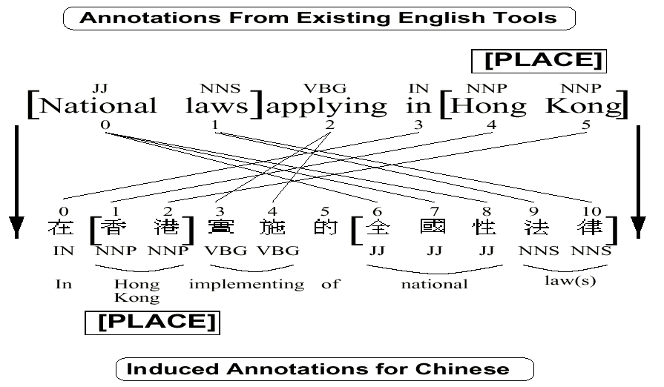
Projecting Hidden Structure
Yarowsky & Ngai ‘01

Slide 4
Projection
Train with bitext
Parse one side
Align words
Project dependencies
Many to one links?
Invalid trees?
Hwa et al.: fix-up rules
Ganchev et al.: trust only some links
Im
Anfang
war
das
Wort
In
the
beginning
was
the
word

Slide 5
Divergent Projection
Auf
diese
Frage
habe
ich
leider
keine
Antwort
bekommen
NULL
I
did
not
unfortunately
receive
an
answer
to
this
question
null
siblings
head-swapping
monotonic

Slide 6
Free Translation
Bad dependencies
Tschernobyl
könnte
dann
etwas
später
an
die
Reihe
kommen
NULL
Parent-ancestors?
Then
we
could
deal
with
Chernobyl
some
time
later

Slide 7
What’s Wrong with Projection?
Hwa et al. Chinese data:
38.1% F1 after projection
Only 26.3% with automatic English parses
Cf. 35.9% for attach right!
52.4% after fix-up rules
Only 1-to-1 alignments:
68% precision
11% recall
Im
Anfang
war
das
Wort
In
the
beginning
was
the
word

Slide 8
Excursus: Domain Adaptation

Slide 9
Projection
Different languages
Similar meaning
Divergent syntax
Im
Anfang
war
das
Wort
In
the
beginning
was
the
word

Slide 10
Adaptation
Same sentence
Divergent syntax
In
the
beginning
was
the
word
In
the
beginning
was
the
word

Slide 11
A Lack of Coordination
now
or
never
now
or
never
Prague
Mel’čuk
now
or
never
now
or
never
CoNLL
MALT

Slide 12
Prepositions and Auxiliaries
in
the
end
in
the
end
in
the
end
I
have
decided
I
have
decided

Slide 13
Adaptation Recipe
Acquire (a few) trees in target domain
Run source-domain parser on training set
Train parser with features for:
Target tree alone
Source and target trees together
Parse test set with:
Source-domain parser
Target-domain parser

Slide 14
Why?
Why not just modify source treebank?
Source parser could be a black box
Or rule based
Vastly shorter training times with a small target treebank
Linguists can quickly explore alternatives
Don’t need dozens of rules
Other benefits of stacking
And sometimes, divergence is very large

Slide 15
Model Structure

Slide 16
What We’re Modeling
t
This paper
im
Anfang
w
Generative
a
w’
in
the
beginning
Conditional
t’
Ongoing work

Slide 17

Stacking
…
Model 2 has features for when to trust Model 1
Model 2
Input
Model 1
Notes:
But first a word about: stacking.
Take a classifier and make it better
TBL et al.
Features that learn when to trust other features

Slide 18
Quasi-Synchronous Grammar
Generative or conditional monolingual model of target language or tree
Condition target trees on source structure
Applications to
Alignment (D. Smith & Eisner ‘06)
Question Answering (Wang, N. Smith, Mitamura ‘07)
Paraphrase (Das & N. Smith ‘09)
Translation (Gimpel & N. Smith ‘09)

Slide 19
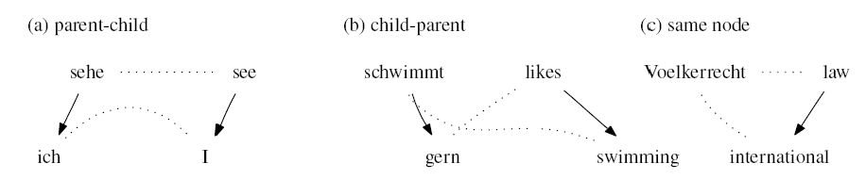
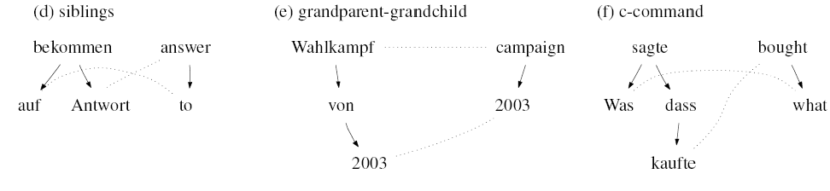
Dependency Relations
+ “none of the above”

Slide 20
QG Generative Story
observed
?
Auf
diese
Frage
habe
ich
leider
keine
Antwort
bekommen
P(parent-child)
NULL
P(breakage)
P(I | ich)
I
did
not
unfortunately
receive
an
answer
to
this
question
P(PRP | no left children of did)
O(m²n³)

Slide 21
Experiments

Slide 22
Experimental Plan
Proof of concept on English dependency-convention adaptation
Unsupervised projection
No target trees
Generative target model + QG features
Supervised projection
Small number of target trees
Conditional target model + QG features

Slide 23
Adaptation Results
Different PTB dep. conversions
See paper for more results

Slide 24
Unsupervised Projection

Slide 25
Supervised Projection

Slide 26
Conclusions
Unified adaptation and projection
Conditional and generative training with quasi-synchronous grammar features
Learned regular divergences
Ongoing work:
Joint, but not synchronous, inference
Better alignments
More adaptation problems

Slide 27
Questions?
Thanks!

Slide 28
Really Different Domains
中国
在
基本
建设
方面
，
开始
In
the
area
of
infrastructure
construction
,
China
has
begun…

