Slide 1
Microsoft Spectrum Observatory
Ranveer Chandra
Microsoft Research
Joint work with:
Anoop Gupta, Matt Valerio, Paul Garnett, Victor Bahl, Aakanksha Chowdhery, Ashish Kapoor, Mariya Zheleva

Slide 2
MSR KNOWS Program (2005 – …)
v1: Ad hoc networking in TV white spaces
  Capable of sensing TV signals, hardware functionality
v2: Infrastructure based networking(WhiteFi)
  Capable of sensing TV signals & microphones, deployed in lab
v3: Campus-wide WhiteFi network + world-wide trials
  Deployed on campus, and provide coverage in MS Shuttles
  Deployments in several countries in Africa, Asia & Europe
v4: White spaces beyond TV spectrum
  Spectrum measurements to identify additional white spaces

Slide 3
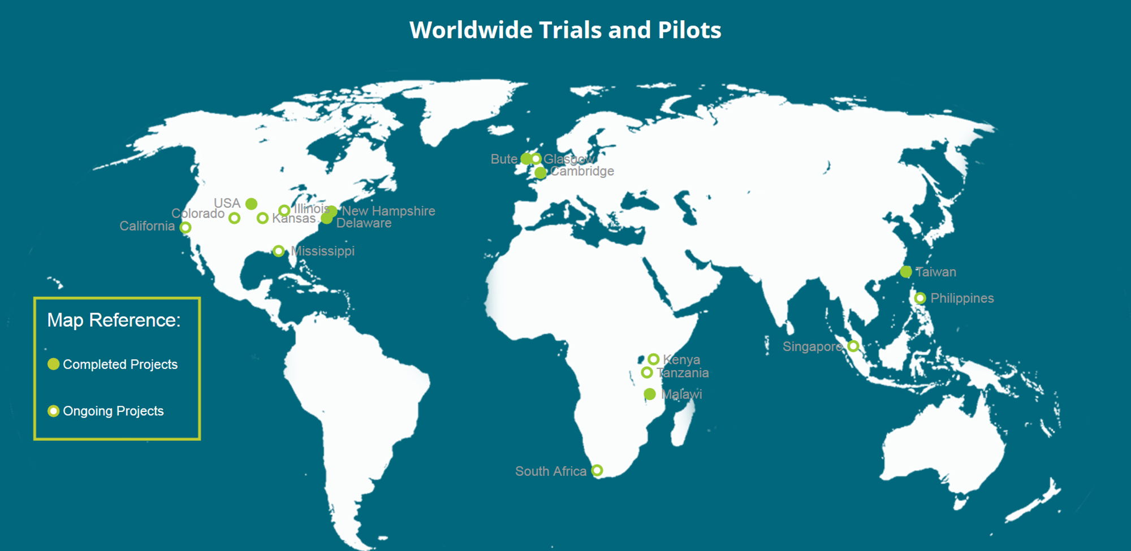
Trials and Pilot Projects

Slide 4
Problem Statement
For a given region, which spectrum bands are best to form DSA networks?

Slide 5
Problem Statement
For a given region, which spectrum bands are best to form DSA networks?
Industrial/Business Radio
GPS Radio-navigation
NASA Deep Space Network
Military Radars
Fixed Service Satellites
Aviation
Maritime
….
Mobile Satellite Services
Diverse set of primary licensees, different transmission schemes, coverage regions etc…

Slide 6




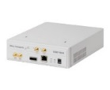
Our Approach
Academics
Regulators
Users
White Space devices
Microsoft
Cloud Service
Wireless Operators
…
<$5,000

Slide 7




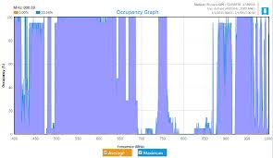
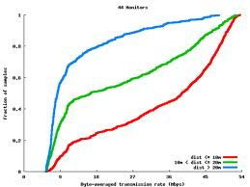

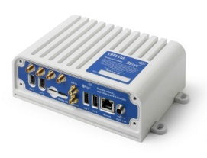
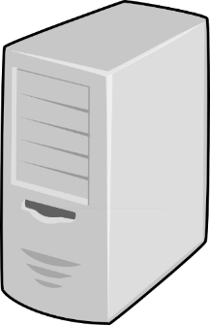


Our Approach
Microsoft Azure
Cloud Service
Visualize
Policy Makers
DSA Users
Researchers
Cmds
• Real-time/History Occupancy
• User Signal Feature
Processed Data
• Other Information…
Control Cmds
End User
<$5,000
Local Station
DATA
Control
Local Processing: Averaging, Sampling, Feature extraction

Slide 8
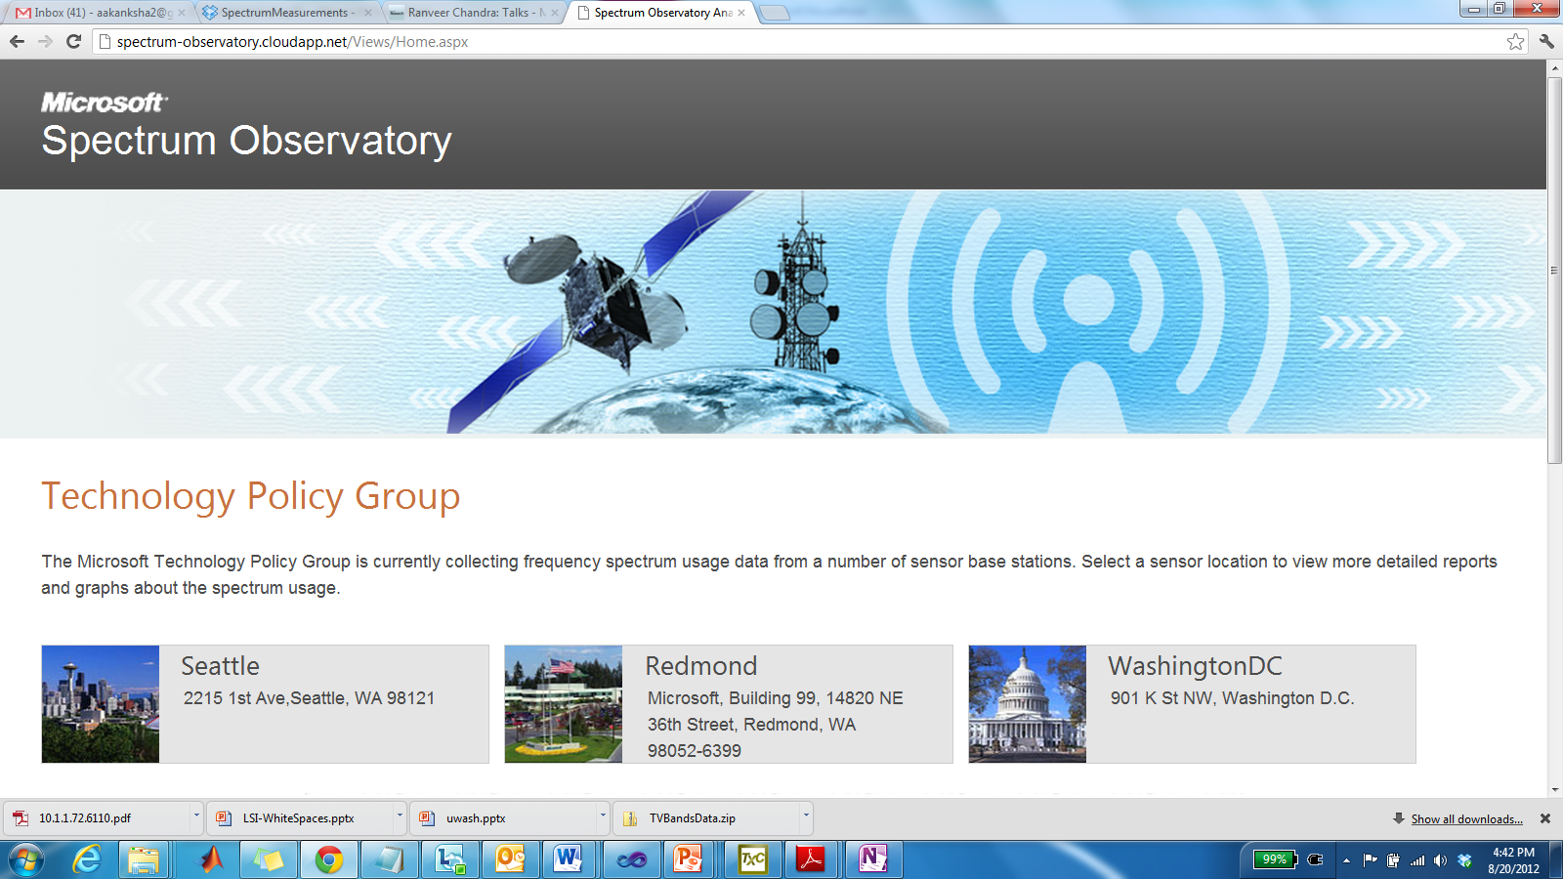
Our Approach
FCC Spectrum Dashboard
Fixed Spectrum Analyzer Measurements
Mobile Spectrum Measurements
Spectrum Occupancy
Smart Visualizations

Slide 9
Use cases
Policy makers:
  Identify unused portions of spectrum, i.e. good for DSA
  Detect rogue transmissions
  Identify locations of transmitters (in developing countries)
White space devices:
  Dynamically consult with database to decide spectrum for communication
Academics/Researchers:
  Modeling the real world

Slide 10
Summary
http://observatory.microsoftspectrum.com
  10+ active stations, many more in the future
    Please contact AnoopG if you are willing to host a station, or interested in analysis
Ongoing Research
  Better Data:
    Quick & reliable spectrum scanning algorithms (with MIT)
    Space-Time-Frequency occupancy using mobile spectrum measurements (with IIT-Delhi)
  Making sense of the data:
    Detecting transmitters in spectrum observatory data (with UCSB)
    DSA metric to identify spectrum most suitable for DSA (with Stanford)

