Slide 1
Crowdsourcing Data Collection
Nov 2014, Changbo Wen

Slide 2
What is the carrier ‘s interests in terms of crowdsourcing data, KPI
Network performance,
  Voice (AFR, DCR), data service(speed), missing negative event- no service
  KPIs to be tracked for carrier/network engineers and equipment vendors, some are not customer related
User experience
  Coverage: outdoor-detail, indoor-, no service, Signal quality, WiFi,
  Data service: speed, App.(web page, video), congestion
  Service (VoLTE), network layer (channel BW, EARFCN, UARFCN), Access failure, drop call,
Competitive view:
  Inter carrier: carrier A Vs B
  Intra carrier: markets, network layers (AWS Vs PCS band), vendors, device, MVNO
Customer feedback: feedback after negative event

Slide 3
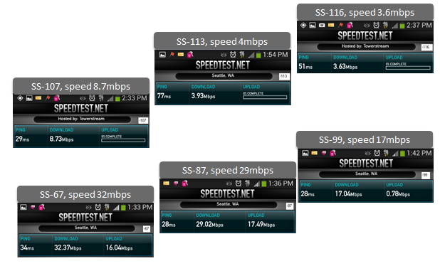
Radio signal strength plays a significant role in user experience and with LTE technology, radio is more robust comparing to older technology
Acceptable speed with low signal
superb speed with good signal

Slide 4
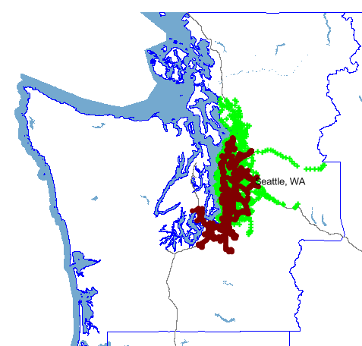
Traditional drive test is limited by resource and take time to complete
Vendor A Drive route is generally larger than Vendor B and usually out-drives our Modernized network areas
Vendor B now drives 137 markets a year while Vendor A drives 213. Again, Vendor A drives well beyond the markets that are a focus for a carrier
Vendor A drive routes
Vendor B drive routes

Slide 5
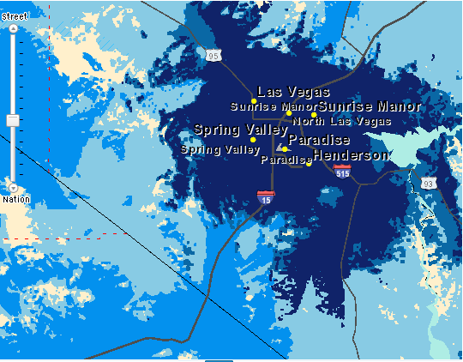
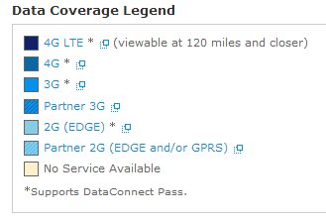
Coverage-most carriers provide prediction to customer challenge: costly to provide timely view from drive test
Crowdsourcing: make it possible
Challenge: to provide user experienced view

Slide 6
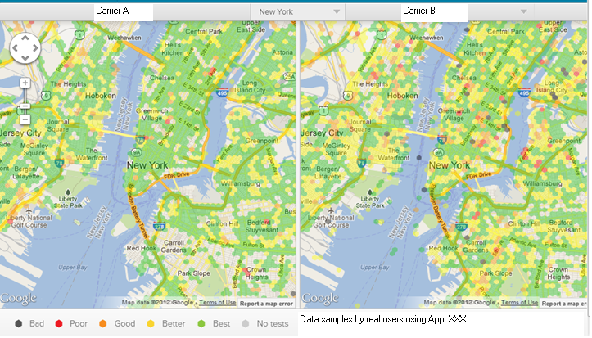
Coverage-provide insight of areas to improve, help customer to select better network
Crowdsoucing data provided more user friendly view

Slide 7
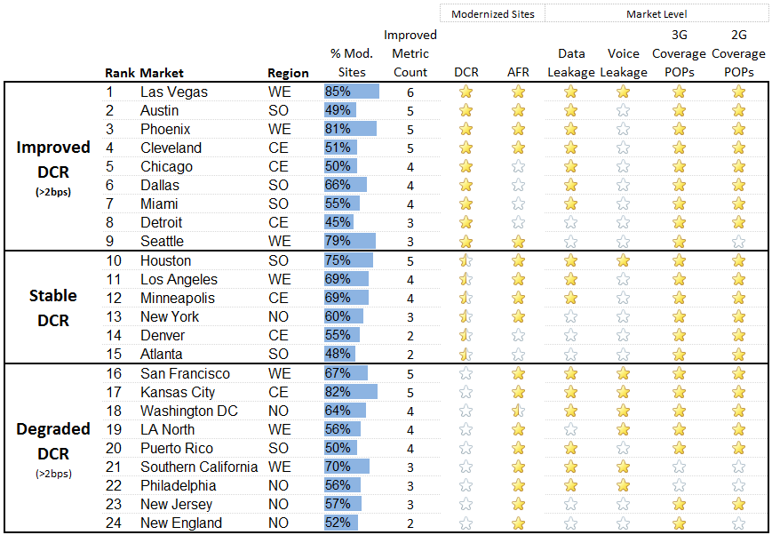
Crowdsoucing data helps to close the gap of network KPI and user experience
Example – not real
Operator always focuses on network KPIs which are tracked and improved over time
Challenge: my experience –user view, negative event, e.g. no service

Slide 8
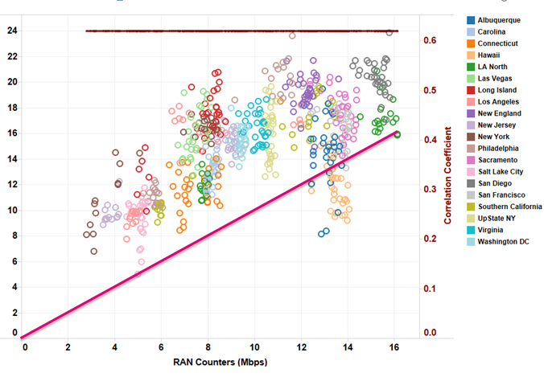
Crowd sourcing speed result has good correlation with network KPI
Android App Speed (mbps)
0.62 correlation

Slide 9
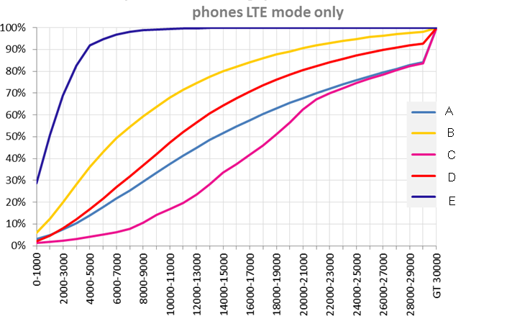
CDF provides population view – carrier C: 90% users having speed of 8mbps+
Higher Better

Slide 10
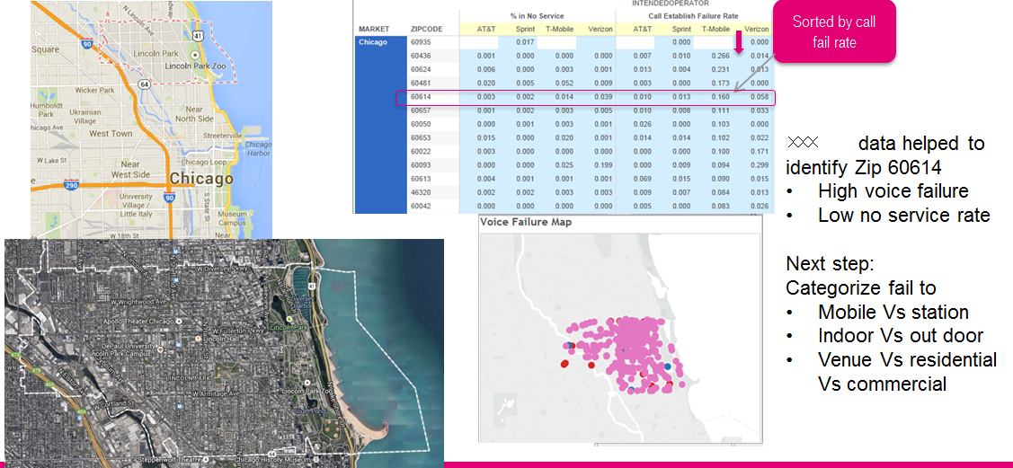
Crowd data provide a view of poor performing area (zip), carrier will need more information e.g. mobile, indoor, business…

Slide 11
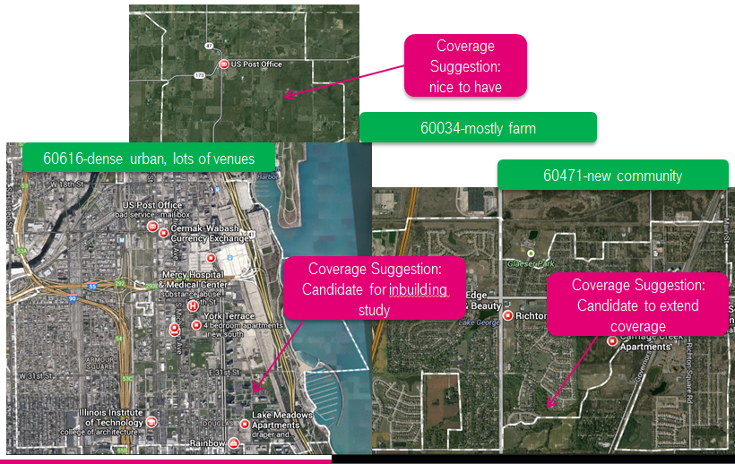
High percentage No service view provide suggestions for different morphologies

Slide 12
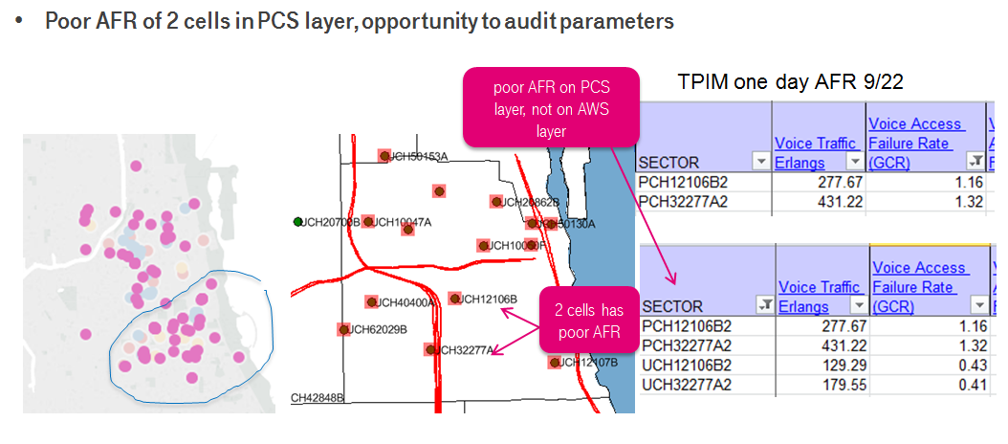
Performance gap by network layers (PCS, AWS), device (model, OEM, software versions)

Slide 13
Android API: ASU Vs dBm
Arbitrary Strength Unit (ASU) is an integer value proportional to the received signal strength measured by the mobile phone.
It is possible to calculate the real signal strength measured in dBm (and thereby power in Watts) by a formula. However, there are different formulas for 2G and 3G networks.
In GSM networks, ASU maps to RSSI (received signal strength indicator, see TS 27.007^{[1]} sub clause 8.5).
  dBm = 2 × ASU - 113, ASU in the range of 0..31 and 99 (for not known or not detectable).
In UMTS networks, ASU maps to RSCP level (received signal code power, see TS 27.007^{[1]} sub clause 8.69 and TS 27.133 sub clause 9.1.1.3).
  dBm = ASU - 116, ASU in the range of -5..91 and 255 (for not known or not detectable).
In LTE networks, ASU maps to RSRP (reference signal received power, see TS 36.133, sub-clause 9.1.4). The valid range of ASU is from 0 to 97.
  For the range 1 to 96, ASU maps to (ASU - 141) ≤ dBm < (ASU - 140).The value of 0 maps to RSRP below -140 dBm and the value of 97 maps to RSRP above -44 dBm.
ASU shouldn't be confused with "Active Set Update". The Active Set Update is a signalling message used in handover procedures of UMTS and CDMA mobile telephony standards. On Androidphones, the acronym ASU has nothing to do with Active Set Update. It has not been declared precisely by Google developers.^{[2]}
Source: http://en.wikipedia.org/wiki/Mobile_phone_signal

Slide 14
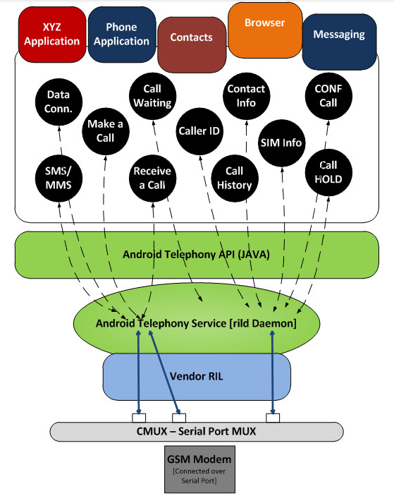
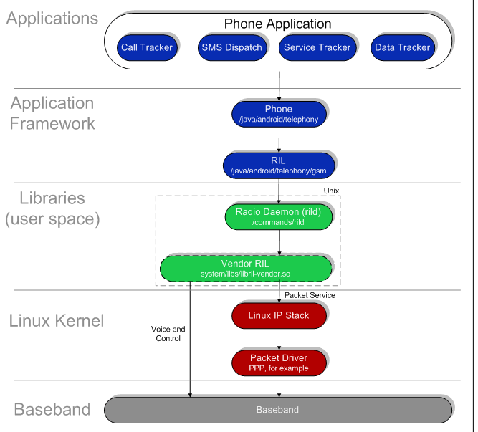
Carrier’s wish: get more information from Android telephony and Radio baseband
Challenge: To detect events
Get more info from lower layer

