Slide 1
Decision-Making Under Uncertainty in Multi-Agent and Multi-Robot Systems: Planning and Learning
Chris Amato
Northeastern University

Slide 2
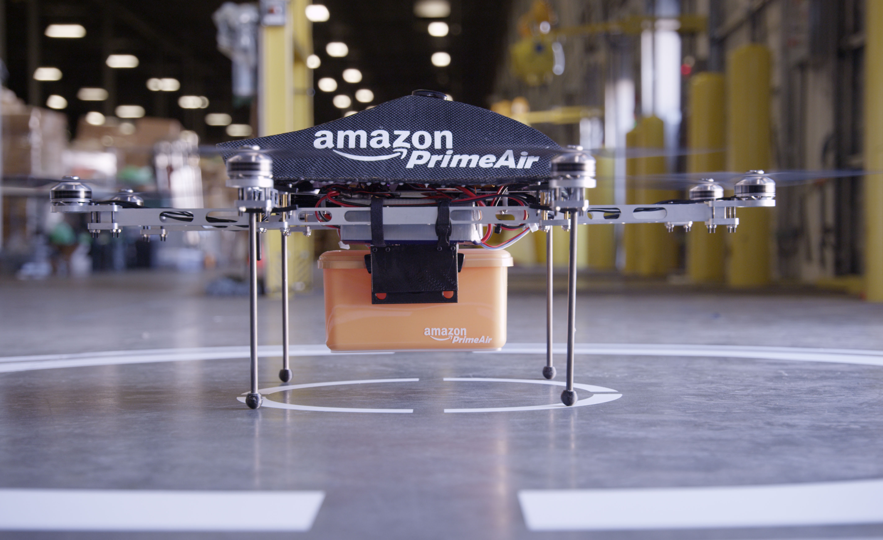
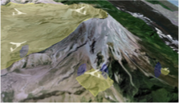
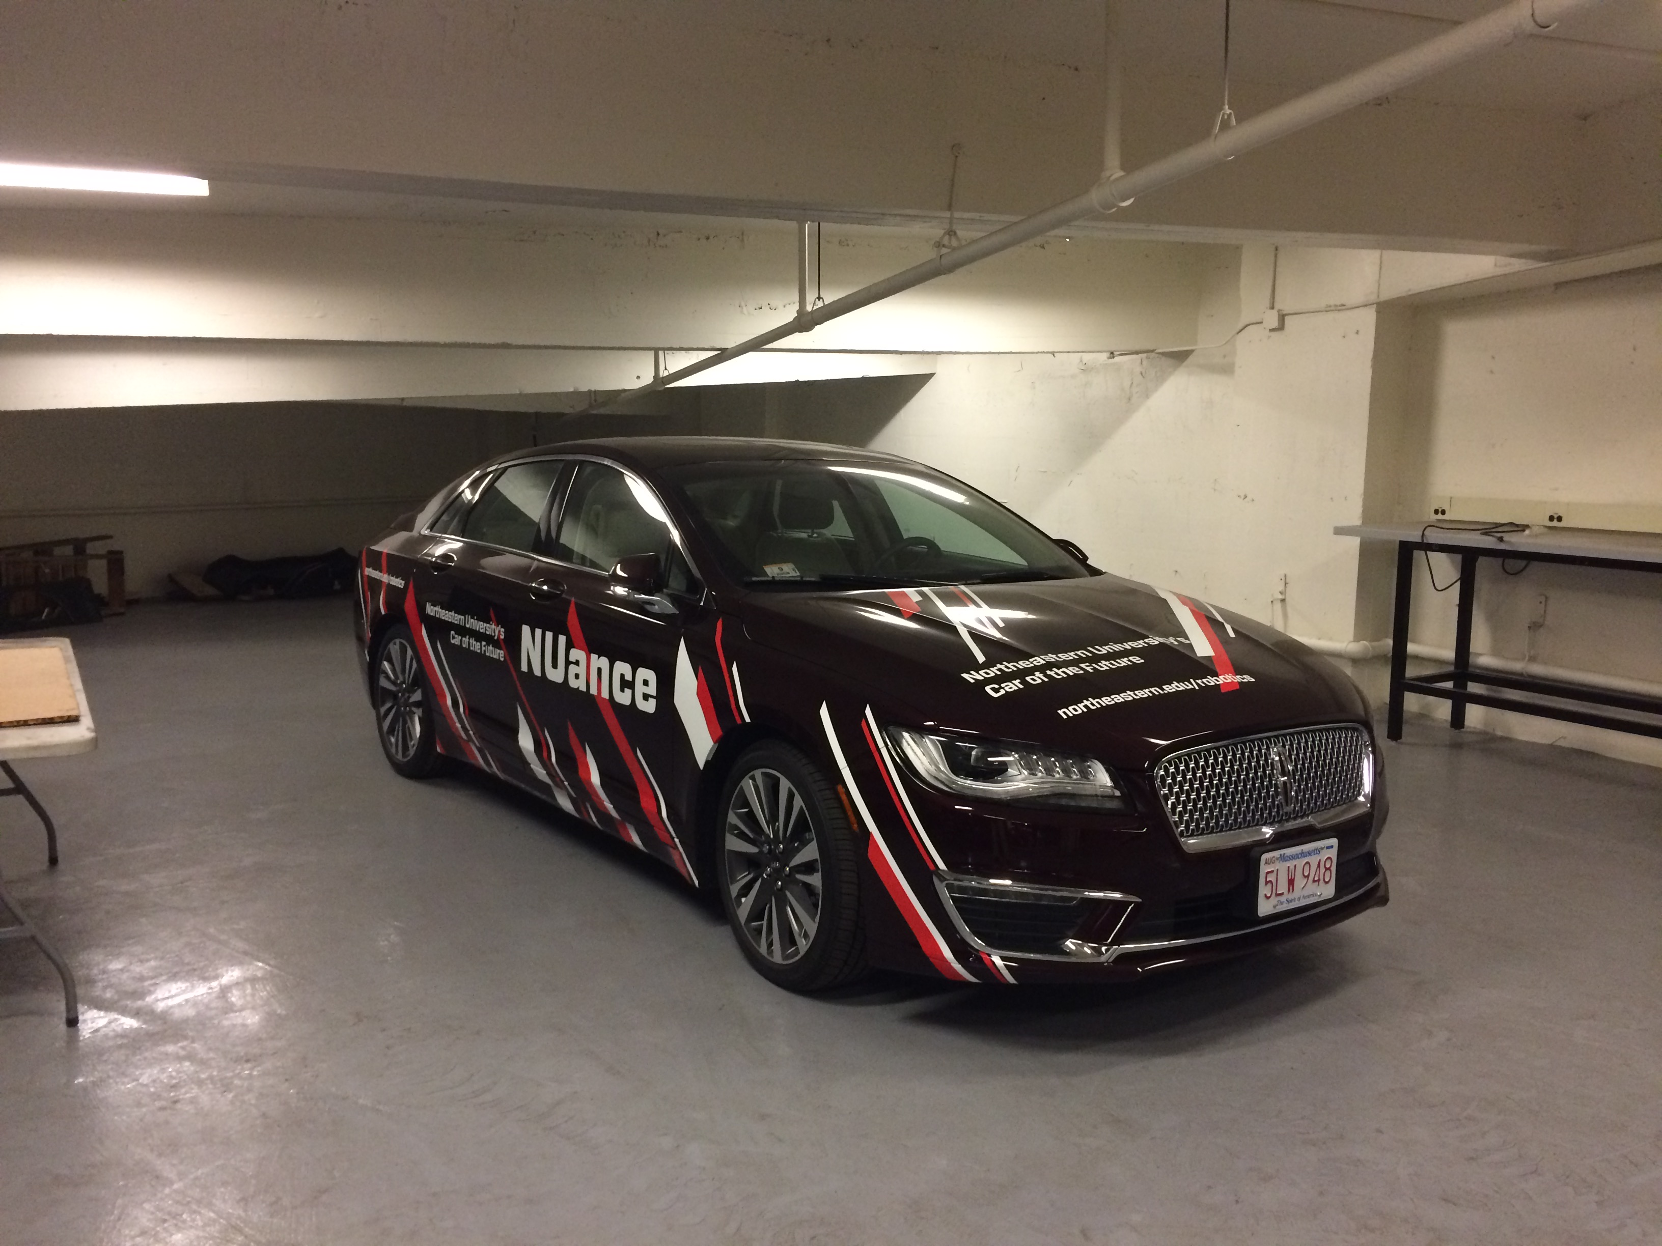
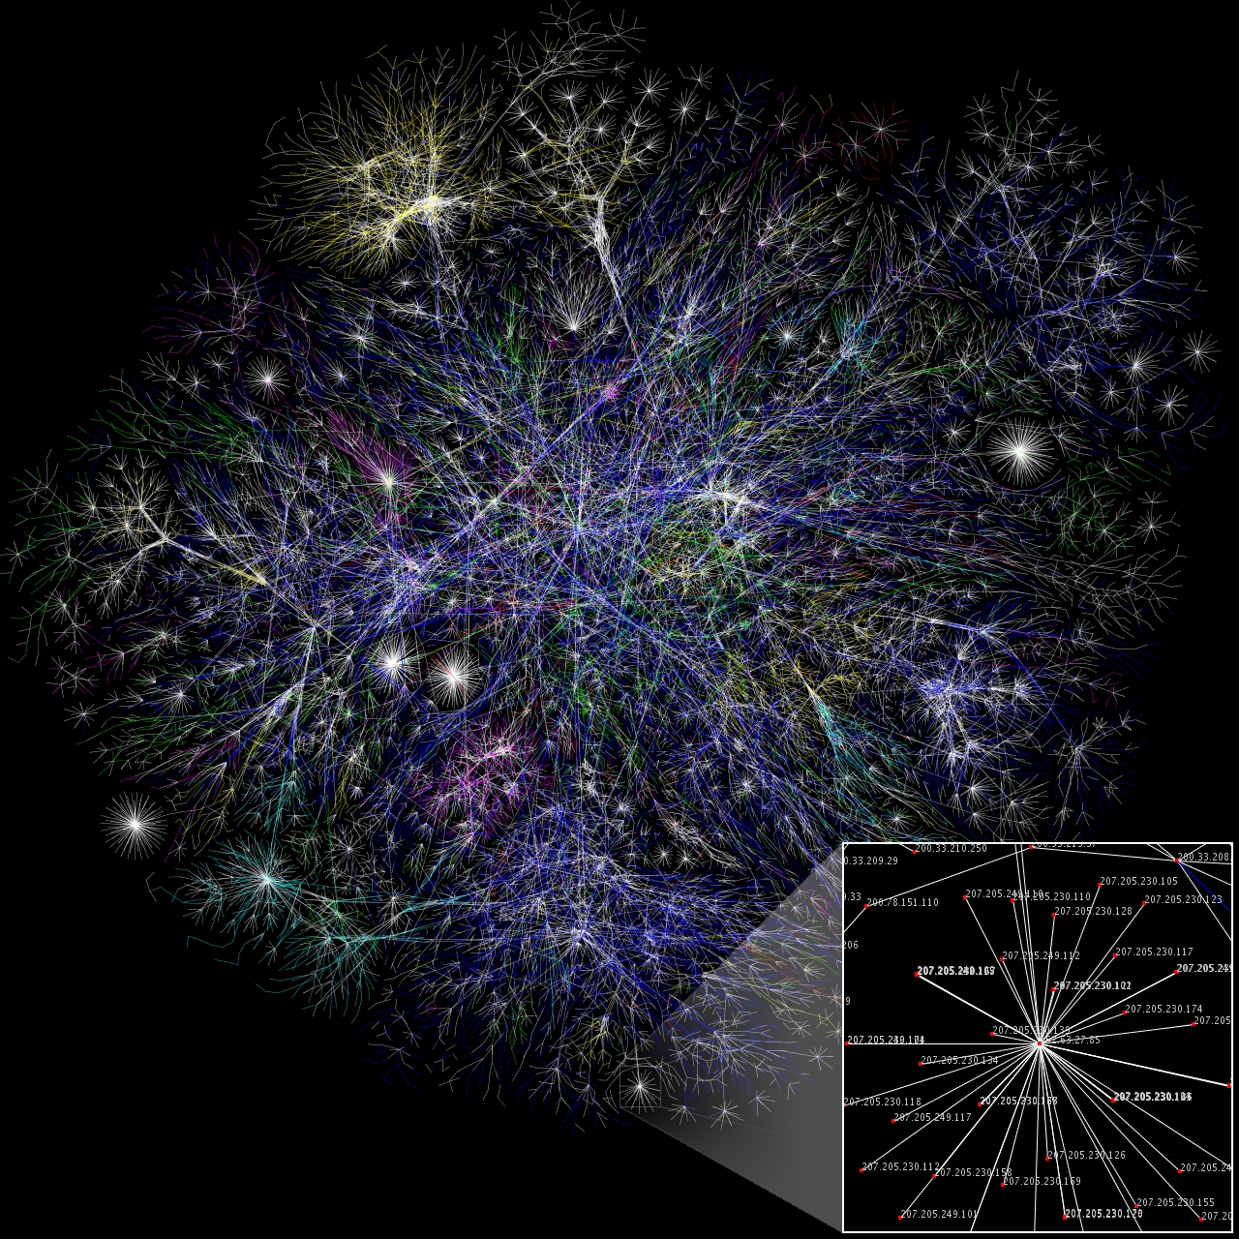
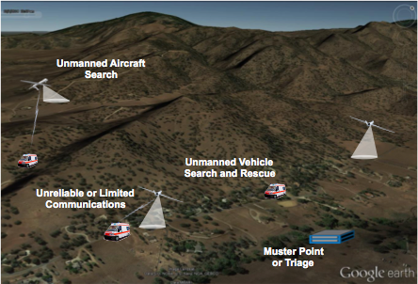
Multi-agent systems are (going to be) everywhere
Drone delivery
UAV surveillance
Autonomous cars
Search and rescue
Smart energy grids
Cyber security

Slide 3
Uncertainties
These real-world problems have several forms of uncertainty:
Outcome uncertainty
Sensor uncertainty
Communication uncertainty

Slide 4
Uncertainties: Search and Rescue
A team of ground and aerial robots searching for people after a disaster:
Outcome uncertainty: movement of robots and people is uncertain
Sensor uncertainty: location of people and obstacles is uncertain
Communication uncertainty: communication range is limited, so location and choices of other robots is uncertain

Slide 5
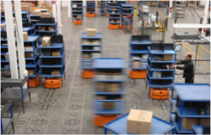
Uncertainties
Many other real-world problems have outcome, sensor and communication uncertainty

Slide 6
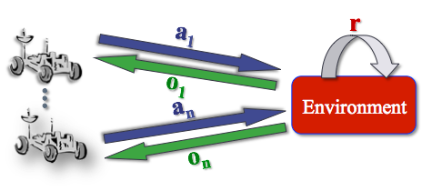
Multiple cooperating agents
Decentralized partially observable Markov decision process (Dec-POMDP) Bernstein et al., 02
Extension of the single agent MDP and POMDP models
Multiagent sequential decision-making under uncertainty
At each stage, each agent takes an action and receives:
A local observation
A joint immediate reward

Slide 7



Dec-POMDP
Decision-theoretic model of multi-agent systems
We need to model:
Each agent's actions, A_{i}, for each agent i
The environment states, S
The environment dynamics,
Each agent’s sensor and communication observations,
The observation function,
The reward function,
A solution seeks to maximize the expected sum of rewards from policies that only consider local observations
𝛺_{i}

Slide 8
Dec-POMDPs are general
Any real-world problem with outcome, sensor and communication uncertainty
If we can solve the Dec-POMDP optimally, we get an optimal solution to our problem
Notes:
POSGs?

Slide 9
Now what?
Any cooperative multi-agent problem is a Dec-POMDP
But, modeling and solving is hard
Solutions: approximate the model or approximate the solution

Slide 10
Our solutions (so far)
Making limited approximations by:
Planning using hierarchy and sample-based methods
Learning solutions directly from data

Slide 11
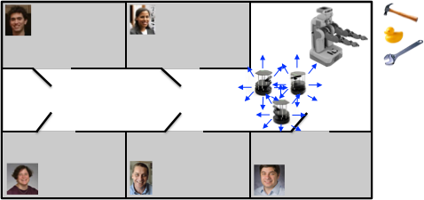
Scaling up: macro-actions Amato, Konidaris and Kaelbling - AAMAS 14
Dec-POMDP methods model and solve at a low level (actions as control inputs)

Slide 12
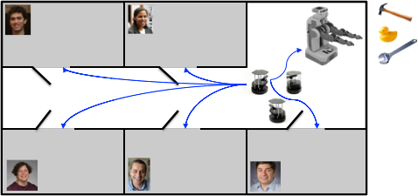
Scaling up: macro-actions Amato, Konidaris and Kaelbling - AAMAS 14
Dec-POMDP methods model and solve at a low level (actions as control inputs)
This is intractable (and unnecessary!) for real-world systems
Often easy to plan for subgoals/subtasks
Set initial and terminal conditions (i.e., states)
Have expertly programmed controllers
Allows for asynchronous decision-making
Resulting model: MacDec-POMDP (macro-action Dec-POMDP)

Slide 13
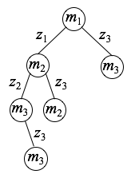
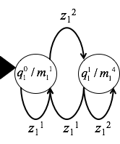
Macro-action solution representations
Can extend policy representations to macro-action case
m = macro-action
z = high-level observation
Finite-state controllers 𝜇 for each agent i defined with node set Qi:
Action selection, λ: Qi → Mi
Node transitions, 𝛿: Qi × Zi → Qi
An initial node: qi⁰ ∈ Qi
But macro-actions finish at different times!
Developed semi-Markov model, decentralized partially observable semi-Markov decision process (Dec-POSMDP)
Omidshafiei, Agha-mohammadi, Amato, Liu and How - IJRR 17

Slide 14
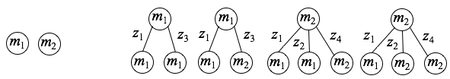
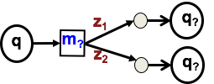

Generating solutions
Extended dynamic programming methods from Dec-POMDPs to build up trees Amato, Konidaris and Kaelbling - AAMAS 14
Developed heuristic-based policy search methods to optimize controller parameters Amato, Konidaris, Anders, Cruz, How and Kaelbling - RSS 15
Perform evaluation using samples from simulator rather than have full model
Orders of magnitude faster and can solve problems that are orders of magnitude larger than previous Dec-POMDP methods (including robotics problems)
Step 1
Step 2

Slide 15
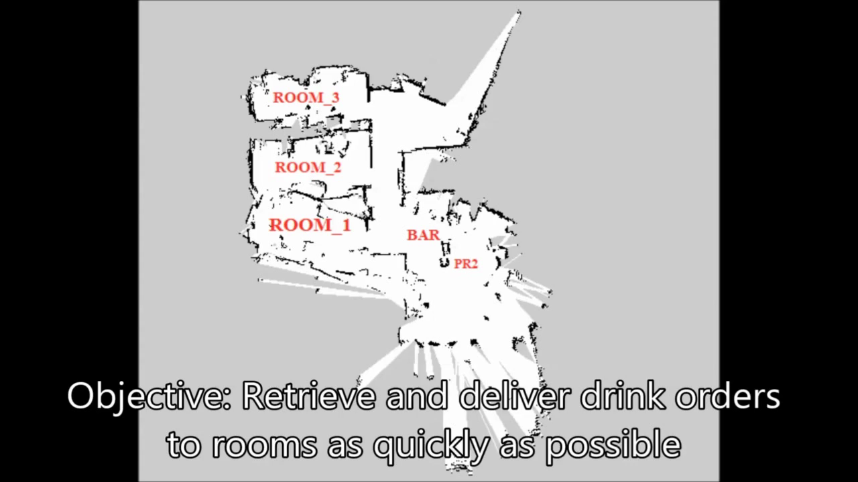
Cooperative beer delivery

Slide 16
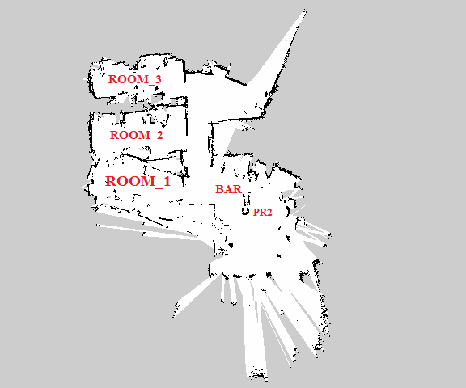
Cooperative beer delivery
Controller values
1-node controllers: 1231 (~13.98 drinks delivered)
5-node controllers: 1296 (~14.56 drinks delivered)
Hand-coded solution: 917 (~11.13 drinks delivered)

Slide 17

Generating the ‘macro’-observations
Omidshafiei, Liu, Everett, Lopez, Amato, Liu, How, Vian - ICRA 17

Slide 18
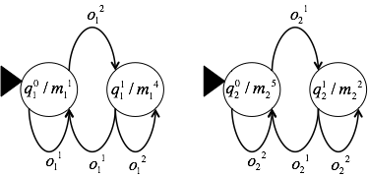
Learning the solutions
We may not have a model of the problem
Want to learn solutions directly from data
E.g., Learning a set of controllers from limited demonstrations Liu, Amato, Anesta, Griffith and How, AAAI 16
Scalable to large state, macro-action and observation sets
R

Slide 19
Why can’t we just use deep RL?
Using deep RL for Dec-POMDPs has become a hot topic (e.g., Omidshafiei, Pazis, Amato, How and Vian, ICML 17, Foerster, Assael, de Freitas, and Whiteson, NIPS 16, Gupta, Egorov, Kochenderfer ICML 17)
Some good results, but many open questions
Centralized vs. decentralized learning
Sample efficiency/online learning
Dealing with nonstationarity
Dealing with partial observability

Slide 20
Conclusions
Dec-POMDPs represent a powerful probabilistic multi-agent framework
Considers outcome, sensor and communication uncertainty in a single framework
Can model any multi-agent coordination problem
Need to think about how to solve them
Macro-actions provide an abstraction to improve scalability
Learning methods can remove the need to generate a detailed multi-agent model
Begun demonstrating scalability and quality in a number of domains, but a lot of great open questions to solve!
A lot of great work by us and others as well (go see Frans Oliehoek!)
Notes:
can use solutions for subproblems (e.g., grasping an object, navigation in a formation) as macro-actions

Slide 21
Postdoc(s) wanted!
Come postdoc with me (or others) at Northeastern
Multi-agent RL
Deep RL
RL for robotic manipulation
Come talk to or email me

